Slide 1
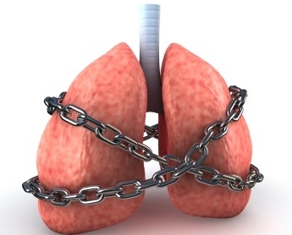

Asthma

Slide 2
What is Asthma?
Asthma is a disease affecting the airways that carry air to and from your lungs.
People who suffer from this chronic condition (long-lasting or recurrent) are said to be asthmatic.

Slide 3
History of Asthma
Asthma was first recognized in ancient Egypt.
In 1873, the first paper was published in explaining this disease.
Pilocarpin was used on 1880 as a medical treatment for asthma.
In 1905, Epinephrine was the first treatment used to control asthma.

Slide 4
What Cause Asthma?
Tobacco Smoke
Air polluted Atmosphere
Allergy
Stress
Obesity
Genes
Atopy
Airway Hyperactivity

Slide 5
Asthma Symptoms
The most common symptom is wheezing. It makes whistling sound while breathing.
Shortness of breath
Chest tightness or pain
Chronic coughing
Trouble sleeping due to coughing or wheezing

Slide 6
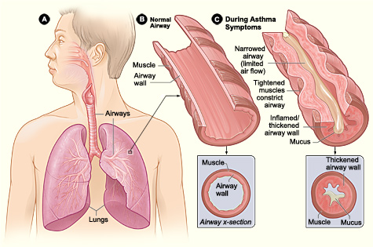
Asthma Symptoms

Slide 7
When Asthma Symptoms Occur?
At night or early morning
During or after exercise
During certain seasons
After laughing or crying
When exposed to common asthma triggers

Slide 8
Types of Asthma
Child-onset Asthma
Adult-onset Asthma
Exercise-induced Asthma
Cough-induced Asthma
Occupational Asthma
Nocturnal Asthma
Steroid Resistant Asthma

Slide 9
Treatment
There is no cure for asthma, but it can be controlled with good treatment.
Some treatment which controls asthma are:
  Continuous Checkup
  Daily medications
  Quick relief medicines
  Inhaler
  Vitamin D

Slide 10
Thank You!!!
www.playppt.com

