Slide 1
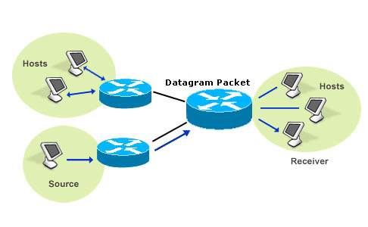
Datagram

Slide 2
Definition
A datagram is an independent, self-contained message sent over the network whose arrival, arrival time, and content are not guaranteed.

Slide 3
Example
OSI LAYER | DATAGRAM RUNNING
Layer 4 | Data segment
Layer 3 | Data packet
Layer 2 | Frames (IEEE 802.3) Frames (IEEE 802.11) Cell ATM
Layer 1 | Chip (CDMA)

Slide 4
Guaranteed:
Clients and servers that communicate via a perfect channel have a dedicated point-to-point channel between themselves.
To communicate, they must first establish the connection, transmit the data, and then close down the connection.
All data sent over the channel is received in the same order that it was sent.
This is guaranteed by the channel.

Slide 5
Not Guaranteed:
Applications that communicate via datagrams send and receive completely independent packets of information.
These clients and servers do not have and do not need a dedicated point-to-point channel.
The delivery of datagrams to their destinations is not guaranteed. Nor is the order of their arrival.

Slide 6
Components
Each datagram has two components,
a header and
a data payload

Slide 7
Header
The header contains all the information sufficient for routing from the originating equipment to the destination without relying on prior exchanges between the equipment and the network.
Headers may include source and destination addresses as well as a type field.

Slide 8
Data Payload
The payload is the data to be transported.
This process of nesting data payloads in a tagged header is called encapsulation.

Slide 9
Internet Protocol:
The Internet Protocol defines standards for several types of datagrams.
The term datagram is often considered synonymous to packet but there are some nuances.
The term datagram is generally reserved for packets of an unreliable service that does not notify the user if delivery fails, while the term packet applies to any message formatted as a packet.

Slide 10
Example: Internet Protocol
For example, Internet Protocol (IP) provides an unreliable service and UDPover IP is also unreliable.
That is why IP and UDP packets are generally called datagrams.

Slide 11
Thank You!!!
www.playppt.com

