Slide 1
EPICYCLIC BEVEL GEAR TRAIN

Slide 2
Introduction
The bevel gears are used to make a more compact epicyclic system and they permit a very high speed reduction with few gears.
The useful application of the epicyclic gear train with bevel gears is found in Humpage’s speed reduction gear and differential gear of an automobile.

Slide 3
Humpage’s Speed Reduction Gear
The Humpage’s speed reduction gear was originally designed as a substitute for back gearing of a lathe, but its use is now considerably extended to all kinds of workshop machines and also in electrical machinery.

Slide 4
Working
In Humpage’s speed reduction gear, the driving shaft x and driving shaft y are co-axial.
The driving shaft carries a bevel gear A and driven shaft carries a bevel gear E.
The bevel gear B meshes with gear A and a fixed gear C.
The gear E meshes with gear D which is compound with gear B.

Slide 5
Working – Contd.
This compound gear B-D is mounted on the arm or spindle F which is rigidly connected with a hollow sleeve G.
The sleeve revolves freely loose on the axes of the driving and driven shafts.

Slide 6
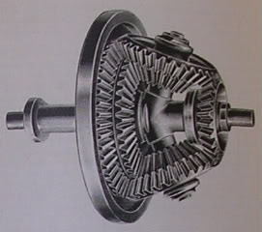
Humpage Gear

Slide 7
Differential Gear of an Automobile
The differential gear used in the rear drive of an automobile can be functioned as:
To transmit motion from the engine shaft to the rear driving wheels, and
To rotate the rear wheels at different speeds while the automobile is taking a turn.

Slide 8
Working
As long as the automobile is running on a straight path, the rear wheels are driven directly by the engine and speed of both the wheels is same.
But when the automobile is taking a turn, the outer wheel will run faster than the inner wheel because at that time the outer rear wheel has to cover more distance than the inner rear wheel.
This is achieved by epicyclic gear train with bevel gears.

Slide 9
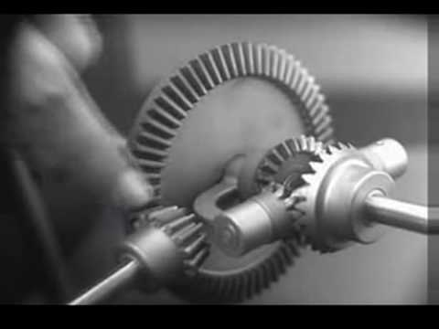
Differential Gear

Slide 10
THANK YOU!!!
www.playppt.com

