Slide 2
Synopsis
Nanomachines
Nanoparticles
Nanoelectronics
Nanobiometrics
Nanomanipulator
Nanorobots
Nanoelasticity
Carbon Nanotubes

Slide 3
Introduction
Nanotechnology is defined as fabrication of devices with atomic or molecular scale precision.
Devices with minimum feature sizes less than 100 nanometers (nm) are considered to be products of nanotechnology.
A nanometer is one billionth of a meter (10-9 m) and is the unit of length that is generally most appropriate for describing the size of single molecules.
The origin of the term ‘Nano’ comes from the Greek work for dwarf but in scientific jargon, Nano means 10^-9. So a nanometer is 10^-9.
Technology means the building of useful things from scientific principles.
Thus nanotechnology means building useful things at the 10^-9 level.

Slide 4
Nano Machines
A nanomachine, also called a nanite, is a mechanical or electromechanical device whose dimensions are measured in nanometers (millionths of a millimeter, or units of 10 -9 meter).
The first useful applications of nanomachines will likely be in medical technology, where they could be used to identify pathogens and toxins from samples of body fluid.
Another potential application is the detection of toxic chemicals, and the measurement of their concentrations, in their environment.
Nanomachines could be programmed to replicate themselves, or to work synergistically to build larger machines or to construct nanochips.
Specialized nanomachines called nanorobots might be designed not only to diagnose, but to treat, disease conditions, perhaps by seeking out invading bacteria and viruses and destroying them.

Slide 5
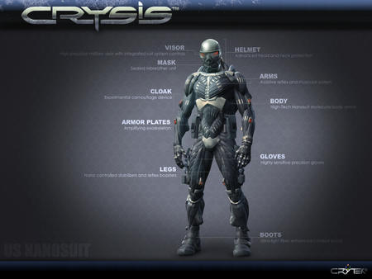
Nano Machines

Slide 6
Nano Particles
Nanoparticles, such as buckyballs, are ultra small particles whose unusual properties sparked substantial interest for their potential use in commercial and industrial products.
Their properties also led to concern about their potential hazard to the environment and how they should therefore be regulated.
Joseph Hughes of the Georgia Institute of Technology and co-workers reported, however, that buckyballs form into clumps called nano-C60 upon contact with water and that nano-C60 is readily soluble.
The researchers also found that even at low concentrations the nanoparticles inhibited the growth of soil bacteria, which potentially would have a negative environmental effect.
Hughes suggested that the antibacterial property of nano-C60 might be harnessed for beneficial uses.

Slide 7
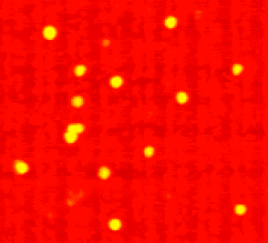
Nano Particles – Gold

Slide 8
Nano Electronics
Nanoelectronics follow the birth of electronics, the invention of the transistor, integrated circuits, optical, electron beam, atomic lithography, molecular beam epitaxy and molecular (including DNA) electronics.
It teaches us how a quantum computer works and how it differs from a conventional computer.
The aim of Nanoelectronics is to process, transmit and store information by taking advantage of properties of matter that are distinctly different from macroscopic properties.
It can group these concepts into three main categories:
1. Molecular electronics
Electronic effects (e.g. electrical conductance of C60)
Synthesis (DNA computing as a buzz word)
2. Quantum Electronics, Spintronics (e.g. quantum dots, magnetic effects)
3. Quantum computing

Slide 9
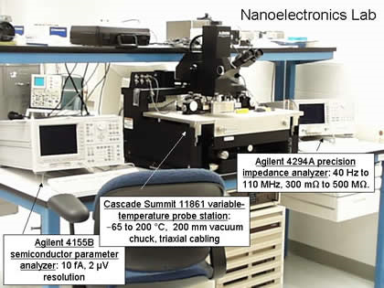
Nano Electronics Lab

Slide 10
Nano Biometrics
Nanobiometrics deals with biology.
It makes us to discuss biological computing which uses a prottwin based 3d optical memory based on bacteriohodoprin.
Biological material such as DNA can be used as sensors and for making nanohinges, nanovires and nanoglue.
Lipids, one of the most versatile building blocks in biology, are used to form three dimensional structures and as a matrix to place other active nanomachines.
This is a rule of thumb for solubility like dissolves like generally the total length of the lipid molecules in 2-4 mm. from these molecules we can build supramolecular.
Structures that are hundreds of nanometers to hundreds of microns in size.

Slide 11
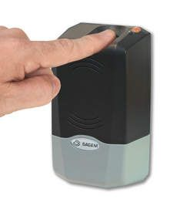
Nano Biometrics

Slide 12
Nano Manipulator
The scanning tunneling electron microscope has a computer-controlled probe that skates across the surface, and the mechanical deflections are transferred to electrical energy like a vinyl record needle.
The probe can also be programmed to push against the surface like a finger.
When pushing, the charge separating the flexing tip and its fixed mount creates an electrical current that is proportional to the pressure exerted on the tip.
By transmitting this current to the proper computer interface a human can actually do the touching.
This instrument is called a nanomanipulator.

Slide 13
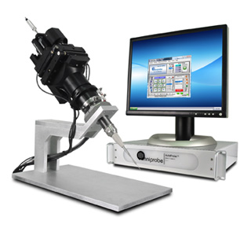
Nano Manipulator

Slide 14
Nano Robots
Nanorobotics is the technology of creating machines or robots at or close to the microscopic scale of a nanometer (10−9 meters). More specifically, nanorobotics refers to the still largely hypothetical nanotechnology engineering discipline of designing and building nanorobots, devices ranging in size from 0.1-10 micrometers and constructed of nanoscale or molecular components.
As no artificial non-biological nanorobots have yet been created, they remain a hypothetical concept. The names nanobots, nanoids, nanites or nanomites have also been used to describe these hypothetical devices.
An example is a sensor having a switch approximately 1.5 nanometers across, capable of counting specific molecules in a chemical sample.
The applications are they are used in medical technology, detection of toxic chemicals, and measurement of their concentrations, in the environment.

Slide 15
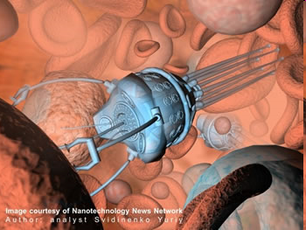
Robots - How Small Can They Go

Slide 16
Nano Elasticity
It concerns the unique elastic and mechanical properties of nanosize objects.
They have not been studied in great detail because it is technically very challenging to do so-how do you indent, squeeze or pull a nanoparticle or a nanotube?
Techniques using atomic force probes and special sample arrangements are emerging, but computer simulation is still being relied on heavily to provide answer.
Graphite is very brittle, yet nanotubes look like being quite resilient after being distorted.

Slide 17
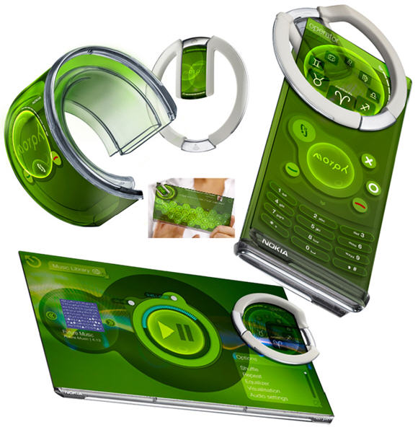
Nano Elasticity

Slide 18
Carbon Nanotubes
Individual carbon nanotubes may be metallic or semi conducting, depending on the helical orientation of the rows of hexagonal rings in the walls of the tubes.
Nanotubes may also be used as highly resilient probe tips for scanning tunneling microscopes and atomic force microscopes.
Carbon nanotubes exhibit faster phonon transport than diamond, which was previously recognized as the best thermal conductor, and the electric current-carrying capacity of nanotubes is approximately four orders of magnitude higher than that of copper.
Nanotubes can be “decapped” by oxidation and the resulting opened tubes filled with metals, such as lead, or even with buckyballs.
Microscopic metal particles that would otherwise be rapidly oxidized may be stabilized in air by encapsulation in nanotube skins.
An example of nanoscale devices already at work are the carbon nanotubes, discovered by Sumio Iijima in Japan in 1991, in use in jumbotron lamps installed in many sports stadiums

Slide 19
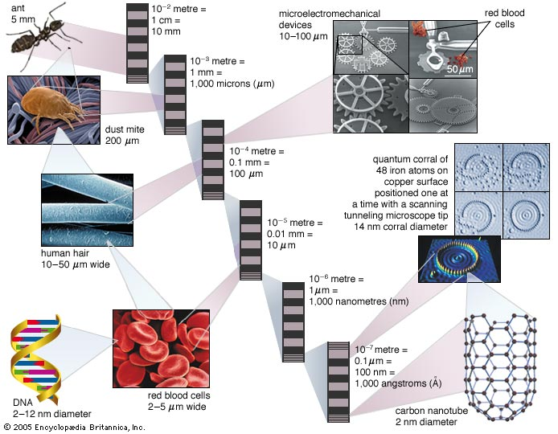
Carbon Nanotubes

Slide 20
Applications
Foresight has identified six Foresight Nanotechnology Challenges in which current and near-term nanotechnology is providing hope for solving critical challenges facing humanity.
Providing Renewable Clean Energy
Supplying Clean Water Globally
Improving Health and Longevity
Healing and Preserving the Environment
Maximizing Productivity of Agriculture
Making Information Technology Available To All
Enabling Space Development

Slide 21
Conclusion
Nanotechnology is predicted to be developed by 2020 but much depends on our commitment to its research.
Nanotechnology offers the ability to build large numbers of products that are incredibly powerful by today's standards.
The range of possible nanotechnology-built products is almost infinite.
Even if allowable products were restricted to a small subset of possible designs, it would still allow an explosion of creativity and functionality.
Hence we the common people should be well known about Nano Technology and make use of its outcome, and let us develop a new era on Nano Technology.

Slide 22
THANK YOU!!!
www.playppt.com

