Slide 1
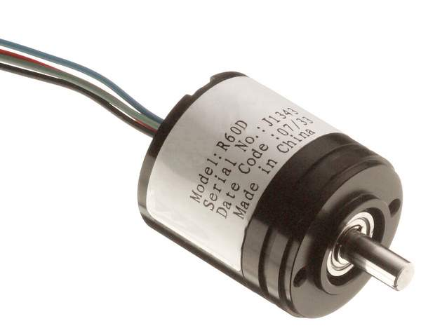
Position / Speed Sensors

Slide 2
Introduction
Position/speed sensors provide information to the ECM about the position of a component, the speed of a component, and the change in speed of a component. The following sensors provide this data:
• Camshaft Position Sensor (also called G sensor).
• Crankshaft Position Sensor (also called NE sensor).
• Vehicle Speed Sensor.
The Camshaft Position Sensor, Crankshaft Position Sensor, and one type of vehicle speed sensor are of the pick-up coil type sensor.
This type of sensor consists of a permanent magnet, yoke, and coil. This sensor is mounted close to a toothed gear. As each tooth moves by the sensor, an AC voltage pulse is induced in the coil. Each tooth produces a pulse. As the gear rotates faster there more pulses are produced. The ECM determines the speed the component is revolving based on the number of pulses. The number of pulses in one second is the signal frequency.

Slide 3
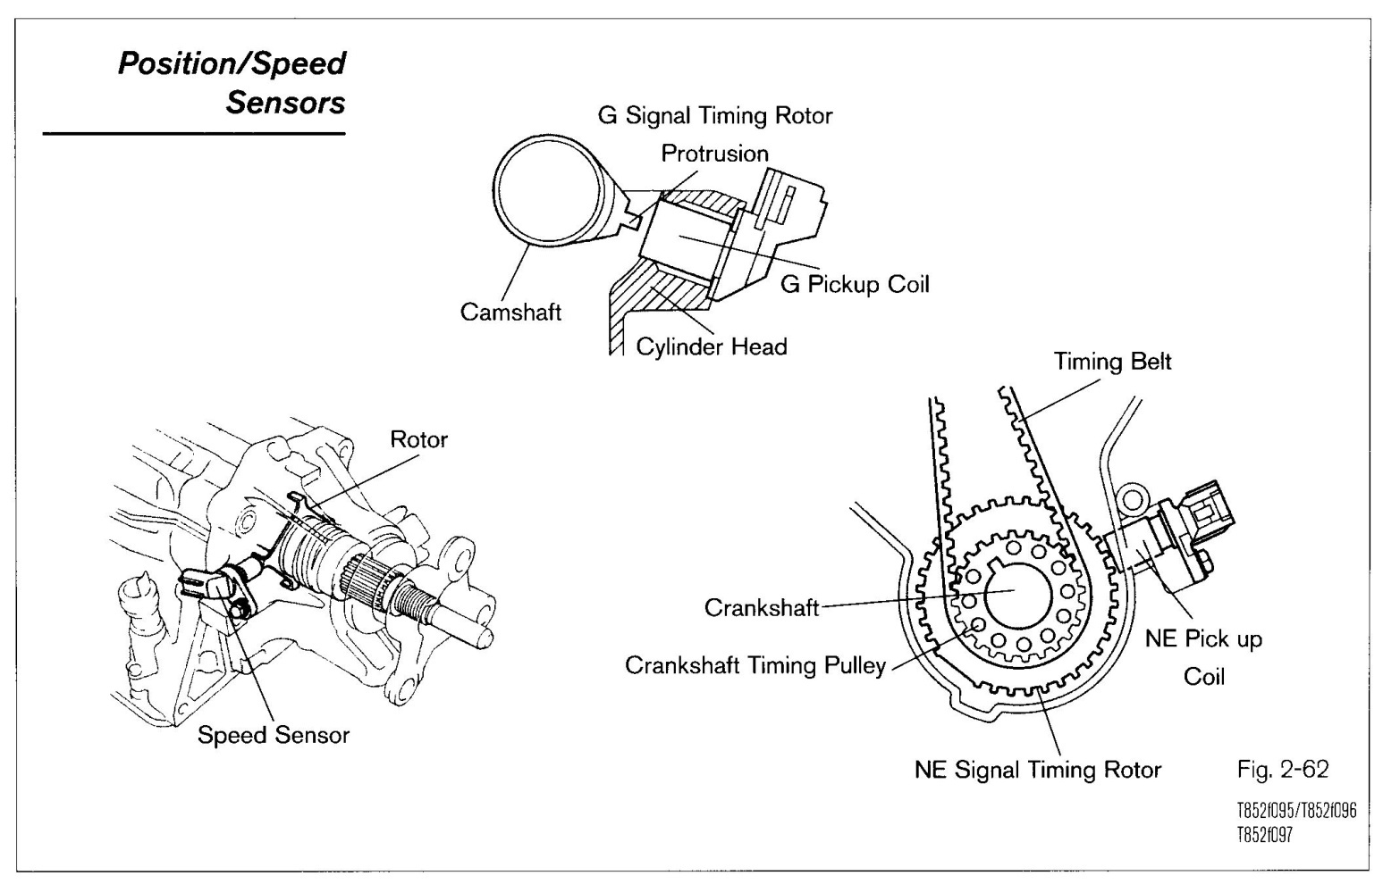
Position / Speed Sensor

Slide 4
Variable Reluctance Sensor
The distance between the rotor and pickup coil is critical. The further apart they are, the weaker the signal.
Not all rotors use teeth. Sometimes the rotor is notched, which will produce the same effect.
These sensors generate AC voltage, and do not need an external power supply. Another characteristic is that they have two wires to carry the AC voltage.
The wires are twisted and shielded to prevent electrical interference from disrupting the signal.
The EWD will indicate if the wires are shielded.
By knowing the position of the camshaft, the ECM can determine when cylinder No. I is on the compression stroke.
This sensor is located near one of the camshafts. With variable timing V-type engines, there is one sensor for each cylinder bank. On distributor ignition systems, it is often called the G sensor and is located in the distributor.
An AC signal is generated that is directly proportional to camshaft speed. That is, as the camshaft revolves faster the frequency increases.

Slide 5
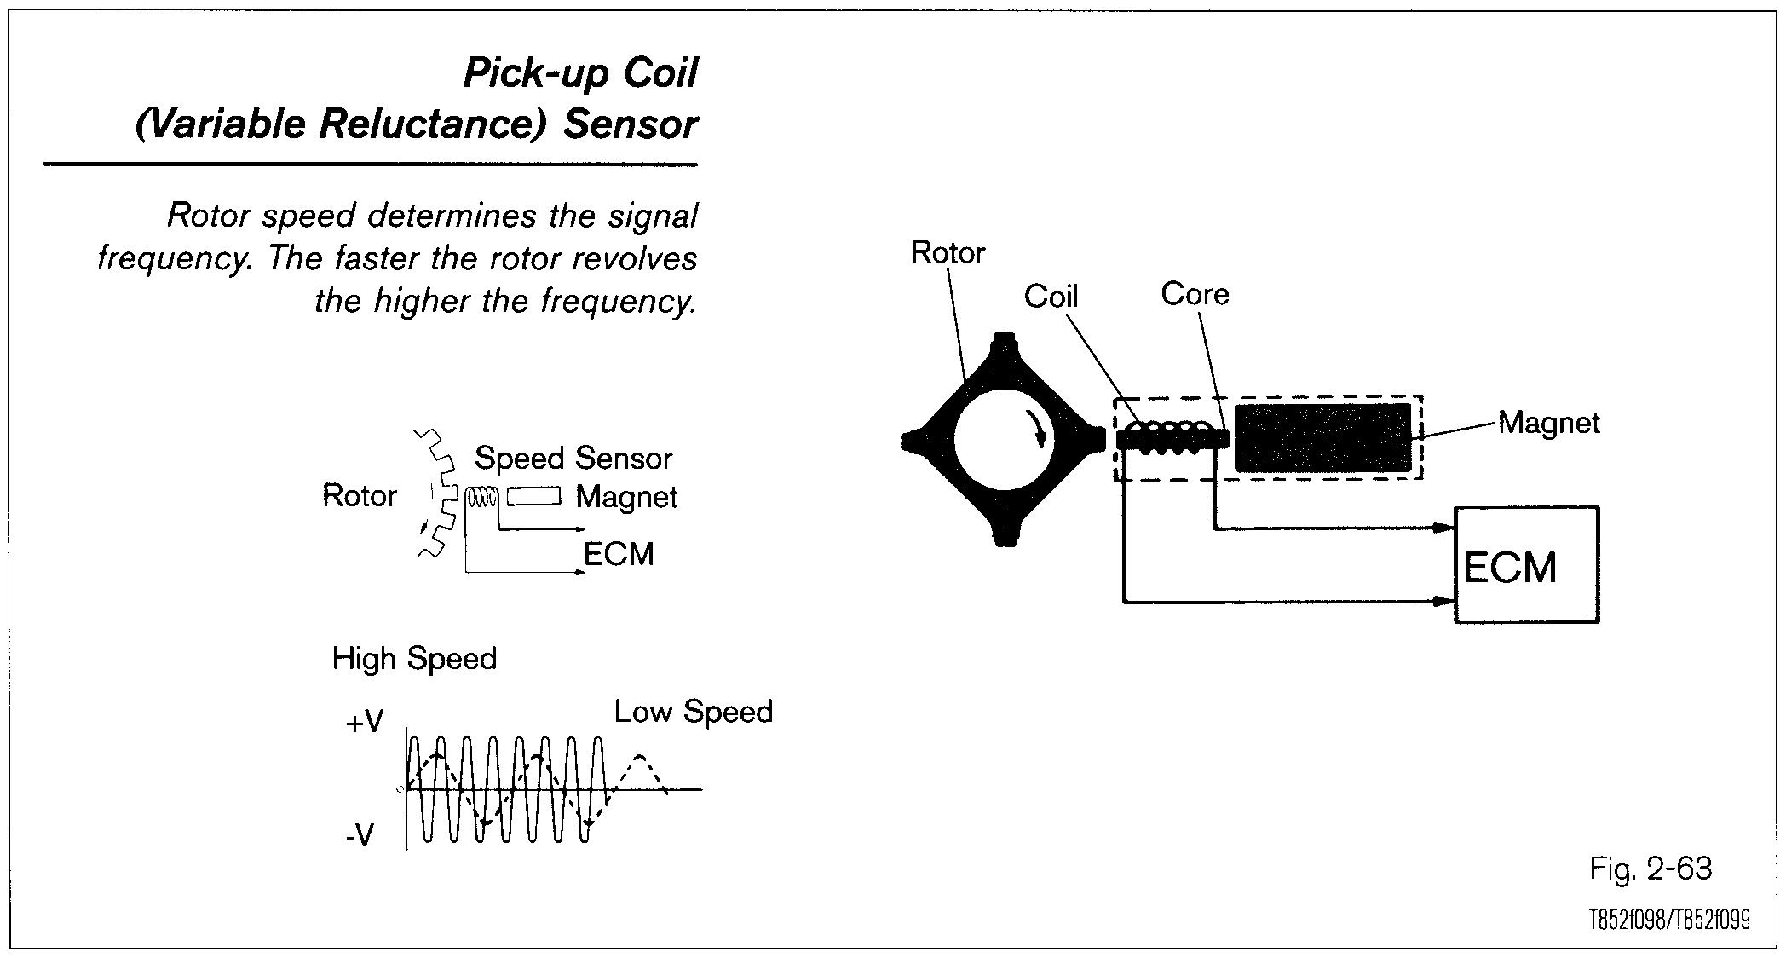
Variable Reluctance Sensor

Slide 6
Camshaft Position Sensor
Camshaft Position Sensor (G Sensor)
The terminal on the ECM is designated with a letter G, and on some models a G and a number,
such as G22 is used.
Variable Valve Position Sensor
Some variable valve timing systems call the Camshaft Position Sensor the Variable Valve
Position Sensor. See section on variable valve timing systems for more information.

Slide 7
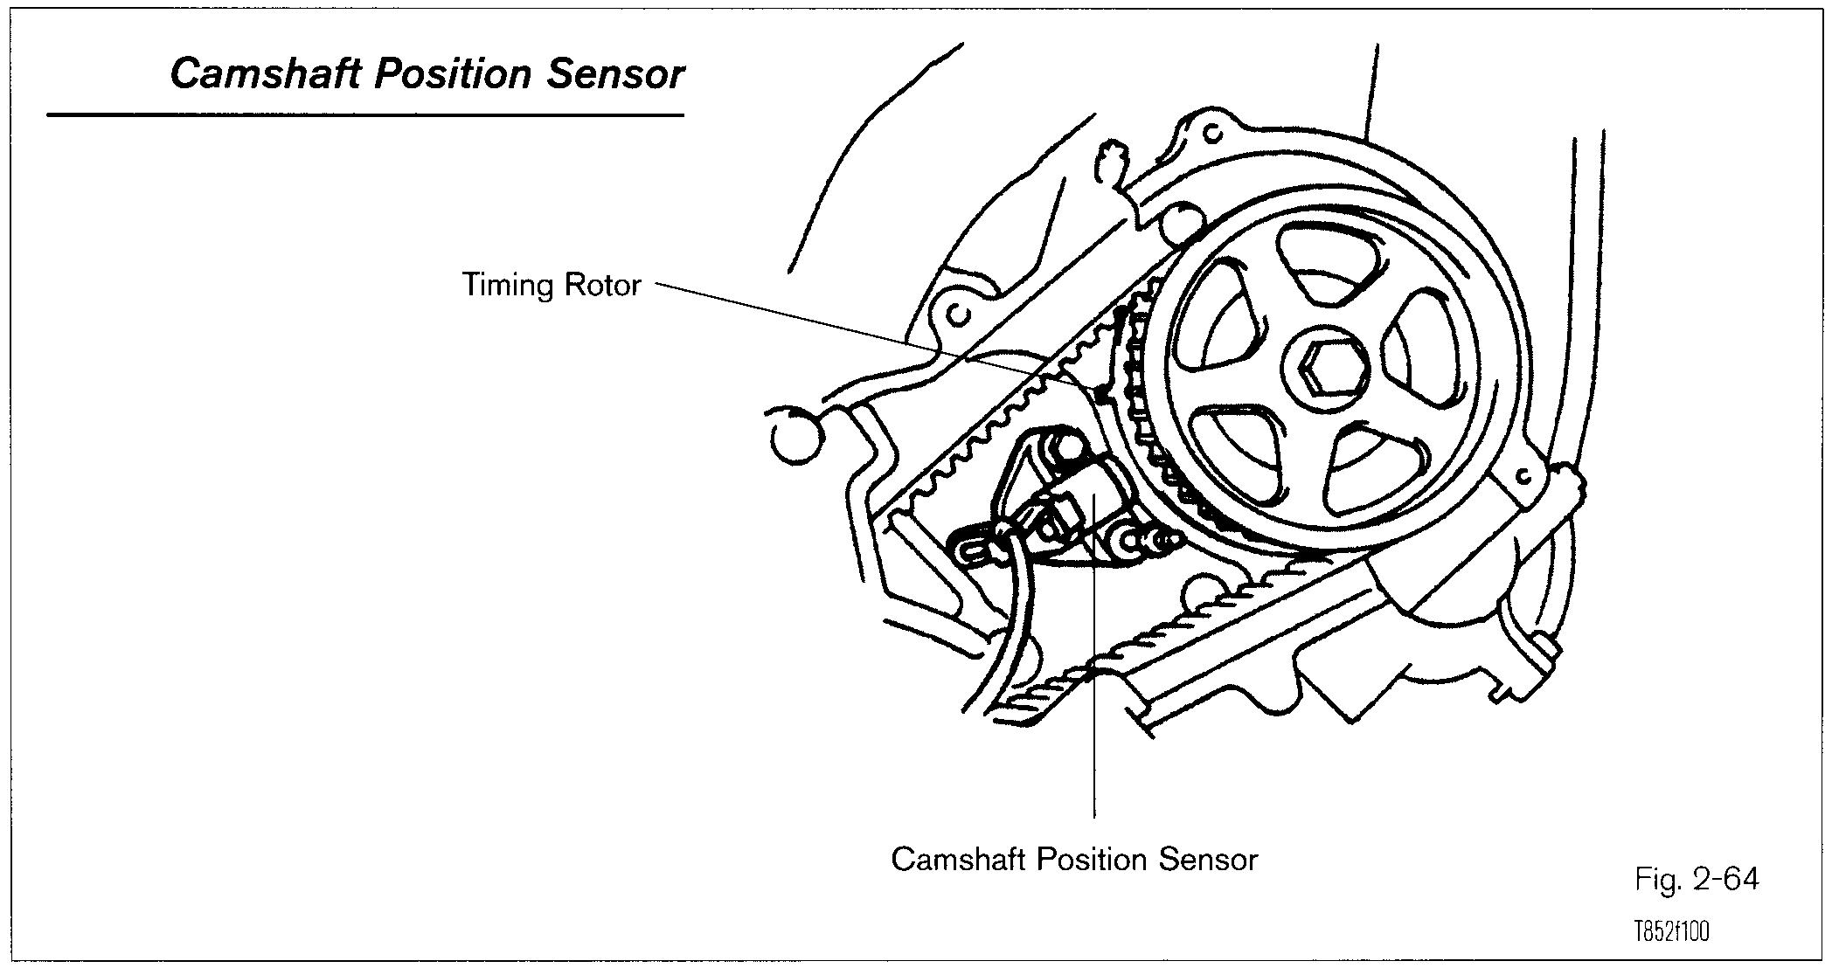
Camshaft Position Sensor

Slide 8
Crankshaft Position Sensor
Crankshaft Position Sensor (NE Sensor)
The ECM uses crankshaft position signal to determine engine RPM, crankshaft position, and engine misfire. This signal is referred to as the NE signal. The NE signal combined with the G signal indicates the cylinder that is on compression and the ECM can determine from its programming the engine firing order. See Section 3 on ignition systems for more information

Slide 9
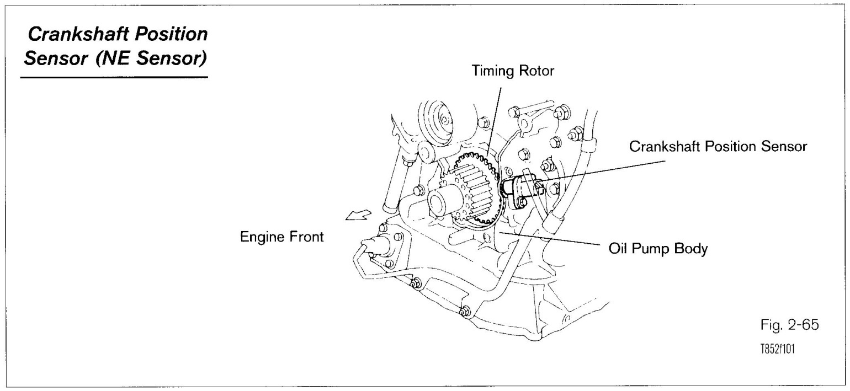
Crankshaft Position Sensor

Slide 10
Vehicle Speed Sensor
Vehicle Speed Sensor (VSS)
The ECM uses the Vehicle Speed Sensor (VSS) signal to modify engine functions and initiate diagnostic routines. The VSS signal originates from a sensor measuring transmission/ transaxle output speed or wheel speed. Different types of sensors have been used depending on models and applications. On some vehicles, the vehicle speed sensor signal is processed in the combination meter and then sent to the ECM. On some anti-lock brake system (ABS) equipped vehicles, the ABS computer processes the wheel speed sensor signals and sends a speed sensor signal to the combination meter and then to the ECM. You will need to consult the EWD to confirm the type of system you are working on.

Slide 11
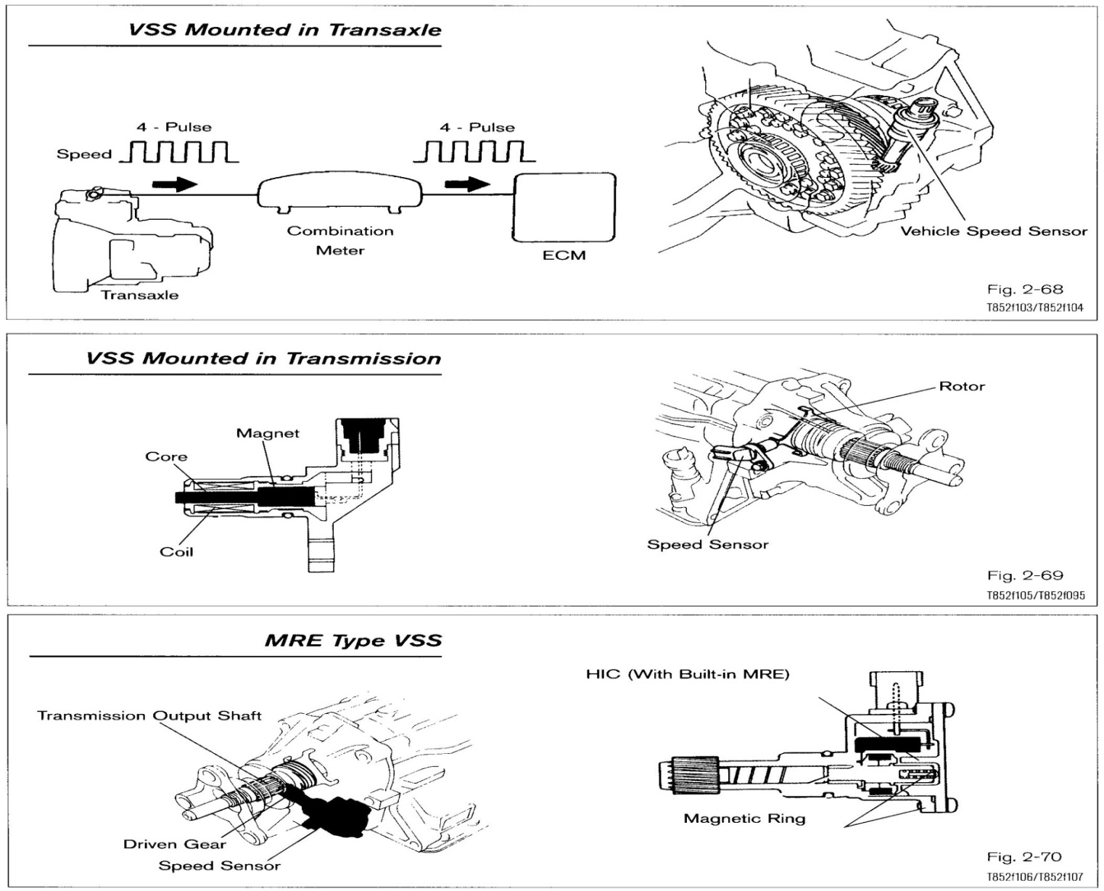
VSS mounted in Transaxle and Transmission

Slide 12
Reed Switch Type
The reed switch type is driven by the speedometer cable. The main components are a magnet, reed switch, and the speedometer cable. As the magnet revolves the reed switch contacts open and close four times per revolution. This action produces 4 pulses per revolution. From the
number of pulses put out by the VSS, the combination meter/ECM is able to determine vehicle
speed.

Slide 13
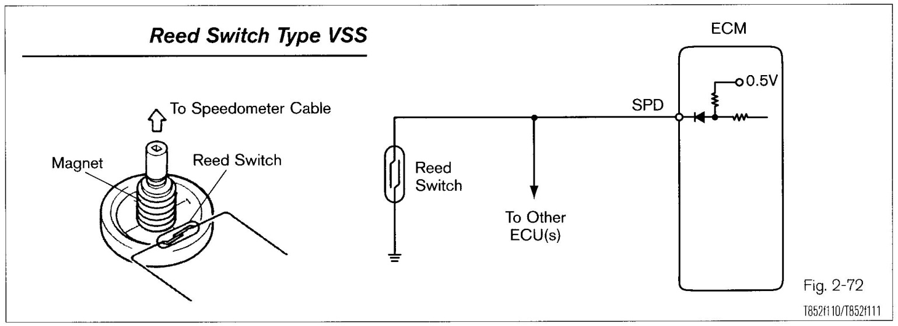
Reed Switch Type

Slide 14
Conclusion
By using the circuit designs described in this presentation to condition non-TTL/CMOS speed sensor signals so that a counter can measure them, your application software can accurately determine frequency and phase-related data of a rotating system. These circuits are extremely flexible, allowing a variety of signals to be converted to TTL/CMOS-compatible levels.
Using this approach, off-the-shelf instruments such as NI 660x, E Series, and S Series devices and Field Point and Compact Field Point modules can extract accurate frequency and phase information from high-speed sensor signals.
Counters can be combined with other data acquisition devices, such as National Instruments dynamic signal acquisition (DSA) products, to build a flexible system solution for monitoring or characterizing rotating systems used in automotive, aerospace and machine-monitoring applications.

Slide 15
Thank You!!!
www.playppt.com

