Slide 1
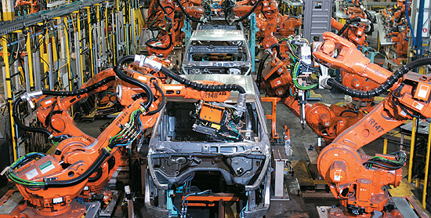
WELDING ROBOTS

Slide 2
INTRODUCTION
Robot Welding is a process of joining different materials.
The large bulk of materials that are welded are metals and their alloys although welding is also applied to the joining of other materials such as thermoplastics.
Welding joins different metals or alloys with help of a number of processes in which heat is supplied either electrically or by means of a gas torch.

Slide 3
WHY ROBOT ARC WELDING?
Arc welding is performed by skilled workers who are assisted by a person called fitter.
The purpose of the fitter is to organize the work and fixture the parts of the welder.
The working condition of the welder is typically unpleasant and hazardous.
The arc from the welding process emits ultra-violet radiations which is injurious to human vision.
As a result welders are required to wear eye protection in the form of a welding helmet with a dark window.
Sparks and smoke are generated during the process are a potential threat to operators.
Because of the hazards for human workers in continuous arc welding, it is logical to consider industrial robots for the purpose.

Slide 4
BENEFITS OF ROBOT ARC WELDING
GREATER QUALITY OF PRODUCT
IMPROVED SAFTEY AND QUALITY-OF-WORK LIFE
HIGHER PRODUCTIVITY

Slide 5
FEATURES OF ARC WELDING ROBOTS
WORK VOLUME AND DEGREES OF FREEDOM
MOTION CONTROL SYSTEM
PRECISION OF MOTION
PROGRAMMING
INTERFACE WITH OTHER SYSTEM

Slide 6
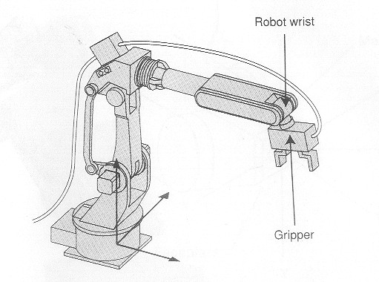
ARC WELDING ROBOT

Slide 7
PROBLEMS FOR ROBOTS IN ARC WELDING
A related problem is that arc welding is often performed in confined areas that are difficult to access, such as insides of tanks, pressure vessels, and ship hulls. Humans can position in to these areas more readily than robots.
One of the most difficult technical problems is the variation in the dimensions of the parts in a batch production job. This type of dimensional variations means that the arc-welding path to be followed will change slightly from part to part.
Another technical difficulty is the variations in the edges and surfaces to be welded together. Instead of being straight and regular, the edges are typically irregular. This causes variations in the gap between the parts and other problems in the way the pieces mate together prior to the welding process.

Slide 8
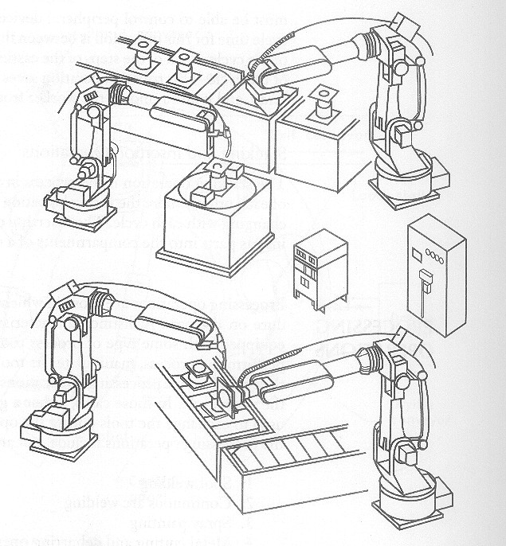
Arc welding robots performing in a workshop

Slide 9
WHY ROBOT SPOT WELDING?
For larger works on spot welding the welding guns with cables attached is quite heavy and can easily exceed 100lb in weight.
To assist the operator in manipulating the gun, the apparatus is suspended from an overhead hoist system.
Even with this assistance, the spot-welding gun represents a heavy mass and is difficult to manipulate by a human worker at high rates of production desired on a car body assembly line.
There are often problems with the consistency of the welded products made on such a manual line as a consequence of this difficulty.
As a result of these difficulties robots have been employed with great success on this type of production line to perform some or all of the welding operations.

Slide 10
BENEFITS OF ROBOT SPOT WELDING
IMPROVED PRODUCT QUALITY
OPERATOR SAFETY
BETTER CONTROL OVER PRODUCTION OPERATION

Slide 11
FEATURES OF SPOT-WELDING ROBOTS
Robots must be relatively large. It must have sufficient payload capacity to readily manipulate the welding gun for the application.
The work volume must be adequate for the size of the product.
The robot must be able to position and orient the welding gun in places on the product that might be difficult to access. This might result in need for an increased number of freedoms.
The controller memory must have enough capacity to accomplish the many positioning steps required for the spot-welding cycle.

Slide 12
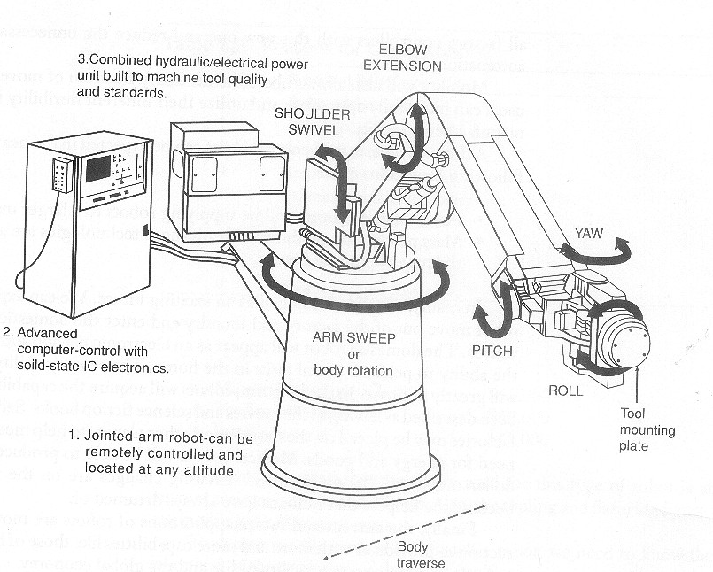
A typical spot welding robot

Slide 13
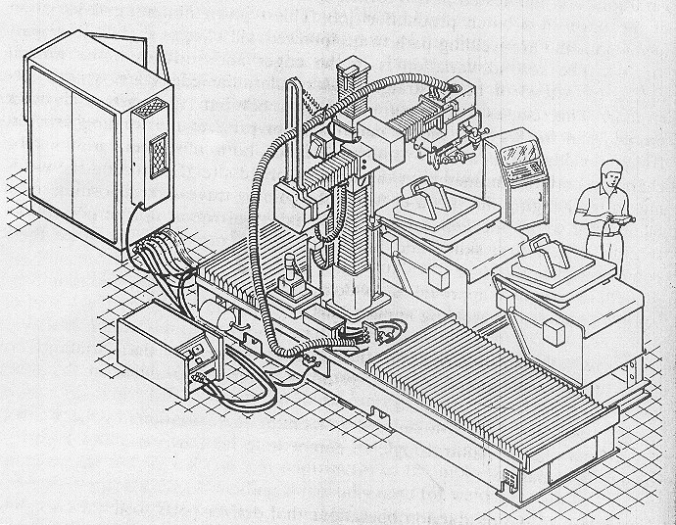
Spot welding robot performing in a welding cell

Slide 14
MANIPULATOR
The robot consists of a manipulator which is a series of mechanical linkages and joints capable of producing all sorts of designed movements.
The body, arm and wrist assembly of a robot is sometimes called as a manipulator.
Each link of a manipulator is driven by activators which may be operated either hydraulic or pneumatic power cylinder or electrical motors.
The forearm of a robot can move in a nearly spherical way, thus covering a large work volume and providing greater application flexibility.
It is easily possible to reach down into or onto objects placed over the conveyor.

Slide 15
SENSORS
The robotic arc welding sensor system considered here are all designed to track the welding seam and provide the information to the robot controller to help guide the welding path.
The approaches used for this purposes divide into two basic categories:
1. Contact sensors.
2. Non-Contact sensors
Contact arc welding sensors make use of a mechanical tactile probe to touch the sides of the groove ahead of the welding torch and to feed back position data so that course corrections can be made by the robot controller.
Some systems use a separate control unit design to interpret the probe sensor measurements and transmit the data to the robot controller.
The sensors used in robotics include the following general categories.
1.Tactile sensors
2.Proximity and range sensors
3.Miscellaneous types
4.Machine vision

Slide 16
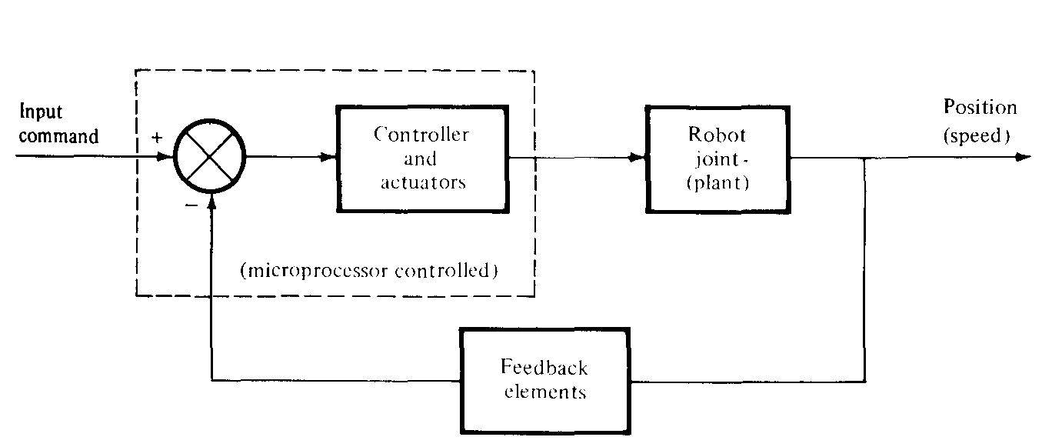
CONTROL SYSTEM
Typical block diagram configuration of a control system for a robot joint.

Slide 17
CONCLUSION
A substantial opportunity exists in the technology of robotics to relieve people from boring, repetitive, hazardous and unpleasant work in all forms of a human labor.
There is a social value as well as a commercial value in pursuing this opportunity. The commercial value of robotics is obvious.
Properly applied, robots can accomplish routine, undesirable work better than humans at a lower cost.
As the technology advances, and more people learn how to use robots, the robotics market will grow at a rate that will approach the growth of the computer market over the past thirty years.
There is every reason to believe that the automation of work through robotics will lead to substantial increases in productivity, and that these productivity increases year by year will permit humans to engage in activities that are cultural and recreational.
Not only will robotics improve our standard of living, it will also improve our standard of life.

Slide 18
THANK YOU!!!
www.playppt.com

