Slide 1
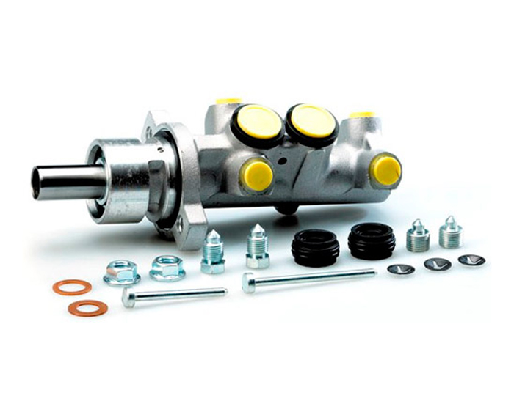

Hydraulics

Slide 2
Introduction
Hydraulic machinery is machines and tools which use fluid power to do work. Heavy equipment is a common example.
In this type of machine, high-pressure liquid — called hydraulic fluid — is transmitted throughout the machine to various hydraulic motors and hydraulic cylinders.
The fluid is controlled directly or automatically by control valves and distributed through hoses and tubes.

Slide 3
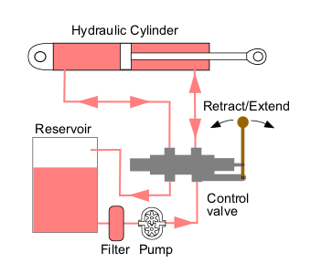
Hydraulic circuits
A simple open center hydraulic circuit.

Slide 4
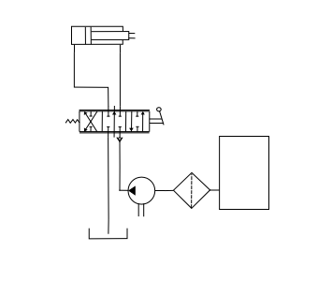
Hydraulic circuits
The equivalent circuit schematic.

Slide 5
Hydraulic circuits
Open center circuits use pumps which supply a continuous flow.
The flow is returned to tank through the control valve's open center; that is, when the control valve is centered, it provides an open return path to tank and the fluid is not pumped to a high pressure.
Closed center circuits supply full pressure to the control valves, whether any valves are actuated or not.
The pumps vary their flow rate, pumping very little hydraulic fluid until the operator actuates a valve.
The valve's spool therefore doesn't need an open center return path to tank. Multiple valves can be connected in a parallel arrangement and system pressure is equal for all valves.

Slide 6
Constant pressure and load-sensing systems
Constant pressure systems (CP-system), standard. Pump pressure always equals the pressure setting for the pump regulator.
This setting must cover the maximum required load pressure.
Pump delivers flow according to required sum of flow to the consumers.
The CP-system generates large power losses if the machine works with large variations in load pressure and the average system pressure is much lower than the pressure setting for the pump regulator.
CP is simple in design.
Works like a pneumatic system.
New hydraulic functions can easily be added and the system is quick in response.

Slide 7
Constant pressure and load-sensing systems
Load-sensing systems (LS-system) generates less power losses as the pump can reduce both flow and pressure to match the load requirements, but requires more tuning than the CP-system with respect to system stability.
The LS-system also requires additional logical valves and compensator valves in the directional valves, thus it is technically more complex and more expensive than the CP-system.
The LS-system system generates a constant power loss related to the regulating pressure drop for the pump regulator:
Power loss =

Slide 8
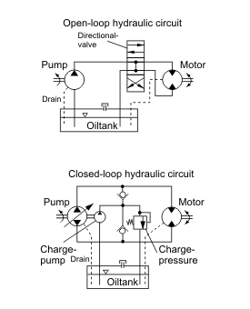
Open and closed circuits

Slide 9
Open and closed circuits
Open-loop: Pump-inlet and motor-return (via the directional valve) are connected to the hydraulic tank. The term loop applies to feedback; the more correct term is open versus closed "circuit".
Closed-loop: Motor-return is connected directly to the pump-inlet. To keep up pressure on the low pressure side, the circuits have a charge pump (a small gear pump) that supplies cooled and filtered oil to the low pressure side. Closed-loop circuits are generally used for hydrostatic transmissions in mobile applications.

Slide 10
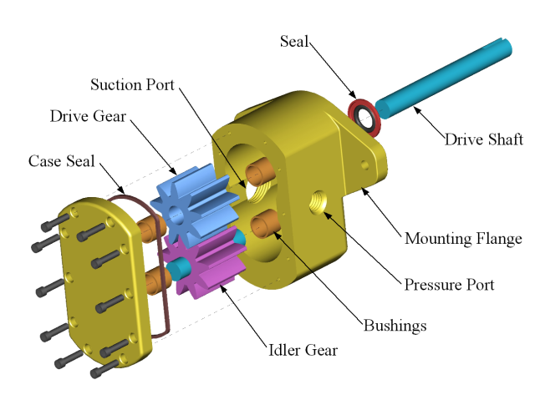
Hydraulic pump

Slide 11
Hydraulic pump
Hydraulic pumps supply fluid to the components in the system. Pressure in the system develops in reaction to the load. Hence, a pump rated for 5,000 psi is capable of maintaining flow against a load of 5,000 psi.
Pumps have a power density about ten times greater than an electric motor (by volume). They are powered by an electric motor or an engine, connected through gears, belts, or a flexible elastomeric coupling to reduce vibration.
Piston pumps are more expensive than gear or vane pumps, but provide longer life operating at higher pressure, with difficult fluids and longer continuous duty cycles. Piston pumps make up one half of a hydrostatic transmission.

Slide 12
Reservoir
The hydraulic fluid reservoir holds excess hydraulic fluid to accommodate volume changes from: cylinder extension and contraction, temperature driven expansion and contraction, and leaks.
The reservoir is also designed to aid in separation of air from the fluid and also work as a heat accumulator to cover losses in the system when peak power is used.
Design engineers are always pressured to reduce the size of hydraulic reservoirs, while equipment operators always appreciate larger reservoirs.
Reservoirs can also help separate dirt and other particulate from the oil, as the particulate will generally settle to the bottom of the tank.

Slide 13
Accumulators
Accumulators are a common part of hydraulic machinery.
Their function is to store energy by using pressurized gas.
One type is a tube with a floating piston. On one side of the piston is a charge of pressurized gas, and on the other side is the fluid.
Bladders are used in other designs.
Reservoirs store a system's fluid.
Examples of accumulator uses are backup power for steering or brakes, or to act as a shock absorber for the hydraulic circuit.

Slide 14
Hydraulic fluid
Also known as tractor fluid, hydraulic fluid is the life of the hydraulic circuit.
It is usually petroleum oil with various additives. Some hydraulic machines require fire resistant fluids, depending on their applications.
In some factories where food is prepared, water is used as a working fluid for health and safety reasons.

Slide 15
Filters
Filters are an important part of hydraulic systems.
Metal particles are continually produced by mechanical components and need to be removed along with other contaminants.
Filters may be positioned in many locations.
The filter may be located between the reservoir and the pump intake.
Blockage of the filter will cause cavitations and possibly failure of the pump.

Slide 16
Tubes, Pipes and Hoses
Hydraulic tubes are seamless steel precision pipes, specially manufactured for hydraulics. The tubes have standard sizes for different pressure ranges, with standard diameters up to 100 mm. The tubes are supplied by manufacturers in lengths of 6 m, cleaned, oiled and plugged.
Hydraulic pipe is used in case standard hydraulic tubes are not available. Generally these are used for low pressure. They can be connected by threaded connections, but usually by welds.
Hydraulic hose is graded by pressure, temperature, and fluid compatibility. Hoses are used when pipes or tubes can not be used, usually to provide flexibility for machine operation or maintenance.

Slide 17
Thank You
www.playppt.com

