Slide 1
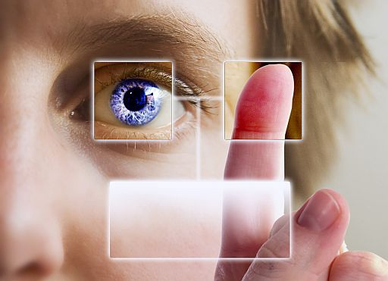
BioMetrics

Slide 2
What is Biometrics?
Biometrics is referred as an authentication system that measures the physiological and individual characteristics of a human being.
Biometrics is derived from Greek word bio (life) and metric (measure).

Slide 3
Identification techniques:
Biometrics technologies can identify the following unique characteristics:
Face
Fingerprint
Hand Geometry
Iris
Retina
Signature
Voice

Slide 4
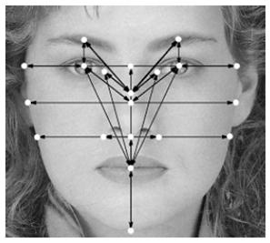
Face Recognition

Slide 5
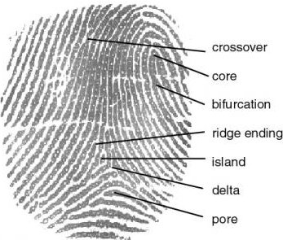
Fingerprint

Slide 6
Hand Geometry

Slide 7
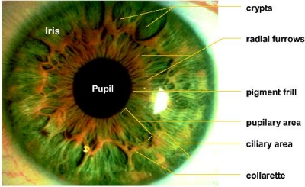
Iris

Slide 8
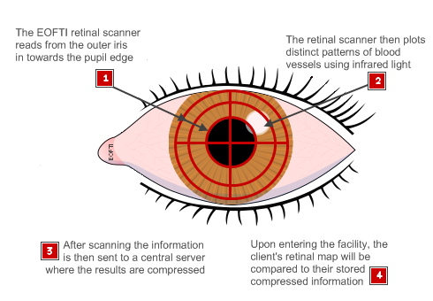
Retina

Slide 9
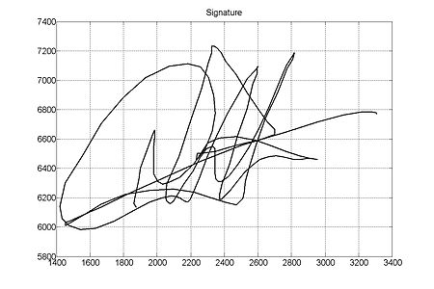
Signature

Slide 10
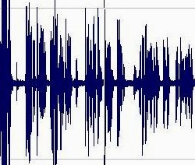
Voice

Slide 11
Accuracy and Ease of Use
Biometric System | Accuracy | Ease of Use
Fingerprint | High | Medium
Hand Geometry | Medium | High
Voice | Medium | High
Retina | High | Low
Iris | Medium | Medium
Signature | Medium | Medium
Face | Low | High
Common Biometric Report by University of Athens

Slide 12
Applications
Biometrics can prevent unauthorized access in:
ATM’s
Desktop PC’s
Smart Phones
Smart Cards
Computer Networks
Workstation

Slide 13
Thank You!!!
www.playppt.com

