Slide 1
Building Automation

Slide 2
Intro
Building automation describes the advanced functionality provided by the control system of a building.
A building automation system (BAS) is an example of a distributed control system.
The control system is a computerized, intelligent network of electronic devices designed to monitor and control the mechanical, electronics, and lighting systems in a building.

Slide 3
Topology
Primary & Secondary Bus:
Low level or High Level Controllers
Input / Output Devices
Human Interface Device
Wireless Network (can be ZigBee)
Input & Output
Analog
Variable Measurement
Temperature, Humidity, and Pressure Sensor
Digital
Switch On or Off
Photocell

Slide 4
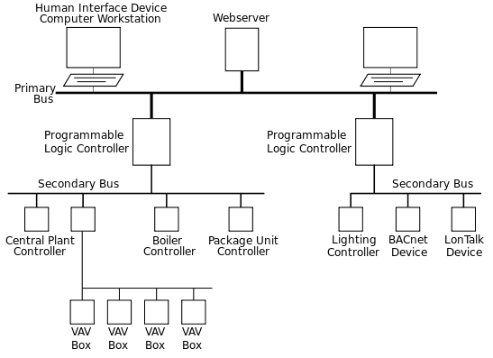
Structure of BAS

Slide 5
Components of BAS
Controllers
Programmable Logic Controllers
System / Networks Controllers
Terminal Unit Controllers
Occupancy
Temperature Sensor
Lighting
Photocell

Slide 6
Components of BAS (Contd..)
Air Handlers
Indoor Air Quality
Demand Control Ventilation
Central Plant
Chilled Water System
Condenser Water System
Hot Water System
Alarms and Security
Fire and Smoke Alarm System

Slide 7
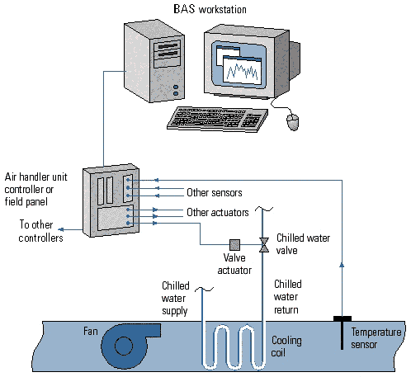
Components of BAS

Slide 8
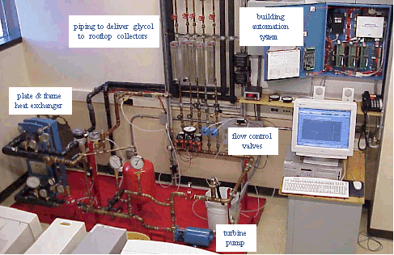
Live Preview of BAS

Slide 9
Why BAS?
Keeps the building climate within a specified range
Provides lighting based on an occupancy schedule
Monitors system performance and device failures
Provides malfunction alarms (via email and/or text notifications) to building engineering/maintenance staff
Reduces building energy and maintenance costs when compared to a non-controlled building.
A building controlled by a BAS is often referred to as an intelligent building or a smart home.

Slide 10
Thank You!!!
www.playppt.com

