Slide 1
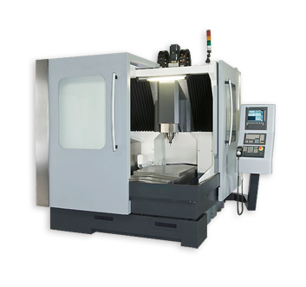
CNC MACHINES

Slide 2
Introduction
CNC (Computer Numerical Control) Machines are automated machines, which uses programs to automatically execute a series of machining operations.
CAD (Computer Aided Design) and CAM (Computer Aided Manufacturing) programs is used in modern CNC machines for end-to-end component design.

Slide 3
How CNC Works?
Controlled by G and M codes.
These are number values and co-ordinates.
Each number or code is assigned to a particular operation.
Typed in manually to CAD by machine operators.
G&M codes are automatically generated by the computer software.

Slide 4
Features of CNC Machines
The tool or material moves.
Tools can operate in 1-5 axes.
Larger machines have a machine control unit (MCU) which manages operations.
Movement is controlled by a motors (actuators).
Feedback is provided by sensors (transducers)
Tool magazines are used to change tools automatically.

Slide 5
Tools
Most are made from high speed steel (HSS), tungsten carbide or ceramics.
Tools are designed to direct waste away from the material.
Some tools need coolant such as oil to protect the tool and work.

Slide 6
Basics of CNC Programming
CNC instructions are called part program commands.
When running, a part program is interpreted one command line at a time until all lines are completed.
Commands, which are also referred to as blocks, are made up of words which each begin with a letter address and end with a numerical value.
Each letter address relates to a specific machine function. “G” and “M” letter addresses are two of the most common.

Slide 7
Types of CNC Machines:
CNC Lathe machines
CNC Milling machines
CNC Grinding machines

Slide 8
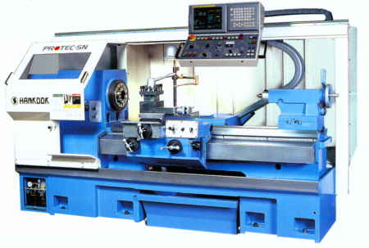
CNC Lathe Machines:
Automated version of a manual lathe.
Programmed to change tools automatically.
Used for turning and boring wood, metal and plastic.

Slide 9
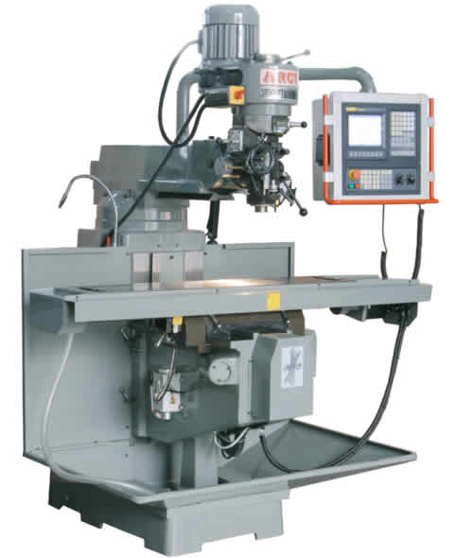
CNC Milling Machines
Has 3 to 5 axes.
Used for wood, metal and plastic.
Used to make 3D prototypes, moulds, cutting dies, printing plates and signs.

Slide 10
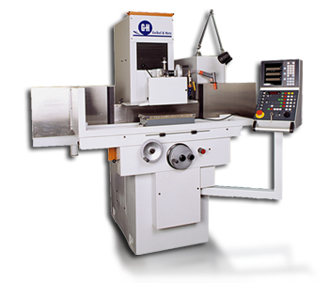
CNC Grinding Machines
Slowly removes metal to create a part.
Some types of CNC grinding are
Surface grinding
Cylindrical grinding
Tool and cutter grinders
Profile grinders

Slide 11
Other types of CNC Machines
Drilling Machines
Horizontal and Vertical boring machines
Jig boring and Jig grinding machines
Plano millers
Coordinate measuring machines
CNC welding machines
Assembly machines
Printed circuit board drilling machines
Tube bending machines.

Slide 12
Advantages
High Repeatability and Precision e.g. Aircraft parts
Volume of production is very high
Complex contours/surfaces need to be machined. E.g. Turbines
Flexibility in job change, automatic tool settings, less scrap
More safe, higher productivity, better quality
Less paper work, faster prototype production, reduction in lead times

Slide 13
Disadvantages
Costly setup, skilled operators
Computers, programming knowledge required
Maintenance is difficult

Slide 14
Thank You!!!
www.playppt.com

