Slide 1
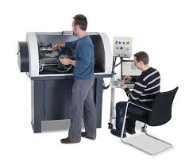
Computer Integrated Manufacturing (CIM)

Slide 2
What is CIM?
It is the manufacturing process done with the use of a computer for controlling the complete production process.
This manufacturing process is very fast and reduces error.
This process is also called as Flexible Design and Manufacturing.

Slide 3
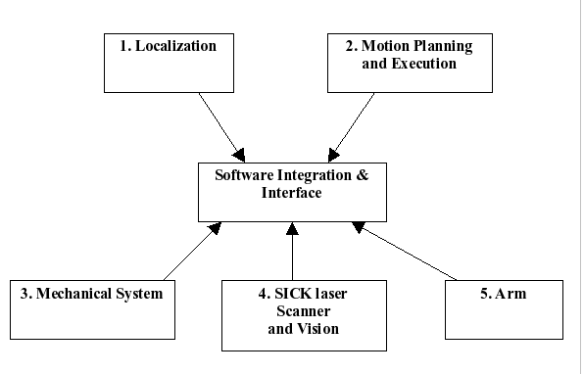
Overview

Slide 4
Devices used
The CIM requires some devices for its process. It includes
Programmable Logic Controller (PLC),
Computer Numerical Control (CNC) machine tools,
Robots,
Direct Numerical Control (DNC) machine tools.
It also includes computers, networks, software, controllers, monitoring equipment, and interfacing.

Slide 5
Technologies used
Automated Storage and Retrieval System (ASRS)
Flexible Manufacturing System (FMS)
Robotics
Automated Guided Vehicle (AGV)
Automated Convergence Systems

Slide 6
Computer Aided Technologies
Computer Aided Design (CAD),
Computer Aided Manufacturing (CAM),
Computer Aided Engineering (CAE),
Computer Aided Quality Assurance (CAQ),
Computer Aided Process Planning (CAPP),
Enterprise Resource Planning (ERP), and
Production Planning and Control (PPC).

Slide 7
Applications
Printed Circuit Board
Integrated Circuit Design Data
Mechanical processes

Slide 8
Advantages
Manufacturing lead time is less.
Good quality products at less expensive.
Increased productivity.
Time for production planning is decreased.
Decreased transportation time.
Competitive power is increased.

Slide 9
Disadvantages
Very Expensive
High Maintenance Cost
Skilled labors are required
May be outdated as the technology grows day by day

Slide 10
Thank YOU!!!
www.playppt.com

