Slide 1
Database Management System (DBMS)

Slide 2
What is DBMS?
Database Management System is a software that is meant for storing records in computers.
This software allows accessing of data such as delete, store, retrieve etc that are available in a database.

Slide 3
History
During early days, for storing data a file system is used.
In a file system, it is difficult to access data, data inconsistency, integrity and security problems etc.
So database management system was first developed on 1960 by Charles Bachman.
Database Management System provides many solutions for problems that are occurred in a file system.

Slide 4
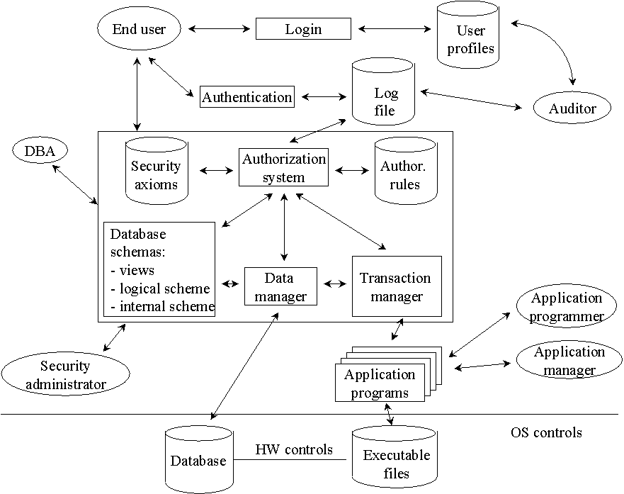
Architecture

Slide 5
Types of DBMS
Hierarchical DBMS
A hierarchical DBMS are established in such a way that one data item is present as the subordinate of another one or a sub unit.
Network DBMS
If the relationships among data in the database are of type many-to-many, then it is network DBMS.
Relational DBMS
A relational DBMS is the database relationships, which are treated in the form of a table.
Object-oriented DBMS
Able to handle many new data types, including graphics, photographs, audio, and video, object-oriented databases represent a significant advance over their other database cousins.

Slide 6
Areas of DBMS
Airlines:
Used for storing information such as availability of seats, train timings etc.
Banking:
Used to store customer details, accounts, transaction etc.
Telecommunication:
For storing bills, caller names etc.

Slide 7
Areas of DBMS
Universities:
To store students register no., marks etc.
Human Resources:
For storing employee details, salary etc.
Sales:
Helps to store customer information, purchases etc.

Slide 8
Advantages
Faster access to information
Cost for user training is low
Multiple usages at a time
No dependence in language
High data security
Eliminates data redundancy
Consistency in data

Slide 9
Disadvantages
Slightly expensive
Requires trained technical employee for operation
Damage in database deletes all data forever
Data conversion is very costly and difficult
Organization has to spend more amounts for training a staff to operate DBMS

Slide 10
Conclusion
The goal of database management system is to offer more convenience as well as more efficiency to access data from a database with high security.
Therefore, nowadays Database Management System is used in all fields for gaining more advantages.

Slide 11
Thank You!!!
www.playppt.com

