Slide 1
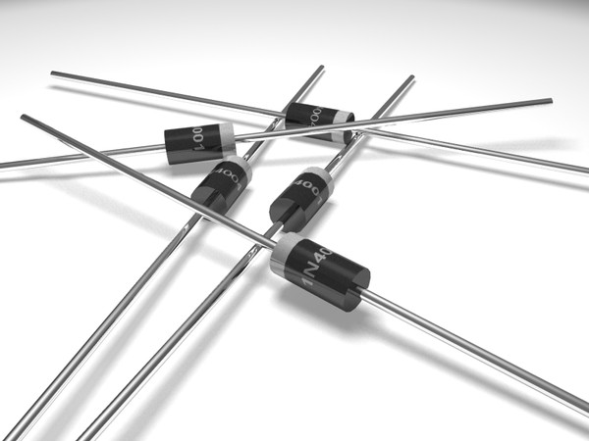
Diode

Slide 2
What is a Diode?
A diode is a semiconductor device which allows current to flow through it in only one direction.
A diode can be used as a rectifier that converts AC (Alternating Current) to DC (Direct Current) for a power supply device.
Diodes can be used to separate the signal from radio frequencies.
Diodes can be used as an on/off switch that controls current.

Slide 3
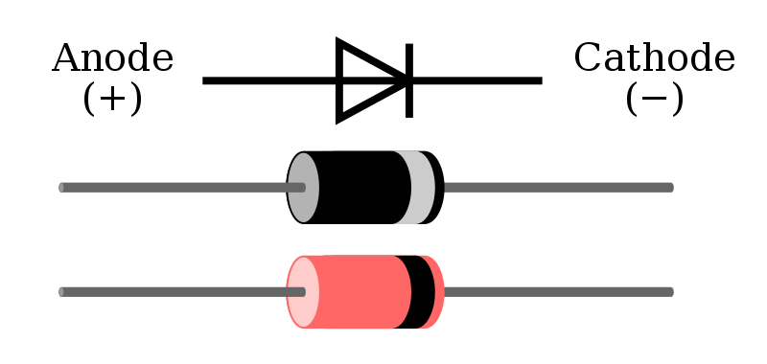
Symbol
This symbol is used to indicate a diode in a circuit diagram.
The meaning of the symbol is (Anode) (Cathode).
Current flows from the anode side to the cathode side.

Slide 4
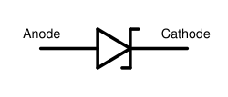
Voltage Regulation Diode (Zener Diode)
It is used to regulate voltage, by taking advantage of the fact that Zener diodes tend to stabilize at a certain voltage when that voltage is applied in the opposite direction.

Slide 5
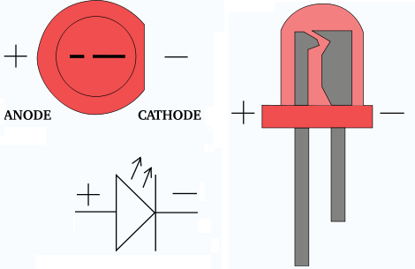
Light Emitting Diode (LED)
This type of diode emits light when current flows through it in the forward direction.

Slide 6
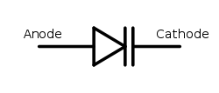
Variable Capacitance Diode
The current does not flow when applying the voltage of the opposite direction to the diode.
In this condition, the diode has a capacitance like the capacitor.
It is a very small capacitance.
The capacitance of the diode changes when changing voltage.
With the change of this capacitance, the frequency of the oscillator can be changed.

Slide 7
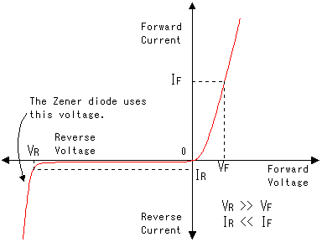
Electrical Characteristics of a typical diode

Slide 8
Rectification/Switching/Regulation Diode
The stripe stamped on one end of the diode shows indicates the polarity of the diode.
The stripe shows the cathode side.
The two devices shown in the picture are diodes used for rectification.
They are made to handle relatively high currents.

Slide 9
Diode Bridge
Rectification diodes are used to make DC from AC.
It is possible to do only 'half wave rectification' using 1 diode.
When 4 diodes are combined, 'full wave rectification' occurs.
Devices that combine 4 diodes in one package are called diode bridges.
They are used for full-wave rectification.

Slide 10
Diode Bridge

Slide 11
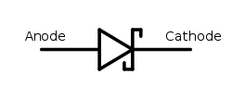
Schottky Barrier Diode
Diodes are used to rectify alternating current into direct current.
However, rectification will not occur when the frequency of the alternating current is too high.
This is due to what is known as the "reverse recovery characteristic."
The Schottky barrier diode has a short reverse recovery time, which makes it ideally suited to use in high frequency rectification.

Slide 12
Thank You!!!
www.playppt.com

