Slide 1
Electronic Business

Slide 2
What is Electronic Business?
It is defined as ICT (Information and Communication Technologies) application with support to all business activities.
The methods of electronic business allow the organizations to connect their external and internal Data Processing System very flexibly and efficiently.
It is also known as eBusiness or Internet Business.

Slide 3
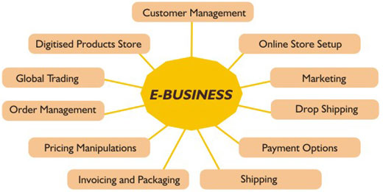
Overview

Slide 4
Areas of eBusiness process:
eBusiness involves on business processes such as
Supply Chain Management
Electronic Purchasing
Electronically Ordering the Processes
Co-operate with Business partners
Handling of better customer service

Slide 5
Sources
eBusiness is managed through
Internet
Web
Intranets
Extranets.

Slide 6
First Category
Enterprise Communication & Collaboration:
This category includes Content Management Systems, E-mail, VoIP technology, Web Conference, Business Process Management, and Voice Mail.

Slide 7
Second Category
Internal Business Systems:
This system carries Enterprise Resource Planning, Customer Relationship Management, Human Resources Management, and Document Management Systems.

Slide 8
Third Category
Electronic Commerce - B2B (Business to Business eCommerce) or B2C (Business to Business eCommerce):
It includes Supply Chain Management, Internet Shop, Offline Marketing, and Online Marketing.

Slide 9
Security concerns
Confidential
Privacy
Data Integrity
Access Control
Reliability

Slide 10
Advantages
Promotions & Marketing are cost effective,
Online business so that business are done worldwide,
Excellent customer service, and
Competitive strategy is developed.

Slide 11
Disadvantages
The optimization solutions of eBusiness are expensive
Sectoral limits

Slide 12
Thank You!!!
www.playppt.com

