Slide 1
Facebook Thrift

Slide 2
What is Facebook Thrift?
A software library with set of code generation tool developed by Facebook (Palo Alto, California) to expedite development and implementation of scalable and efficient backend services.
Thrift is designed to be as simple as possible for the developers who can define all the necessary data structures and interfaces for a complex service in a single short file.
This file is called as Thrift Interface Definition Logic File or Thrift IDL File.

Slide 3
Goal of Facebook Thrift
The primary goal of thrift is to enable efficient and reliable communication across programming languages by abstracting the portions of each language that tend to require the most customization into a common library that is implemented in each language.
This is done by allowing the users to define the data types and service interfaces in a common Interface Definition Logic File (IDL File) which is supposed to be language neutral file and it generates all the necessary code to build Remote Procedure Calls to clients and servers.

Slide 4
Features of Thrift Design
The developers identified some important features while evaluating the technical challenges of cross language interactions in a networked environment.
Types
Transport
Protocol
Versioning
Processor

Slide 5
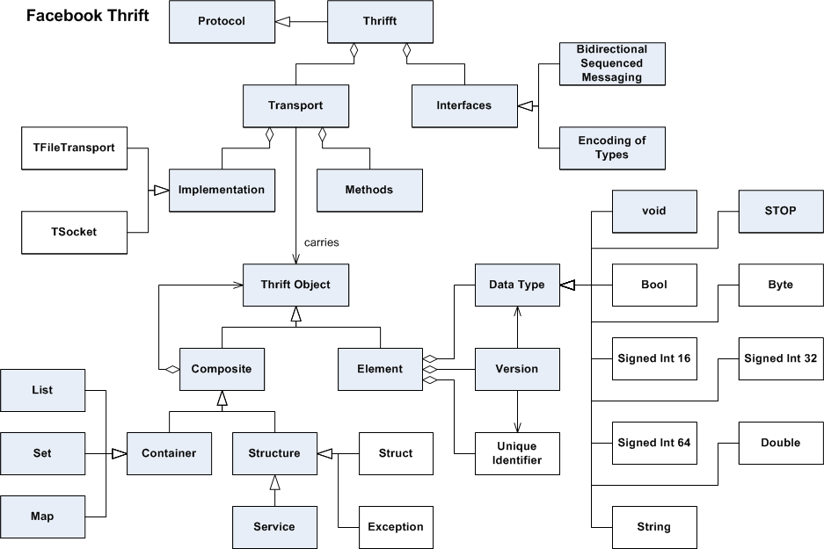
Thrift Design

Slide 6
Thrift Struct
A thrift struct defines a common object to be used across languages.
A struct is essentially similar to a class in object oriented programming languages.
A Thrift struct has a strongly typed field with unique field identifiers.
The basic syntax for Thrift struct is very similar to the structs used in C.

Slide 7
How a thrift struct look?
struct Example { 1: i32 number =10, 2: i64 bignumber, 3: double decimals, 4: string name= “NB” };

Slide 8
Services of Facebook Thrift
Thrift has been employed in a large number of applications at Facebook, including search, logging, mobile, ads and the developer platform.
The most important services of Facebook are:
Search
Logging

Slide 9
Search
Thrift is used as the underlying protocol and transport layer for the Facebook Search service.
The multi-language code generation is well suited for search because it allows for application development in an efficient server side language (C++) and allows the Facebook PHP-based web application to make calls to the search service using Thrift PHP libraries.

Slide 10
Logging
The Thrift Tfile Transport functionality is used for structured logging.
Each service function definition along with its parameters can be considered to be a structured log entry identified by the function name.
This log can then be used for a variety of purposes, including online and offline processing, stats aggregation and as a redo log.

Slide 11
Conclusion
Thrift has enabled Facebook to build scalable backend services efficiently by enabling engineers to divide and conquer.
Finally Thrift has been added to Apache Software Foundation as the Apache Thrift Project , making it open source framework for cross-language services implementation.

Slide 12
Thank You!!!
www.playppt.com

