Slide 1
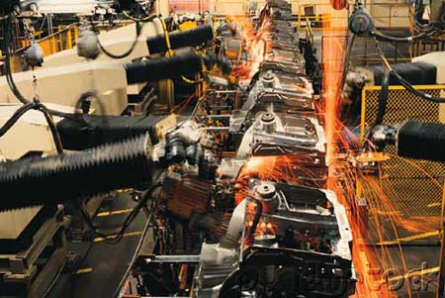

Industrial Automation

Slide 2
Introduction
Automation means Self Dedicated that comes from Greek work.
The automation can be done through roboticization, computer numerical control etc.
The control of industrial machines and process with the help of computer by replacing human operators is known as Industrial Automation.

Slide 3
Features of Industrial Automation
Nowadays industrial automation is done mostly with the robots. The use of robots can be divided into three categories:
  Material handling
  Processing
  Assembly and inspection

Slide 4
Material Handling
The purpose of material handling robots is to pick up parts and place them on another.
The processing operations include spot welding, continuous arc welding and spray painting.
Spot welding is done by fusing two sheet metals together by passing large electric.
Arc welding is a continuous process whereas the spot welding is a discontinuous process.
Spray painting is a hazardous process for human beings because of fire hazards.

Slide 5
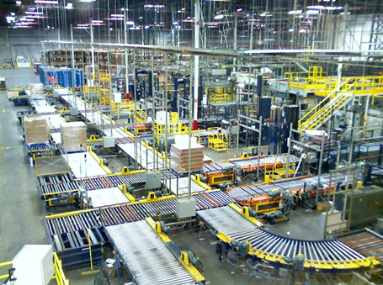
Material Handling

Slide 6
Machine Vision
The industrial robots mainly work with the help of machine vision.
Machine vision is a technology with sensor for sensing vision data, interpretation by computer while inspection and identification of part.
They have camera for performing this process.
The machine vision system operation consists of three important functions namely
  Sensing and digitizing image data
  Image processing and analysis
  Application

Slide 7
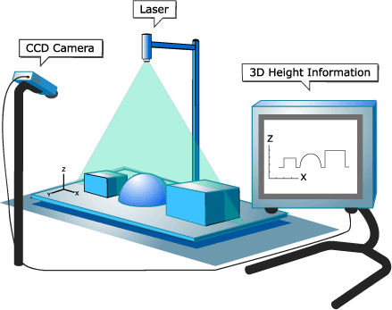
Machine Vision

Slide 8
Programming
The industrial robots require programming for operation.
The programming can be done in several ways.
The one method is that the manipulator is driven to the places where the operation is to perform and recorded the motions in robots memory.
The second method is the activities to be performed by textual programming in the computer.
Another way is that the motions are taught to the robot with the help of Teach Pendant.

Slide 9
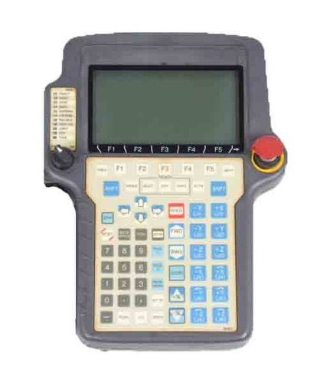
Teach Pendant

Slide 10
Advantages
High quality
Repeatability
Reduced manufacturing lead time
Increase in production
Labor cost is reduced

Slide 11
Disadvantages
Costly setup
Skilled operators are required
Does not guarantee results
Maintenance is difficult

Slide 12
Conclusion
Some industries have lacking of productivity ratio in their product.
However the setup of industrial automation cost is high, the industries started picking up industrial automation to develop their productivity ratio at low cost and good quality.

Slide 13
Thank You!!!
www.playppt.com

