Slide 1
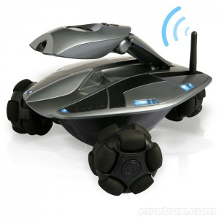

Intelligent Spy Robot

Slide 2
Intro to Spy Robot
A Spy robot is a mobile robot that can go through any neighborhood for the mission of your rescue team.
As the name suggests, Spy robot is a rescue robot in which you can use it for monitoring an environment and also for serious rescue missions.

Slide 3
Components of Spy Robot
Wireless Camera
Operator Control Unit
Battery
Motors
Chassis

Slide 4
Wireless Camera
A small wireless camera is used to capture the motion monitored in the environment.
These wireless cameras can transmit high quality video and audio according to its recommended distance.
This wireless camera allows you to monitor what goes on around your home or business very easily.

Slide 5
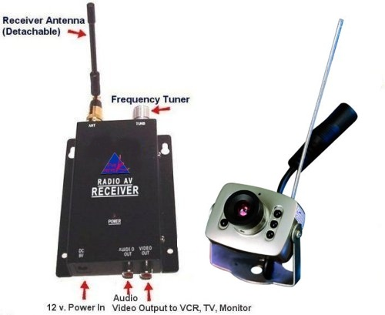
Wireless Camera

Slide 6
Operator Control Unit
To control the spy robot remotely, a Radio Frequency Controller is used.
RF is a popular method for communicating with remote controls because its signal can't easily be blocked.
The signal can even go through a wall.

Slide 7
Operator Control Unit
It has a transmitter and receiver module.
The transmitter will act as a remote which is controlled by the operator.
The receiver will be incorporated in the robot for receiving the commands provided by the controller.

Slide 8
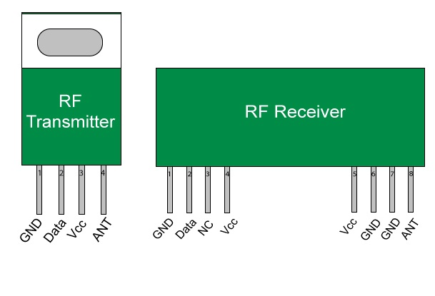
Operator Control Unit

Slide 9
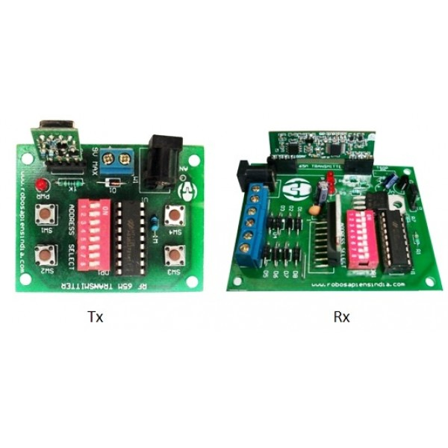
Operator Control Unit

Slide 10
Applications
Barricaded Suspects
Hostage Rescue
High-Risk Warrant Service
Inspection of Ventilation Ducts
Inspection of Contaminated/Hazardous Environments
Prison/Jail Riots

Slide 11
Conclusion
Know before you go! The Spy Robots are “throw able” robots, which serve as your "man on the inside" for a broad range of military, police, security, and rescue applications.
In any dangerous, hostile, or confined environment, you’ll instantly get critical visual intelligence that can save lives and reduce property damage.

Slide 12
Thank You!!!
www.playppt.com

