Slide 1
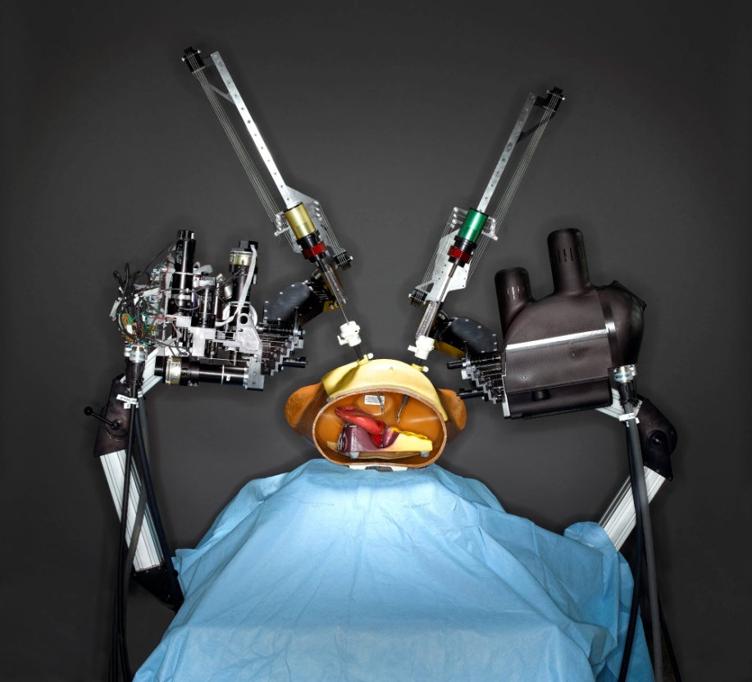
Micro Mechatronics in Surgery

Slide 2
What is micro mechatronics?
Micro mechatronics is the synergistic integration of micro-electro-mechanical system, electronic technologies, and precision mechatronics with high added value.
Micro-mechatronic devices would be in the range of a few microns to 1 cm, which has played a vital role in the evolution of MIS (Minimally Invasive Surgery).

Slide 3
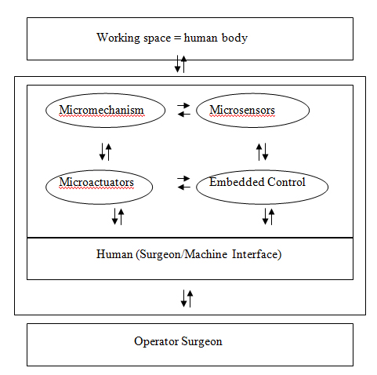
Layout of micro mechatronics surgical system

Slide 4
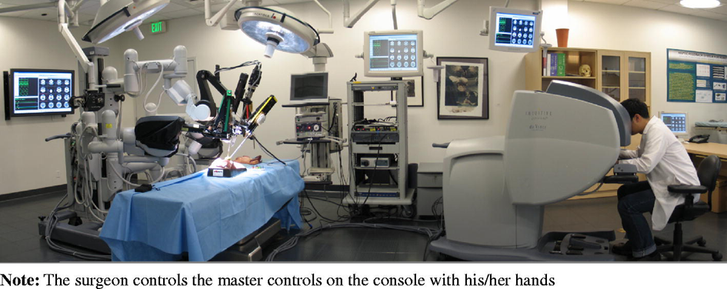
Enhanced Accuracy

Slide 5
Enhanced Accuracy
In the previous slide, the surgeon’s motions are scaled down such that a large translation made by the master controller would cause the slave micromanipulator to be moved only a fraction of the distance.
Such a system would improve dexterity and accuracy as it relieves most of the surgeon’s technical difficulties.

Slide 6
Improved Diagnosis Procedure
Another possible use of micro mechatronics in surgery is in the area of diagnosis.
Noninvasive real-time diagnosis of the tissue of interest can be obtained by incorporating temperature, biochemical and micro-optical sensors into surgical tools.
The real-time diagnosis of the tissue’s pathology would allow the surgeon to decide, on the spot, a suitable therapy, reducing the need for follow-up surgeries.

Slide 7
Applications:
Endoscopic Surgery
Micro Surgery
Micro Gripper

Slide 8
Endoscopic Surgery
The main objective of endoscopic surgery is to perform inspection and surgical procedures by inserting long instruments, called endoscopes, into natural orifices or small incisions.
Endoscopes, either rigid or flexible, would normally have onboard an ultra-compact CCD camera, optical fibers, air/water channels and a surgical tool channel.

Slide 9
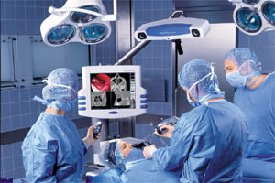
Endoscopic Surgery

Slide 10
Micro Surgery
Micro Surgery, a sophisticated surgical technique which involves the use of fine instruments and visual magnification to allow the surgeon to carefully manipulate very small structures.
In this operation, severed vessels and nerves of diameters less than 1 mm are tediously reconnected.
Since 1994, a group from NASA has been developing a new robotic micro dexterity platform called Robot Assisted Micro Surgery (RAMS), which will enable new microsurgical procedures of the brain, eye, ear, nose, throat, face and hand.

Slide 11
Micro Gripper
Traditional precision machining and laser cutting technologies were used to fabricate the earlier prototypes.
However, LIGA (in German: Lithographie, Galvanoformung, Abformung) was employed for the latest prototype due to the unique advantages it can offer in the fabrication of structures with high aspect ratios.
The ‘finger’ of this 200 micro-meter thick micro gripper was designed to have a displacement of between 100 to 200 micrometer each.

Slide 12
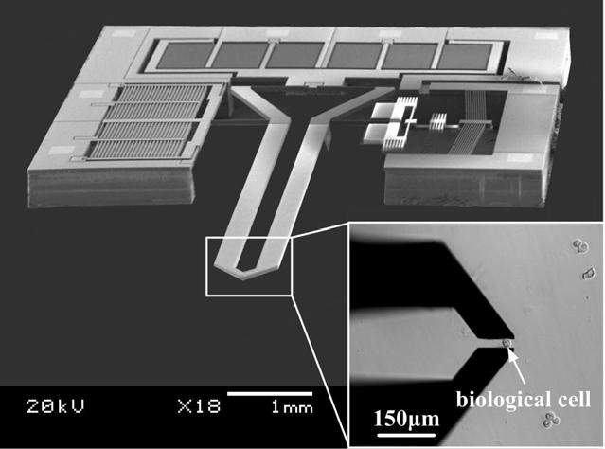
Micro Gripper

Slide 13
Conclusion
Micromechatronic technologies will have an even greater impact in the field of surgery.
Surgeons can be more relieved from technical difficulties while patients can suffer less pain and discomfort.
Exciting micro-scale actuator and sensor technologies are being introduced and developed at a rapid pace.

Slide 14
Thank You!!!
www.playppt.com

