Slide 1
PWM (Pulse Width Modulation)

Slide 2
What is PWM?
PWM (Pulse Width Modulation) is used to keep the output voltage of the inverter at the rated voltage irrespective of the output load.
Its main use is to allow the control of the power supplied to electrical devices, especially to inertial loads such as motors.

Slide 3
Why PWM?
In a conventional inverter the output voltage changes according to the changes in the load.
To nullify effect caused by the changing loads, the PWM inverter correct the output voltage according to the value of the load connected at the output.
This is accomplished by changing the width of the switching frequency generated by the oscillator section.

Slide 4
Circuits used in PWM inverters
Battery charging current sensor circuit
Battery voltage sensing circuit
AC mains sensing circuit
Low battery cut off circuit
Soft start circuit
Change over circuit

Slide 5
Circuits used in PWM inverters
Overload sensing circuit
Shut down circuit
PWM controller circuit
Oscillator circuit
Driver circuit
Output section

Slide 6
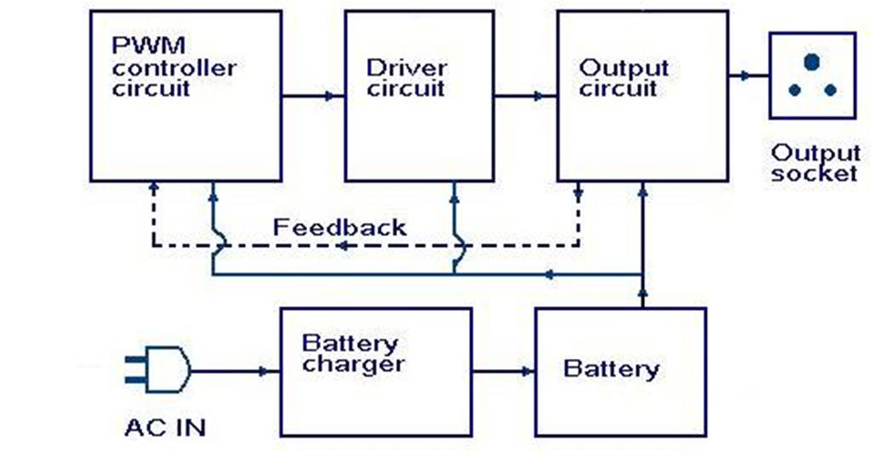
Blog diagram of basic PWM inverter

Slide 7
Popular PWM techniques
Some popular PWM techniques are:
SINE-PWM technique
Space Vector based PWM technique
Hysteresis Current controller based PWM technique
Some of the PWM techniques can be realized using analog circuits alone
Some others are more easily realized with the help of digital processors like
Microprocessor
Digital signal processor (DSP)
Personal Computer (PC)

Slide 8
Types of PWM
Three types of pulse-width modulation (PWM) are possible:
The pulse center may be fixed in the center of the time window and both edges of the pulse moved to compress or expand the width.
The lead edge can be held at the lead edge of the window and the tail edge modulated.
The tail edge can be fixed and the lead edge modulated.

Slide 9
Applications:
Telecommunication
Power Delivery
Voltage regulation
Audio effects and amplification
Electrical

Slide 10
Thank You!!!
www.playppt.com

