Slide 1

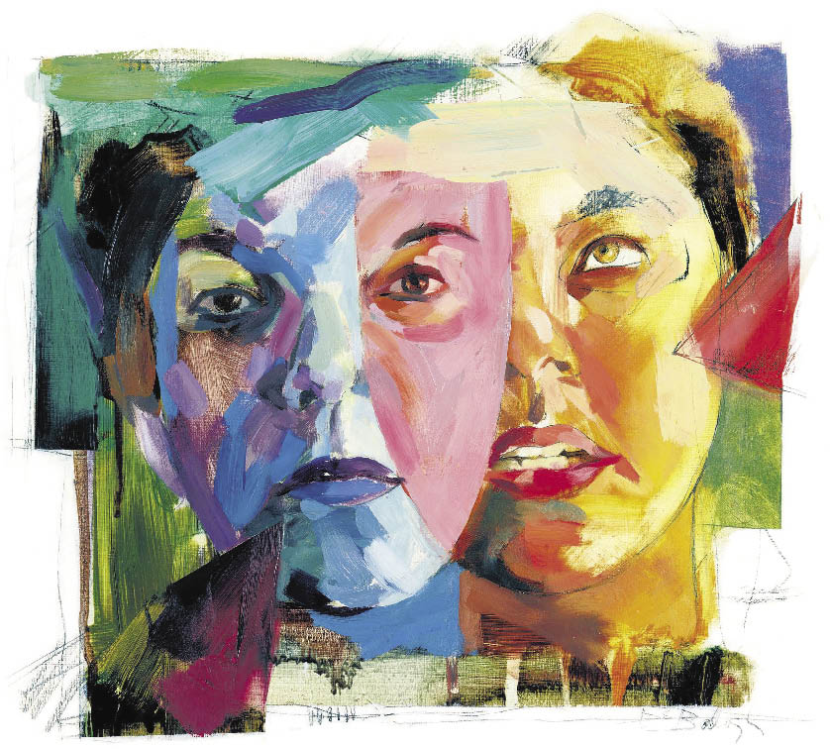
Personality Disorder

Slide 2
Introduction
A personality disorder is a type of mental illness in which you have trouble perceiving and relating to situations and to people — including yourself.
Personality disorder peoples have a rigid and unhealthy pattern of thinking and behaving no matter what the situation.
This leads to significant problems and limitations in relationships, social encounters, work and school.

Slide 3
Symptoms
Frequent mood swings
Stormy relationships
Social isolation
Angry outbursts
Suspicion and mistrust of others
Difficulty making friends
A need for instant gratification
Poor impulse control
Alcohol or substance abuse

Slide 4
Types
The specific types of personality disorders are grouped into three clusters based on similar characteristics and symptoms.
  Cluster A
  Cluster B
  Cluster C

Slide 5
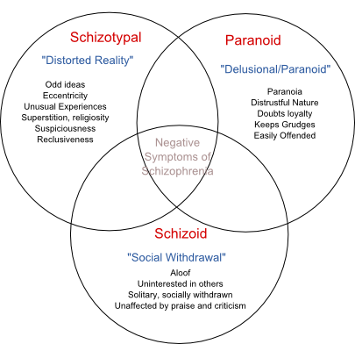
Cluster A Personality Disorder

Slide 6
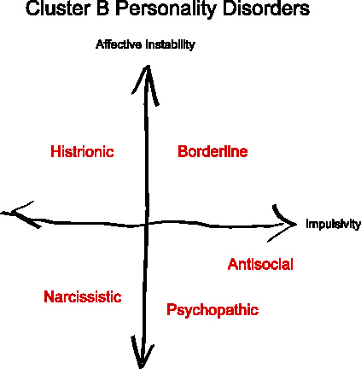
Cluster B Personality Disorder

Slide 7
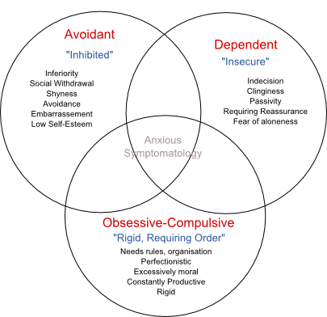
Cluster C Personality Disorders

Slide 8
Risk Factors
A family history of personality disorders or other mental illness
Low socioeconomic status
Verbal, physical or sexual abuse during childhood
Neglect during childhood
An unstable or chaotic family life during childhood
Being diagnosed with childhood conduct disorder
Loss of parents through death or traumatic divorce during childhood

Slide 9
Treatments
Psychotherapy
  Cognitive Behavior Therapy
  Dialectical Behavior Therapy
  Psychodynamic psychotherapy
  Psycho education
Medications
  Antidepressant Medications
  Mood-Stabilizing Medications
  Anti-Anxiety Medications
  Antipsychotic Medications
Hospitalization

Slide 10
Remedy
Stick to your treatment plan
Take your medications as directed
Learn about your condition
Pay attention to warning signs
Get active
Avoid drugs and alcohol
Get routine medical care

Slide 11
Thank You!!!
www.playppt.com

