Slide 1
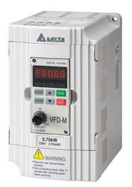

SPEED CONTROL OF THREE PHASE INDUCTION MOTOR WITH ENERGY SAVING

Slide 2
COMPONENTS USED
Main components:
Variable Frequency Drive (VFD)
Three-Phase Induction Motor
Energy Meter
Clamp Meter
Timer

Slide 3
What is VFD?
A Variable Frequency Drive (VFD) is used to control the speed of the 3-phase induction motor.
VFD uses power electronics to vary the frequency of input power to the motor, thereby controlling motor speed.

Slide 4
Three sections in vfd
There are three basic section in the VFD.
They are:
Rectifier
DC Bus
Inverter

Slide 5
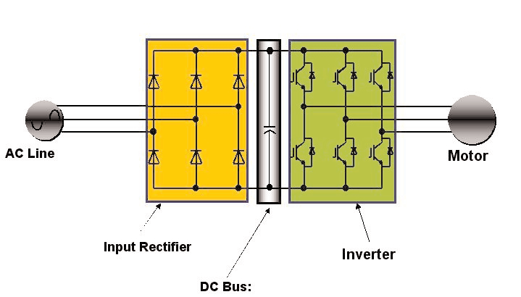
VFD: EXISTING TECHNOLOGY

Slide 6
HOW SPEED IS CONTROLLED USING VFD?
Rectifier:
The rectifier in a VFD is used to convert incoming ac power into direct current (dc) power.
One rectifier will allow power to pass through only when the voltage is positive.
A second rectifier will allow power to pass through only when the voltage is negative.

Slide 7
HOW SPEED IS CONTROLLED USING VFD?
DC bus:
After the power flows through the rectifiers it is stored on a dc bus.
The dc bus contains capacitors to accept power from the rectifier, store it, and later deliver that power through the inverter section.
The dc bus may also contain inductors, dc links, chokes, or similar items that add inductance, thereby smoothing the incoming power supply to the dc bus.

Slide 8
HOW SPEED IS CONTROLLED USING VFD?
Inverter:
The inverter contains transistors that deliver power to the motor.
The “Insulated Gate Bipolar Transistor” (IGBT) is a common choice in modern VFDs.
The IGBT can switch on and off several thousand times per second and precisely control the power delivered to the motor.
The IGBT uses a method named “pulse width modulation” (PWM) to simulate a current sine wave at the desired frequency to the motor.

Slide 9
HOW SPEED IS CONTROLLED USING VFD?
Motor speed (rpm) is dependent upon frequency.
Varying the frequency output of the VFD controls
motor speed:
Speed (rpm) = frequency (hertz) x 120 / no. of poles
Example:
4-pole motor at different frequencies
3600 rpm = 60 hertz x 120 / 4 = 1800 rpm
3000 rpm = 50 hertz x 120 / 4 = 1500 rpm
2400 rpm = 40 hertz x 120 / 4 = 1200 rpm

Slide 10
HOW ENERGY IS SAVED USING VFD?
As the VFD makes the motor to start from the lower point, the motor starts smoothly and as well as stops smoothly.
It also reduces the sudden jerks that tend to happen at the start of the motor.
As a result, a large amount of energy is saved.

Slide 11
APPLICATIONS
Leather Industry
Spray painting
Water flow control
Crane and hoist
Elevators

Slide 12
CONCLUSION
Provides the most efficient means of motor speed control.
Reduces the thermal and mechanical stresses on the motor.
Provides low motor starting.
Saves more energy.

Slide 13
Thank you!!!
www.playppt.com

