Slide 1
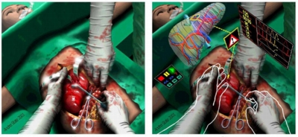

Tele Immersion

Slide 2
What is Tele Immersion?
Tele-immersion is a technology to be implemented with Internet2 that will enable users in different geographic locations to come together in a simulated environment to interact.
Users will feel like they are actually looking, talking, and meeting with each other face-to-face in the same room.

Slide 3
How tele-immersion is achieved?
Computers recognizes:
  the presence and movements of individuals and objects,
  tracking those individuals and images, and
  reconstructing them onto one stereo-immersive surface.

Slide 4
How tele immersion is achieved?
3D reconstruction for tele-immersion is performed using stereo, which means two or more cameras take rapid sequential shots of the same object, continuously performing distance calculations, and projecting them into the computer-simulated environment, as to replicate real-time movement.

Slide 5
Tele Immersion and Virtual Reality
A major difference between these two technologies is that Virtual Reality allows you to move in a computer generated 3-D environment, while Tele Immersion can only create 3-D environment that you can see but not interact with.
Interaction is only possible by combining these two technologies

Slide 6
Applications
Tele-immersion techniques can be viewed as the building blocks of the office of tomorrow, where several users from across the country will be able to collaborate as if they're all in the same room.
Scaling up, transmissions could incorporate larger scenes, like news conferences, ballet performances, or sports events.
With mobile rather than stationary camera arrays, viewers could establish tele-presence in remote or hazardous situations.

Slide 7
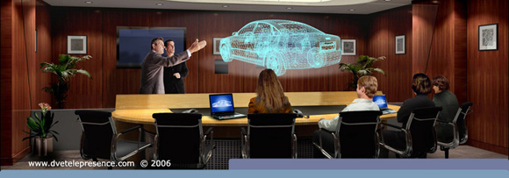
Example

Slide 8
Future Scope
The tele immersion can be ideally:
  Support one or more flat projectors with ultra-high color resolution
  Be stereo capable without special glasses
  Have tether less, low latency, high accuracy tracking
  Have exquisite directional sound capability
  Be available in a range of compatible hardware and software configurations
  Use a range of sophisticated to couple to human movement and touch

Slide 9
Conclusion
Tele Immersion allows widely separated people to share a complex virtual experience.
In future, it will be one of the major developments.
You can visit each other environment, but one thing which is far behind to achieve is the physical contact of individuals at each end.

Slide 10
Thank You!!!
www.playppt.com

