Slide 1
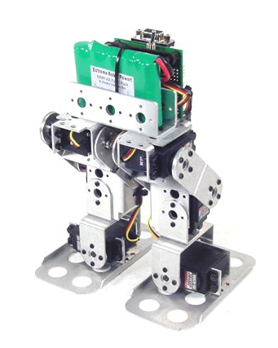
BIPED ROBOT

Slide 2
Introduction
Designing controllers for walking robots presents many challenges.
In order for walking robotics to reach this stage, perhaps a new approach to legged robotics is necessary.
Two of today's premieres walking robots are ASIMO and Qrio, made by Honda and Sony, respectively.
Mainly conducted usability studies in critical robotic applications such as in the area of Search, Rescue and on teleportation in nuclear environments dealing with run-time interaction with the robots.

Slide 3
Problems in Existing Model
The position controller requires an exorbitant amount of energy.
Far beyond that required by real human walking.
Furthermore their movements are tense and shaky, and high precision is necessary in all motion.
Difficult to graphical user interface (GUI).
Cost of the robot is high and program is more complicated.
A solution to this control problem requires exploring alternative controller designs.

Slide 4
Machine Learning Hypothesis
Machine learning techniques are derived from a set of algorithms used to train neural networks in the human brain.
Robot can essentially learn how to walk given a simple set of initial conditions.
Based upon feedback controller system.

Slide 5
Biped Walking Mechanism
Rolling of a polygon with side length equal to the length of the step
The smaller the step gets, the more the polygon tends to a circle (wheel)
However, fully rotating joint was not developed but, it can be reached by a ball type joint in hip part.

Slide 6
Biped Walking Mechanism

Slide 7
Case Study
It can be replaced by ball joint hip and knee.
Through the ball joint, it’s rotation can be increased in many activities.
Free flow action can achieved easily.

Slide 8
General Specification
Accelerometer, gyros and lidar’s.
Potentiometer control’s the pitch oscillation of the hip.
Force sensing sensors are mounted on the underside of each foot
Microcontroller
TSOP Sensor.

Slide 9
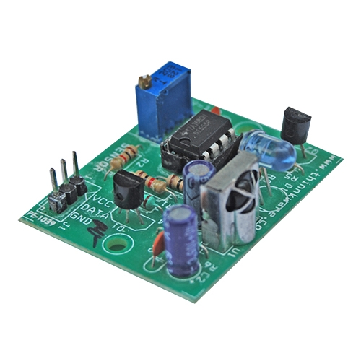
TSOP Sensor
It is just a receiver, that increases the signal even if the input frequency is low.
It will receive the signal and sends it to the micro-controller.
High immunity against ambient light

Slide 10
Accelerometer
Motion input could be recorded from both the leg‘s independently.
Accelerometers that measure gravity

Slide 11
Lidar
LIDAR does not suffer from “sweep” error when the operator uses the equipment correctly and when the LIDAR unit is equipped with algorithms that are able to detect when this has occurred.

Slide 12
Simple Board Design
Servo motor connector
Reset switch
Other switches
Crystal
Diodes
Battery connector
Jumper
SMD capacitor
USB connector
Battery charger
Power switch
Capacitors
Microcontroller
TSOP IR receiver
Pull up resistor
Sensor connector

Slide 13
Future of Bipedal
It can be used in many ways
Pre-programmable
Live commanding
Voice commanding also can be upgraded.

Slide 14
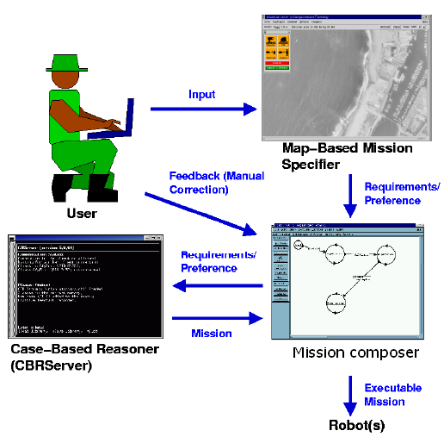
Future of Bipedal

Slide 15
Conclusion
Through this project and case study we learned many thing’s practically & theoretically in this paper.
The above results demonstrate that the general strategies towards achieving the specifications laid out in the beginning.
The main design considerations in the creation of a bipedal robots are size, DOFs, actuators, sensors and control hardware & software.

Slide 16
Thank You!!!
www.playppt.com

