Slide 1
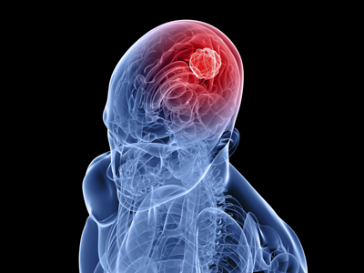
Brain Tumor

Slide 2
Introduction
A tumor is a mass of tissue that's formed by an accumulation of abnormal cells.
Normally, the cells in your body age, die, and are replaced by new cells.
With cancer and other tumors, something disrupts this cycle.
Tumor cells grow, even though the body does not need them, and like normal old cells, they don't die.
As this process goes on, the tumor continues to grow as more and more cells are added to the mass.

Slide 3
Types of Brain Tumor
Primary brain tumors
It occurs in brain tissue
Secondary brain tumors
It is known as cancers which will spread to brain tissue from tissue in some other place of body.

Slide 4
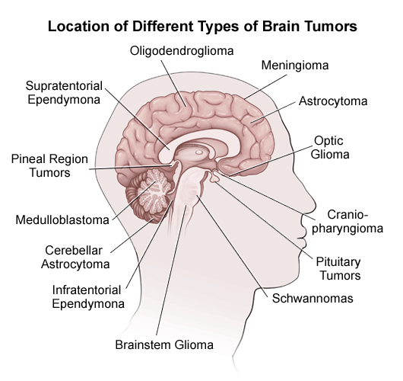
Overview

Slide 5
Symptoms
Headaches
Vomiting
Changes occurring in vision, hearing and voice
Also changes occurring in personality, concentration and mood
Some problems occur with memory
Difficult to walk or balance
Jerking of muscles
Tingling in the legs or arms

Slide 6
Causes
Generally brain tumors are mostly affected by males than females. However, females are more commonly affected by meninglomas.
Brain tumors more often affects white people than other race people.
Peoples at the age of 70 years or above are mostly detected with brain tumors.

Slide 7
Causes
Gliomas disease is likely to be developed to the people of their family members.
The brain tumor can affect to the persons those working in nuclear or chemical industries.
The brain tumor also affects persons working in exposure area of formaldehyde, acrylonitrile and vinyl chloride.

Slide 8
Treatment Methods
According to the size, type and location of brain tumor, the treatment can be done in three methods:
Surgery,
Radiation Therapy and
Chemotherapy.

Slide 9
Test taken to Diagnose tumor
Imaging studies such as a CT(CAT) scan or MRI to see detailed images of the brain
Angiogram or MRA, which involve the use of dye and X-rays of blood vessels in the brain to look for signs of a tumor or abnormal blood vessels

Slide 10
Conclusion
The peoples affected by brain tumors should have regular checkups which will help in shortening the risk factors.

Slide 11
Thank You!!!
www.playppt.com

