Slide 1

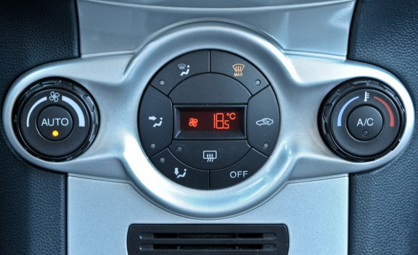
Climate Control in Cars

Slide 2
Introduction
Automatic climate control is the ability to monitor and influence the temperature of a specified space without manual intervention.
The primary purpose of automatic climate control is to manage the temperature of a given area based on settings by a user of the system.
This climate control capability can be found in many cars, boats, and airplanes.

Slide 3
Why Climate Control?
Prior to climate control, a heating and cooling system could only be engaged by manually selecting one of the mechanisms.
While a user could select a general temperature via a sliding warmer or cooler control, the system would not automatically switch from air conditioning to heating without manual intervention.
The creation of the automatic climate control system has advanced the overall comfort for automobiles, as users are not forced to constantly move the controls to adjust the temperature of the compartment.

Slide 4
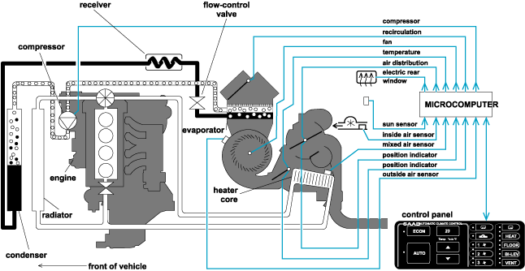
Overview

Slide 5
Mechanism
The mechanics of automated climate control require sensors to be placed into the compartment of the area to be managed.
These sensors read the current temperature of the area.
These readings are then matched to the setting defined by the occupants through the computer system within the vehicle, and the heating and cooling are adjusted appropriately.

Slide 6
Mechanism
An automatic climate control system also includes a computer that regulates the entire air system within the compartment.
This computer system regulates the fan speed, engagement of air conditioning compressor, and overall air temperature to be disbursed into the compartment.
Typically, these processes are integrated into the overall computer system within modern automobiles.

Slide 7
Advances
Advances in automatic climate control in automobiles have evolved into zoned climate control.
In this type of implementation, each occupant can adjust the temperature of the seating area in which he or she is seated.
Each area within the defined zones has a separate climate control sensor that reads the current temperature of the specified area.

Slide 8
Advantages
Increases comfort of occupants by allowing the perfect in-car temperature to be selected and maintained
Protects from pollution, smog and traffic fumes
Constantly filters air-borne pollutants like pollen and dust from entering the car
Enjoy warmth without stuffiness in winter
Clean fresh air even in the heaviest traffic
Remain cool, calm and collected regardless of the external temperature or humidity

Slide 9
Conclusion
These types of systems are not limited to automobiles.
Automatic climate control systems can also be found in many boats and airplanes.
While the implementation is unique for each type, the overall concept is the same.

Slide 10
Thank You!!!
www.playppt.com

