Slide 1

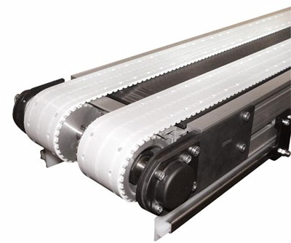
Conveyor Control using PLC, VFD, and Sensor

Slide 2
Why Conveyor Control?
A conveyor system is a common piece of mechanical handling equipment that moves materials from one location to another.
It is used to move package goods, assemblies, process byproducts, or any material from one place to another.
A main disadvantage in the conveyor system is that it even runs when there is no object placed on it.
As a result, there is a waste in energy and cost.

Slide 3
How to overcome?
In order to overcome these problems, a PLC (Programmable Logic Controller) is used to start and stop the motor of a conveyor belt.
An IR sensor is incorporated in the system to detect the availability of materials in the conveyor.
Therefore, the conveyors work only when there are any materials placed on it.
Additionally, a VFD (Variable Frequency Drive) is mounted for controlling the speed and torque of a three-phase induction motor, which in turn helps in saving the high loss of power.

Slide 4
Main Components
Programmable Logic Controllers (PLC)
Variable Frequency Drive (VFD)
Infrared Sensors
Switched Mode Power Supply (SMPS)
Three Phase Induction Motor

Slide 5
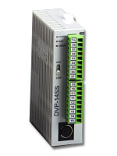
PLC

Slide 6
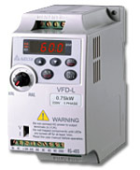
VFD

Slide 7
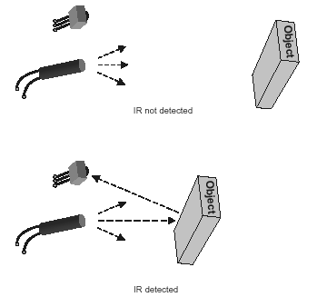
Infrared Sensors

Slide 8
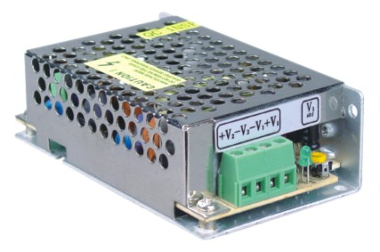
SMPS

Slide 9
How it works?
The program for the operation to be performed must be uploaded in the PLC through a computer.
The power supply must be given to the PLC via a SMPS, VFD, and three-phase induction motor.
The frequency and speed of the three-phase induction motor must be entered and saved in the VFD.
Now, the program in the PLC must be executed by pushing the button from stop to run mode.
Subsequently, the settings set in the VFD must also be executed.
As a result of these processes, the three-phase induction motor starts and the conveyor system is ready for use.

Slide 10
Where it can be used?
This conveyor system can be used in the industries, where there are the following requirements:
  Various speed to be set in the conveyor
  Low energy consumption
  Start and stop the conveyor when any objects are placed on it
  Slow welding process can be done by setting less speed on the program
  Hot objects can be detected and cooled by adding the cooling fans at the side of the conveyor

Slide 11
Thank You!!!
www.playppt.com

