Slide 1
Customer Relationship Management (CRM)

Slide 2
Introduction
Customer Relationship Management is a process used for developing stronger relationship between the customers by learning the needs and behaviors of them.
The CRM offers more information together about customers, marketing responsiveness, effectiveness, trends and sales.

Slide 3
Goal
The goal of CRM are:
to attract and get new clients,
bring the old clients with new attractive offer,
increases the company profit and
decreases the cost of client and marketing services.

Slide 4
Overview

Slide 5
CRM Software
eCRM
Sales Force Automation
Customer Service
Partnership Relationship Management

Slide 6
eCRM
Self service CRM Software: This software is used to enable the web based interaction of customer, call logs, website analytics, and call logs.
Survey Management Software: This software is used to automate the enterprises of polls, electronic surveys and questionnaires and also enables to understand the customer preferences.

Slide 7
Sales Force Automation
Contact Management Software: This software tracks, organizes, stores contacts and leads of enterprise.
Lead Management Software: This software is used to enable the organization to track, manage and predict sales leads. It also helps to improve and understand the conversion rates.

Slide 8
Customer Service
Call center software and
Help desk software.

Slide 9
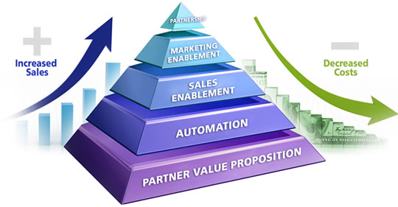
Partner Relationship Management
Contract management software and
Distribution management software.

Slide 10
Uses
Better customer service can be provided.
New customers are discovered.
Offers more customers revenues.
Sales and Marketing processes are simplified.
Call centers are made very efficient.

Slide 11
Advantages - Sales
Reduces service giveaways.
Customer loyalty is increased.
Production barriers are eliminated.
Develop profitable relationship.

Slide 12
Advantages - Marketing
Marketing velocity is increased.
Returns of marketing investments are also increased.
Control of marketing process and visibility are maximized.

Slide 13
Advantages – Partner Channel Management
Decreases the cost of indirect channel support.
Maximizes partner satisfaction.
Doing business is very easy.
Maximizes the customer values by enabling the partners.

Slide 14
Advantages – Web Channel Enablement
Customer satisfaction and convenience are increased.
Decreases sales and support costs.
Increase service and sales profitability.

Slide 15
Advantages – Running an Interaction Center
Maximizes customer satisfaction.
Productivity and income are increased.
Increase customer creditability.

Slide 16
Disadvantages
Trained workers are required.
Menial and repetitive work.
Difficult to integrate with other system.

Slide 17
Conclusion
The Customer Relationship Management has simplified the handling of customers in many industries.
Therefore, after few years CRM will be the important and better process for customer management.

Slide 18
Thank You!!!
www.playppt.com

