Slide 1
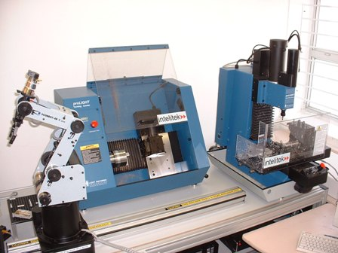
Flexible Manufacturing System

Slide 2
What is FMS?
A flexible manufacturing system (FMS) is a manufacturing system in which there is some amount of flexibility that allows the system to react in case of changes, whether predicted or unpredicted.

Slide 3
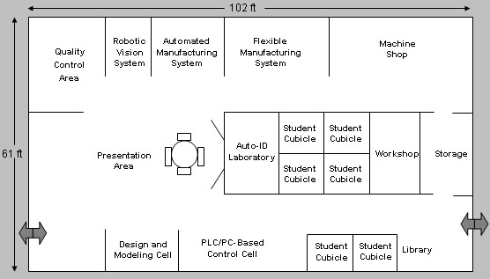
Overview

Slide 4
FMS Main Components
Robots
Computer-controlled Machines & Numerical controlled machines (CNC)
Instrumentation devices
Computers
Sensors
Inspection machines.

Slide 5
Three Manufacturing Flexibilities
Basic flexibilities
System flexibilities
Aggregate flexibilities

Slide 6
Basic Flexibilities
Machine flexibility - the ease with which a machine can process various operations
Material handling flexibility - a measure of the ease with which different part types can be transported and properly positioned at the various machine tools in a system
Operation flexibility - a measure of the ease with which alternative operation sequences can be used for processing a part type

Slide 7
System Flexibilities
Volume flexibility - a measure of a system’s capability to be operated profitably at different volumes of the existing part types
Expansion flexibility - the ability to build a system and expand it incrementally
Routing flexibility - a measure of the alternative paths that a part can effectively follow through a system for a given process plan
Process flexibility - a measure of the volume of the set of part types that a system can produce without incurring any setup
Product flexibility - the volume of the set of part types that can be manufactured in a system with minor setup

Slide 8
Aggregate Flexibilities
Program flexibility - the ability of a system to run for reasonably long periods without external intervention
Production flexibility - the volume of the set of part types that a system can produce without major investment in capital equipment
Market flexibility - the ability of a system to efficiently adapt to changing market conditions

Slide 9
Advantages
Reduced manufacturing times
Lower cost per unit produced
Greater labor productivity
Greater machine efficiency
Improved quality
Increased system reliability
Reduced parts inventories
Adaptability to CAD/CAM operations

Slide 10
Disadvantages
Cost to implement
Substantial pre-planning
Requirement of skilled labor

Slide 11
Thank You!!!
www.playppt.com

