Slide 1
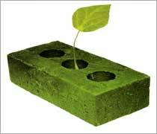
GREEN CONCRETE

Slide 2
What is Green Concrete?
A concrete that uses less energy in its production & produces less carbon dioxide than normal concrete is green concrete.
Green Concrete is taken to mean environment-friendly concrete.

Slide 3
Why Green Concrete?
The main ingredient in concrete is cement and it consists of Limestone (Calcium Carbonate CaCO3).
During manufacture of cement, its ingredients are heated to about 800 - 10000C.
During this process the Carbon Dioxide is driven off.
Approximately 1kg of cement releases about 900gms of Carbon Dioxide into the atmosphere.
Therefore, green concrete came into existence to reduce the emission of carbon dioxide.

Slide 4
Materials for Green Concrete
Locally available: Construction materials, components, and systems found locally or regionally, saving energy and resources in transportation to the project site.
Salvaged, re-furnished, or re-manufactured: Includes saving a material from disposal and renovating, repairing, restoring, or generally improving the appearance, performance, quality, functionality, or value of a product.
Reusable or recyclable: Select materials that can be easily dismantled and reused or recycled at the end of their useful life.

Slide 5
Materials for Green Concrete
Recycled Demolition Waste Aggregate
Recycled Concrete Aggregate
Blast furnace Slag
Manufactured Sand
Glass Aggregate
Fly ash

Slide 6
Mix Design
Optimizes void space between aggregates by optimizing particle proportions and packing of materials. This makes more effective use of the cement binder.
Aggregates replace excess cement paste to give improved stability, less shrinkage and increase in strength & durability.
Less cement also generates less heat of hydration.

Slide 7
Mix Design
The slump of the concrete and its flow are a function of the shape & the quantity of the predominant size of the aggregate in the mix.
Use of more fine aggregate gives higher slump & flow. So the optimum proportions of coarse & fine aggregate must be critically found to have the best and dense concrete in both fresh & hardened stage of concrete.

Slide 8
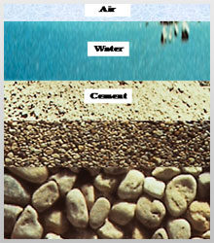
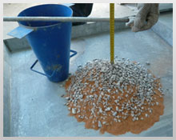
Mix Design

Slide 9
Improved Properties
Mix can result in a reduced paste volume within the concrete structure resulting in a higher level of protection against concrete deterioration.
Higher strength per kilogram of cement
Increased durability & lower permeability
More aggregates typically mean higher Modulus of elasticity.

Slide 10
Advantages
User-friendly
Optimized mix designs mean easier handling, better consistency and easier finishing
Reduction in shrinkage & creep
Green Concrete uses local and recycled materials in concrete.
The heat of hydration of green concrete is significantly lower than traditional concrete
This result in a lower temperature rise in large concrete pours which is a distinct advantage for green concrete.

Slide 11
Thank You!!!
www.playppt.com

