Slide 1


Plastic Recycling

Slide 2
Introduction
Plastic Recycling is a technique of recovering waste plastic and recycling it to a useful product.
Sometimes, the recycled plastics will be in different in form from their original stage.
For example: the plastic bottles could be recycled to make plastic chairs and tables.

Slide 3
Machines Used
Three machines are used for the plastic recycling process. They are:
  Extruder.
  Plastic Grinder Machine.
  Plastic Cutting Machine.

Slide 4
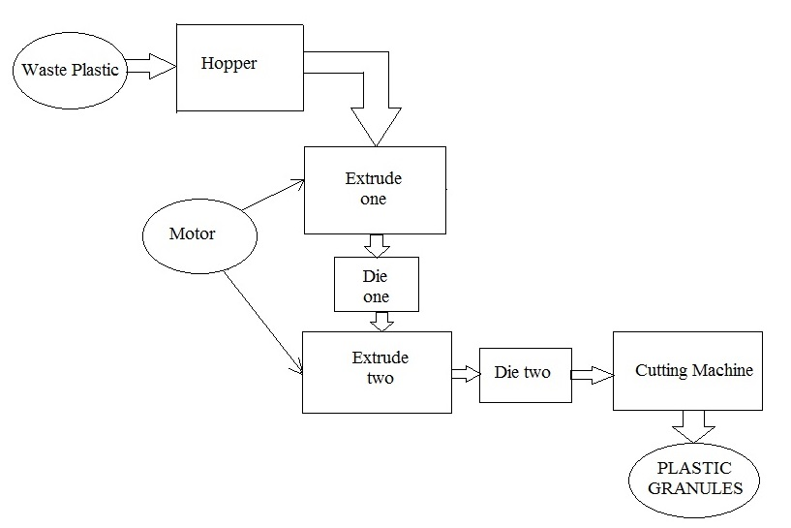
Overview

Slide 5
Working Process
The plastic recycling process has large extruder & small extruder with a die, a cutting machine, hopper and a motor.
The melting of Low Density Polyethene (LDPE), Polypropylene (PP), and High Density Polyethene (HDPE) is the important operation in this process.
A long horizontal bed along with six heaters and a die are placed in the large extruder.
Similarly, the small extruder has incorporated four heaters and a die.

Slide 6
Working Process
The placing of plastic wastes on the hopper starts the process.
It is sent to the large extruder and die for making the wastes into liquid.
Consequently, the processed output from the first operation is sent into the hopper for processing it in the small extruder and die.
The wastes from the last process are placed into a plastic grinder for producing discrete elements.
These elements are then placed into the first extruder and passes twin extruder screw for providing finite plastic discrete elements.

Slide 7
Working Process
Then, it is melted with the help of high temperature.
It will now pass the two dies and comes out in a liquid form.
It is now stored collectively for future processes.

Slide 8
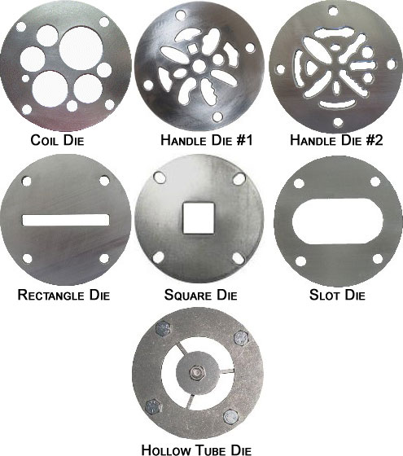
Extruder - Die
Dies are often used in extruder for producing different types of plastic shapes at the exit.
It will be a great work, if it is incorporated in the cutter machine.

Slide 9
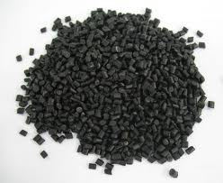
Plastic Granules

Slide 10
Output
The output of the plastic recycling process is the plastic granules.
This output is achieved by finishing the Plastic Cutting process.
These plastic granules are used for producing polythene cover.
Another major use of this output is producing mobile panels.

Slide 11
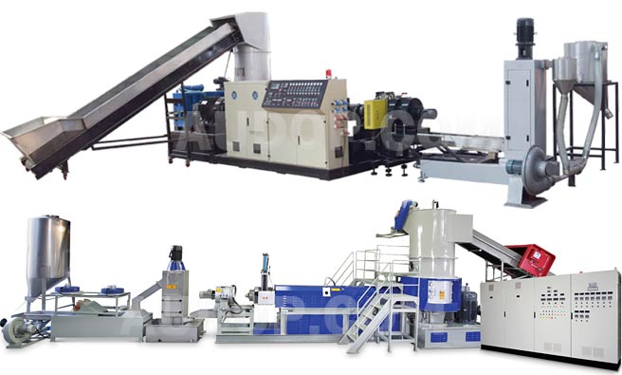
Plastic Recycling Machine

Slide 12
Thank You!!!
www.playppt.com

