Slide 1

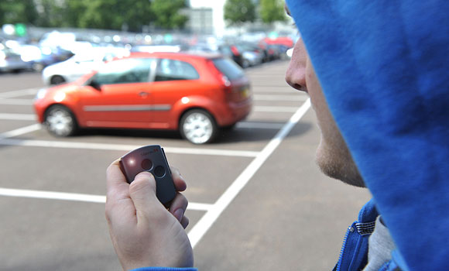
Power Door Locks

Slide 2
Intro
Power door locks (also known as electric door locks or central locking) allow the driver or front passenger to simultaneously lock or unlock all the doors of an automobile or truck, by pressing a button or flipping a switch.

Slide 3
History
Power door locks were introduced on the luxury Scripps-Booth in 1914, but were not common on luxury cars until Packard reintroduced them in 1956.
Nearly every car model today offers this feature as at least optional equipment.

Slide 4
Overview
Early systems locked and unlocked only the car doors.
Many cars today also feature systems which can unlock such things as the luggage compartment or fuel filler cap door.
It is also common on modern cars for the locks to activate automatically when the car is put into gear or reaches a certain speed.
Automatic unlocking when the car is parked is usually also featured on such systems.

Slide 5
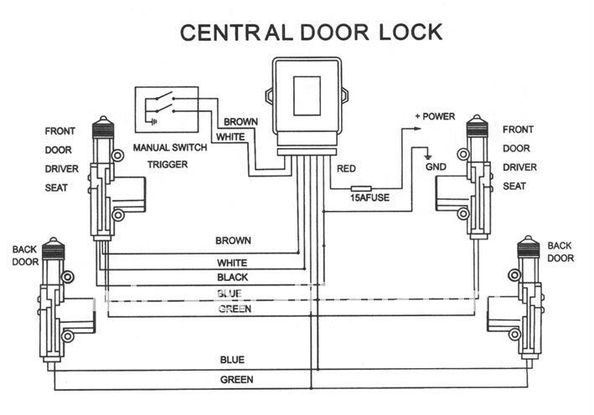
Overview

Slide 6
Body Controller
In the case of power door locks, the body controller monitors all of the possible sources of an "unlock" or "lock" signal.
It monitors a door-mounted touchpad and unlocks the doors when the correct code is entered.
It monitors a radio frequency and unlocks the doors when it receives the correct digital code from the radio transmitter in your key fob, and also monitors the switches inside the car.
When it receives a signal from any of these sources, it provides power to the actuator that unlocks or locks the doors.

Slide 7
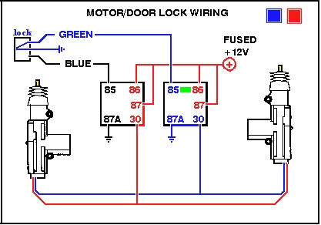
Lock

Slide 8
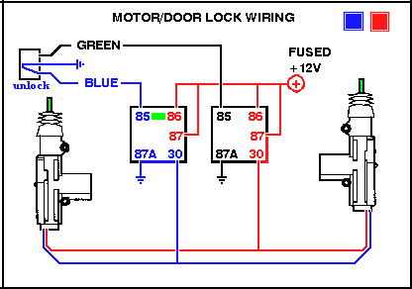
Unlock

Slide 9
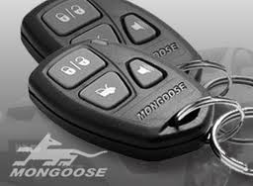
Remote Control
Pressing a button on the key unlocks all of the car doors.
Another button locks the car.
Today, many cars with power door locks also have a radio frequency remote keyless system, which allows a person to press a button on a remote control key fob.

Slide 10
Horn Signal
This system confirms successful (un)locking through either a light or a horn signal, and usually offers an option to switch easily between these two variants.
Both provide almost the same functionality, though light signals are more discreet while horn signals might create a nuisance in residential neighborhoods and other busy parking areas (e.g. short-term parking lots).
Some manufacturers offer the ability to adjust the horn signal volume.

Slide 11
Thank You!!!
www.playppt.com

