Slide 1
Radio frequency module

Slide 2
Introduction
An RF module is a small electronic circuit used to transmit and receive radio signals.
As the name suggests, RF module operates with the help of Radio Frequency.
The corresponding frequency range varies between 30 kHz & 300 GHz.

Slide 3
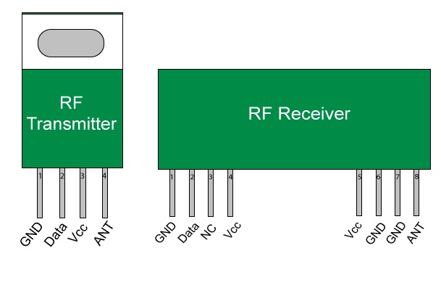
Main Components
RF Transmitter
RF Receiver
HT12E IC
HT12D IC

Slide 4
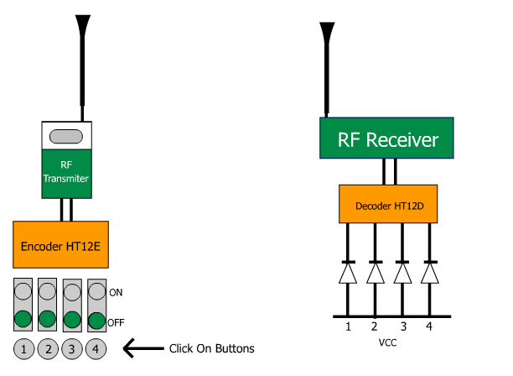
Overview

Slide 5
HT12E IC – The Encoder
HT12E is an encoder integrated circuit of 2¹² series of encoders.
It converts the parallel inputs into serial output.
It encodes the 12 bit parallel data into serial for transmission through an RF transmitter.
These 12 bits are divided into 8 address bits and 4 data bits.

Slide 6
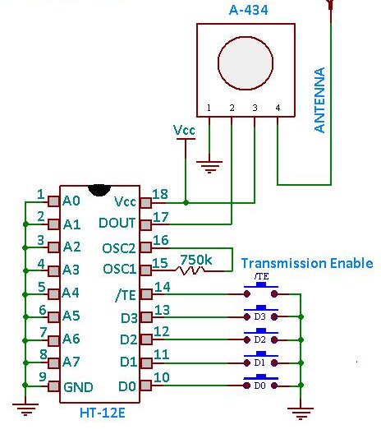
Pin out Diagram

Slide 7
HT12D IC – The Decoder
HT12D IC is a decoder integrated circuit that belongs to 2¹² series of decoders.
It converts the serial input into parallel outputs.
The serial input data is compared with the local addresses three times continuously.
The input data code is decoded when no error or unmatched codes are found.

Slide 8
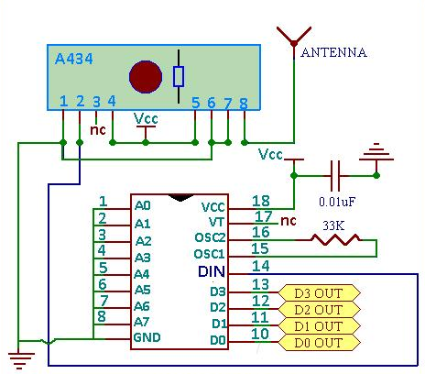
Pin out Diagram

Slide 9
How it works?
The RF transmitter/receiver pair operates at a frequency of 434 MHz.
An RF transmitter receives serial data and transmits it wirelessly through RF connected at pin 4.
The transmission occurs at the rate of 1 Kbps – 10 Kbps.
The transmitted data is received by an RF receiver operating at the same frequency as that of the transmitter.

Slide 10
Important Applications
Remote control
Wireless data transmissions
Wireless home security systems
Digital video / audio transmissions
Biological signal acquisition

Slide 11
Thank You!!!
www.playppt.com

