Slide 1
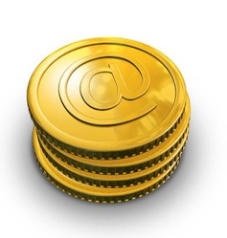
Electronic Money

Slide 2
What is Electronic Money?
Scrip or money that is exchanged only through electronically is referred to as electronic money.
Electronic Money is also referred as e - money, Electronic Cash, Digital Money, Electronic Currency, Digital Currency, e - currency, Digital Cash, and Cyber Currency.
Electronic Money uses Internet, Digital Stored Value systems, and Computer Networks.

Slide 3
Examples
Direct Deposit
EFT (Electronic Funds Transfer)
Virtual Currency
Digital Gold Currency.

Slide 4
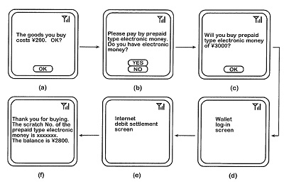
How it works?

Slide 5
Systems
Centralized Systems
Decentralized Systems
Offline Anonymous Systems

Slide 6
Centralized Systems
There are many centralized systems that directly sell their e-currency to end users is WebMoney, PayPal, Hub Culture Ven, and CashU but Liberty Reserve sells only via 3rd party digital currency exchangers.

Slide 7
Decentralized Systems
Electronic Money includes some decentralized systems. They are:
Bitcoin: It is a Peer to Peer Electronic Money system with maximized inflation limit.
Ripple Monetary System: This system is developed to distribute electronic money system independent to local currency.

Slide 8
Offline Anonymous Systems
Offline Anonymous System can be done ‘offline’.
In this electronic money system, the merchants do not need to have interaction with banks before receiving currency from the users.
Instead of that, the merchants can collect spent money by users and deposits the money later to the bank.
The merchant can deliver his storage media in bank for exchanging the electronic money to cash.

Slide 9
Types of eMoney
Hard Electronic Currency
Soft Electronic Currency

Slide 10
Hard Electronic Currency
Hard Electronic Currency does not allow reversing charges i.e. it supports only Non - Reversible transaction.
The advantage of this type is that it reduces the operating cost of e - currency system.

Slide 11
Soft Electronic Currency
Soft Electronic Currency allows payment reversals.
The payment is reversed only in case of dispute or fraud.
The payment reversible time will be 72 hrs or even more.
Some examples of this type are Credit Card and PayPal.

Slide 12
Conclusion
Electronic Money systems are developing day by day.
Some of the developments are: it can be used with Secured Credit Cards for wide range facilities and the bank accounts that are linked can be used with an internet to exchange currency with Secure Micropayment system like PayPal.

Slide 13
Thank You!!!
www.playppt.com

