Slide 1
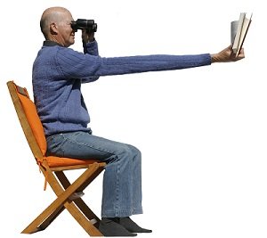
Presbyopia

Slide 2
What is Presbyopia?
Presbyopia is the gradual loss of your eyes ability to focus actively on nearby objects.
It is a natural, often annoying part of aging that usually becomes noticeable in early to mid 40’s.
It may get worsen until the age around 65.

Slide 3
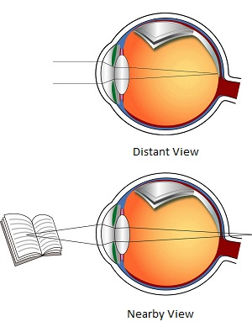
Overview

Slide 4
Symptoms
A tendency to hold reading material farther away to make the letters clearer
Blurred vision at normal reading distance
Eyestrain or headaches after reading or doing close work

Slide 5
How Normal Eye reacts?
The lens is flexible and has the capability to change shape with the help of circular muscle.
When a distant image is viewed, the circular muscle relaxes.
When a nearby image is viewed, the muscle constricts.
This allow the lens to curve more steeply and change its focusing power.

Slide 6
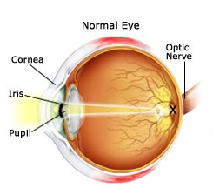
Normal Eye

Slide 7
How Presbyopia Eye reacts?
The main cause of Presbyopia is the hardening of eye lenses.
During Presbyopia, lens become less flexible.
So it can’t change the shape to focus on close-up images.
Overall, the close-up images goes out of focus.

Slide 8
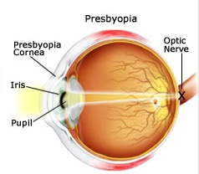
Presbyopia Eye

Slide 9
Risk Factors
Age of 40 is the major risk factor for Presbyopia.
Diseases like diabetes, cardiovascular diseases, multiple sclerosis can increase the risk of Presbyopia.
Usage of nonprescription drugs can decrease the focusing ability of eyes.

Slide 10
Treatment method
A best way to diagnose presbyopia is fixing an appointment with the eye doctor.
A thorough eye examination can fix this problem.
Wearing of bifocal glasses can correct the effects of presbyopia.

Slide 11
Conclusion
Presbyopia is a curable disease.
Having regular eye check-up, eating healthy foods, prevention of eye injuries, protection of eyes from sun are some of the remedies to keep your eyes safe from presbyopia.

Slide 12
Thank You!!!
www.playppt.com

