Slide 1
Thematic Appreciation Test

Slide 2
Definition
Thematic Apperception Test (TAT) is a projective personality test in which a person's patterns of thought, attitudes, observational capacity, and emotional responses are evaluated on the basis of responses to ambiguous test materials.

Slide 3
History
Founded by Christiana D. Morgan and Henry A. Murray
Designed at Harvard University
In the year 1930s

Slide 4
Why TAT?
The original purpose of the TAT was to reveal the underlying dynamics of the subject's personality, such as internal conflicts, dominant drives and interests, motives, etc.
The specific motives that the TAT assesses include the need for achievement, need for power, the need for intimacy, and problem-solving abilities.

Slide 5
For what it is used?
Used to research certain topics in psychology, such as
dreams and fantasies,
mate selection,
the factors that motivate people's choice of occupations, and similar subjects.
It is sometimes used in psychiatric evaluations to assess disordered thinking and in forensic examinations to evaluate crime suspects, even though it is not a diagnostic test.

Slide 6
Description
The TAT consists of 31 pictures that depict a variety of social and interpersonal situations.
The subject is asked to tell a story about each picture to the examiner.
Of the 31 pictures, 10 are gender-specific while 21 others can be used with adults of either sex and with children.

Slide 7
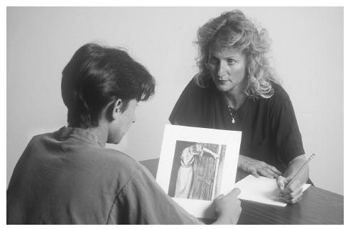
Example

Slide 8
Preparation
There is no specific preparation necessary before taking the TAT, although most examiners prefer to schedule sessions (if there is more than one) over two days.

Slide 9
Risks
The chief risks involved in taking the TAT are a bad "fit" between the examiner and the test subject, and misuse of the results.

Slide 10
Results
Since the TAT is used primarily for personality assessment rather than diagnosis of mental disorders, it does not yield a "score" in the usual sense.

Slide 11
Thank You!!!
www.playppt.com

