Slide 1
Thyroid Cancer

Slide 2
Introduction
Thyroid cancer is formed when unusual cells are grown in the thyroid gland.
It has a shape of butterfly and it is found in the front of the neck.
The thyroid hormones are produced by thyroid glands during normal regulation of body metabolism.

Slide 3
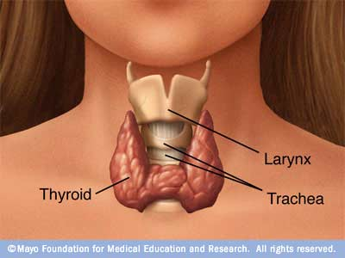
Overview

Slide 4
Symptoms
A nodule or lump developing in front neck region.
Difficult to speak in normal voice.
Develop swollen lymph nodes.
Create pain in neck or throat.
Difficult to breathe and swallow.

Slide 5
Types
Follicular thyroid cancer.
Papillary thyroid cancer.
Medullary thyroid cancer.
Thyroid lymphoma.
Anaplastic thyroid cancer.

Slide 6
Causes
The accurate causes of thyroid cancer are unknown.
Some doctors use to explain the causes of thyroid cancer to the patients.
However there are some risk factors in which thyroid cancer can be identified.

Slide 7
Causes
Papillary or follicular thyroid cancer are formed to the peoples those are affected to high level of radiation.
Medullary thyroid cancer are formed to the peoples by a change in RET gene. This gene can pass from parent to child.
Mostly thyroid cancer affects peoples above 40 years of age.
If there is less iodine in the diet, it may be the major risk factor for causing thyroid cancer.

Slide 8
Treatment Methods
Surgery
Total Thyroidectomy
Lobectomy
Hormone Treatment
Radioactive Iodine Therapy
Chemotherapy
External Radiation Therapy

Slide 9
Recap
The causes of thyroid cancer are not known.
But many risk factors are identified.
Some of the most common thyroid cancer symptoms are nodule or lump which is felt in neck region.
A thyroid lump can be found as cancer through surgery or needle in thyroid tissues.
The most common way for thyroid cancer treatment is surgery.

Slide 10
Thank You!!!
www.playppt.com

