Slide 1
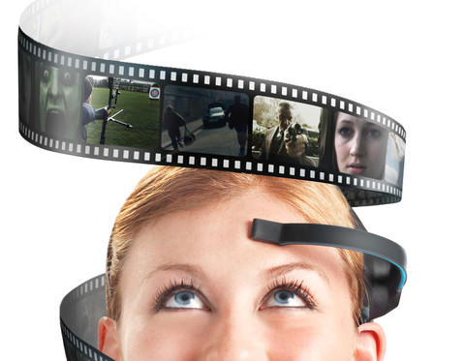
NeuroSky Technology

Slide 2
Introduction
NeuroSky is a Silicon Valley company located at California
Produces innovative biosensors in hundreds of wearable products for body and mind health.
These solutions capture, quantify and reveal unique health and wellness insights
Peoples can monitor and improve the performance of body and mind.

Slide 3
About NeuroSky Inc.
1999 - The work for NeuroSky technology was began
2004 - NeuroSky Inc. was incorporated in San Jose, California.
2009 - MindSet, Multimedia headset and free SDK/developer tools were launched.
2011 - MindWave was launched.
2014 - World’s most advanced ECG biosensor will be built for monitoring the heart performance.

Slide 4
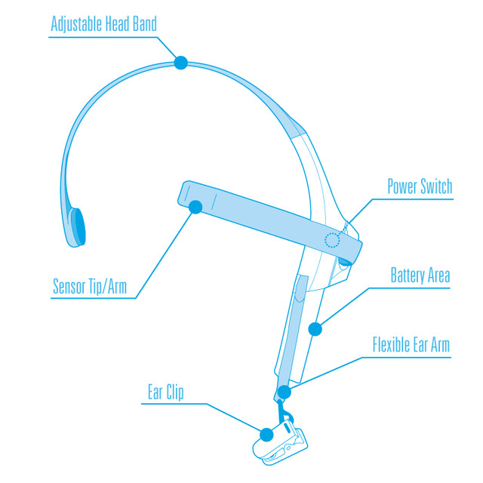
Overview

Slide 5
Brain
The human brain is made up of billions of interconnected neurons
The patterns of interaction between these neurons are represented as thoughts and emotional states.
Every interaction between neurons creates a minuscule electrical discharge; alone these charges are impossible to measure from outside the skull.
However, the activity created by hundreds of thousands concurrent discharges aggregates into waves which can be measured.

Slide 6
How it works?
All electrical activities produces waves characterized by different amplitude and frequencies.
Thus it creates some level of ambient noise.
This “noise” interferes with the waves coming from the brain.
This is why most EEG devices will pick up readings even if they are not on a person’s head.

Slide 7
How it works?
Most people don’t have rooms in their house devoid of electronic devices nor do they want to apply a conductive liquid to their head every time they use a BCI device.
NeuroSky has developed complex algorithms built into their products which filter out this “noise”.
NeuroSky’s white paper claims the ThinkGear technology has been tested at 96% as accurate as that within research grade EEGs.

Slide 8
NeuroSky Products
MindWave
Research Products
Mind Kit & Mind Set
Non-Contact Sensors
Pre MindKit

Slide 9
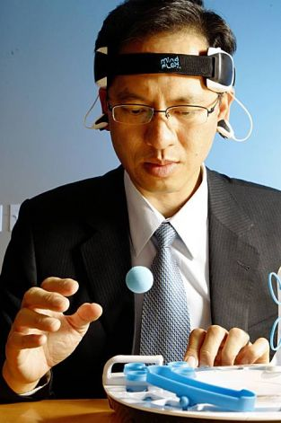
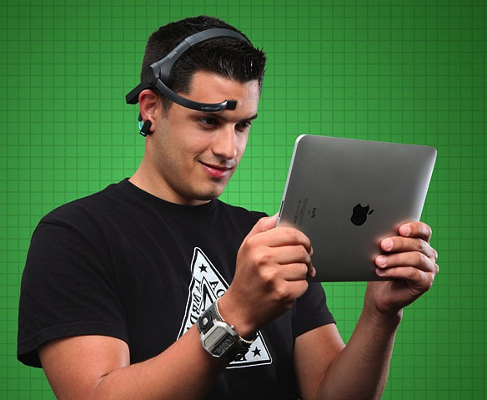
Product Pics

Slide 10
Partners of NeuroSky
US Archery Team
Toshiba
Square Enix
InteraXon
Uncle Milton Industries
Mattle Inc
Sega Toys
Musinaut
Mind Games
Universities and Research Institutions

Slide 11
Products developed by Partners
Mindflex – It was developed in conjunction with Mattel. It is a game in which players lift a ball by concentrating and move it through a maze.
Star Wars Force Trainer – It was developed in conjunction with Uncle Milton Inc. It is a game in which players life a ball by concentrating to learn how to control the Force in the first Star Wars.

Slide 12
Thank You!!!
www.playppt.com

