Slide 1
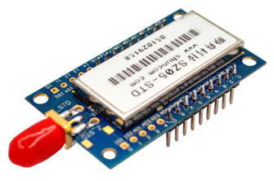
ZigBee

Slide 2
What is ZigBee?
ZigBee is a specification for a suite of high level communication protocols used to create personal area networks built from small, low-power digital radios.
It is a low power spin off of Wi-Fi.
It’s specification is based on IEEE 802.15.4 – 2003 Wireless Personal Area Networks Standard.

Slide 3
Why ZigBee?
Can be used almost anywhere
Easy to implement
Little power to operate
Long battery life
Low cost

Slide 4
History
1998 - ZigBee was conceived
2003 – Standardized
2004 – Specifications ratified
2005 – ZigBee 2004 announced for availability
2006 – Revised
2007 – ZigBee Pro was introduced

Slide 5
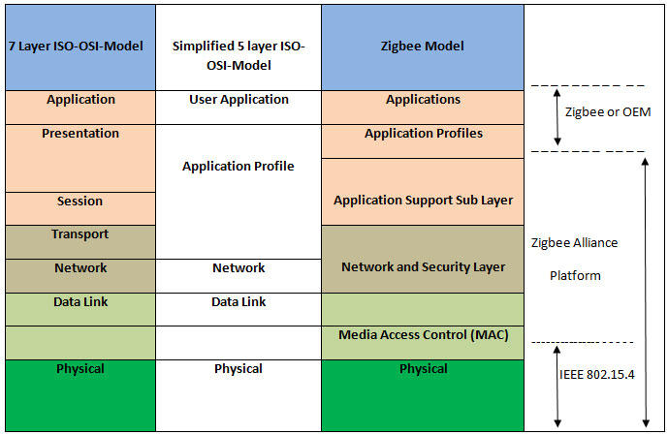
Architectural Overview

Slide 6
Types
ZigBee Coordinator (ZC)
ZigBee Router (ZR)
ZigBee End Device (ZED)

Slide 7
ZigBee Networks
ZigBee devices can form networks with Mesh, Star and Generic Mesh topologies among themselves.
The network can be expanded as a cluster of smaller networks.

Slide 8
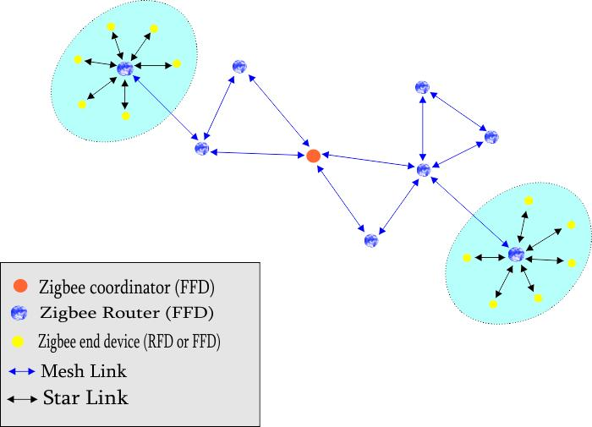
ZigBee Networks

Slide 9
Simulation
Network simulators, like NS2, OPNET, and NetSim can be used to simulate IEEE 802.15.4 ZigBee networks.
These simulators come with open source C or C++ libraries for users to modify.

Slide 10
Released Specifications
ZigBee Home Automation 1.2
ZigBee Smart Energy 1.1b
ZigBee Telecommunication Services 1.0
ZigBee Health Care 1.0
ZigBee RF4CE – Remote Control 1.0
ZigBee RF4CE – Input Device 1.0
ZigBee Light Link 1.0
ZigBee IP 1.0
ZigBee Building Automation 1.0
ZigBee Gateway 1.0
ZigBee Green Power 1.0

Slide 11
Specifications in Development Phase
ZigBee Smart Energy 2.0
ZigBee Retail Services
ZigBee Smart Energy 1.2/1.3
ZigBee Light Link 1.1
ZigBee Home Automation 1.3

Slide 12
Security
ZigBee provides facilities for carrying out secure communications, protecting establishment and transport of cryptographic keys, cyphering frames and controlling devices.
It builds on the basic security framework defined in IEEE 802.15.4.
ZigBee uses 128-bit keys to implement its security mechanisms.

Slide 13
Applications
Wireless Sensor Networks
Embedded Sensing
Home Entertainment and Control
Smoke and intruder warning
Industrial control
Building Automation

Slide 14
Thank You!!!
www.playppt.com

