Slide 1
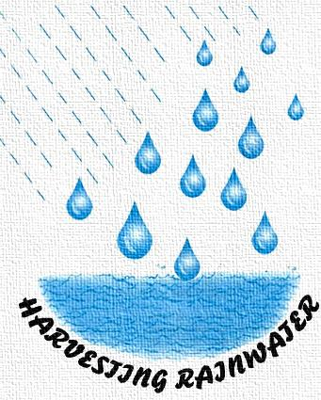
Rainwater Harvesting

Slide 2
Introduction
Rainwater Harvesting is a technology used for collecting and storing rainwater from rooftops, the land surface or rock catchments.
This technique usually found in Asia and Africa arise from practices employed by ancient civilizations.

Slide 3
History
During 3rd century BC, the farming communities in Pakistan, Afghanistan, Iran, and India used rainwater harvesting for irrigation.
In ancient Tamil Nadu, Chola Kings were using this system.
Madhya Pradesh, Maharashtra and Chhattisgarh were other states who were using this system for longer years.

Slide 4
Why rainwater harvesting?
Rainwater harvesting is essential because:
Surface water is inadequate to meet our demand and we have to depend on ground water.
Due to rapid urbanization, infiltration of rain water into the sub-soil has decreased drastically and recharging of ground water has diminished.

Slide 5
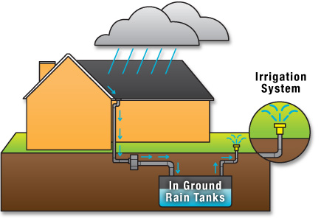
Overview

Slide 6
Two Techniques
Rainwater Storage for future use
Ponds
Dams
Tanks
Recharging of ground water
Pits
Dug Wells
Recharge Shafts
Hand Pumps
Trenches

Slide 7
Recharge methods in Urban areas
Rooftop collection
Roadtop collection
Pits, Trenches, Wells, and Shafts
Water Spreading
Surface water bodies

Slide 8
Countries
At present, the following countries uses rainwater harvesting:
India
Sri Lanka
United Kingdom
Israel
China
Brazil
U.S. Virgin Islands
Ireland

Slide 9
Advantages
Use of natural resources
Reduces flooding, storm water, and erosion
Excellent source of water for landscape irrigation with no chemicals
Simple to install
Promotes both water and energy conservation

Slide 10
Thank You!!!
www.playppt.com

