Slide 1

ROBOTICS

Slide 2
Introduction
The term Robotics deals with the mixture of electronics, machine design, and computer programming.
In brief, “Robotics” is the study of robot designs and applications.
A Robot is a machine which can do a work by itself without any human assistance.

Slide 3
History
1817 – Talk of Robotics started in Science-Fiction Stories
1920 – The origin of word ‘Robot’ was stated in Czech drama by Karel Capek
1942 – Isaac Asimov gave three laws for Robotics
1961 – First Robotics company ‘UNIMATE’ was established
1978 – First Industrial Robot ‘PUMA’ was developed

Slide 4
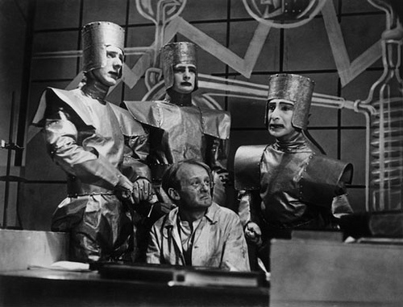
Robot in Karel Capek’s Drama

Slide 5
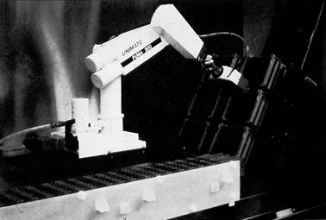
PUMA Robot

Slide 6
Three Laws of Robotics
1st law:
A robot may not injure a human being or through inaction, allow a human being to come to harm.
2nd law:
A robot must obey orders given it by human beings except where such orders would conflicts with the First Law
3rd law:
A robot must protect its own existence as long as such protection does not conflict with the First or Second Law.

Slide 7
Why Robot?
Repetitive tasks
Dangerous tasks
Daily tasks
In places where man power is difficult to obtain
  Example - Ship building

Slide 8
Key Applications
Machine Loading and Unloading
Material Handling
Processing
Assembly & Inspection
Search & Rescue
Surveillance

Slide 9
Types of Robots
Walking Robot
Entertainment Robot
Armed Robot
Wheeled Robot
Tracked
Contest Robot

Slide 10
Robot Design
Physical Design
Design software
Tools and Equipment
Electronic Components
Mechanical Components
Building materials
Basic Programming

Slide 11
Important Robot Components
Actuation Devices
  Motors
  Stepper Motors
  Shape Memory Alloys
  Air muscle
  Linear Electromagnetic
  Piezoelectric Actuators
  Pneumatics/Hydraulics
  Miniature internal combustion engines
Power Sources
Grippers
Audio
Video

Slide 12
Sensors
Sensors that a robot uses generally fall into three different categories:
  Environment Sensors
    Thermal Sensors
    Pressure Sensors
    Ranging Sensors
    Touch Sensors
  Feedback Sensors
  Communication Sensors

Slide 13
Interface
Microcontrollers
Remote Control
Personal Computer
Single Board Computer
Networks

Slide 14
Factors for selecting a Robot
Type of job
Configuration
Number of axes
Drive system
Programming method
Control system

Slide 15
Top Notch Robots in the World
Honda’s ASIMO
Boston Dynamic’s BigDog
NASA’s Robonaut
Sony’s Aibo
iRobot’s Roomba

Slide 16
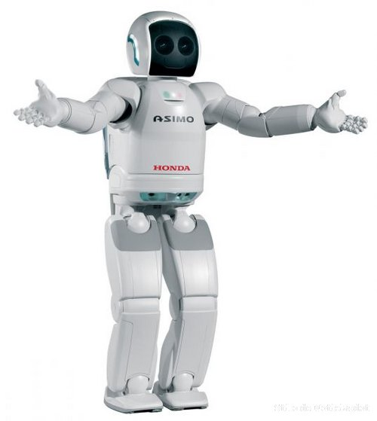
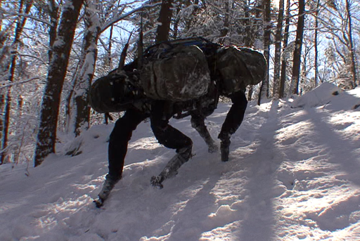
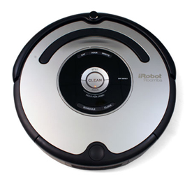
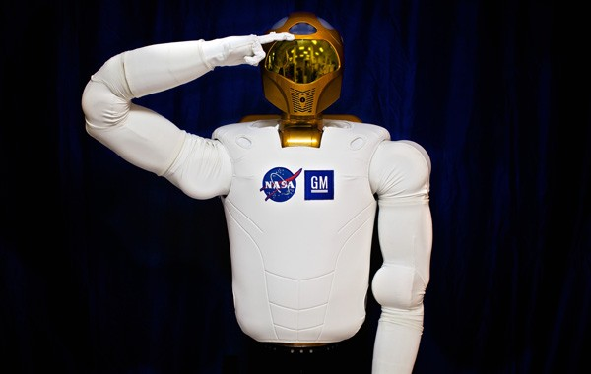
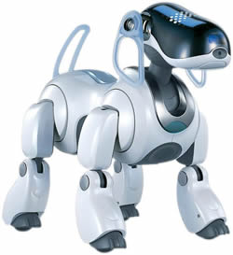
Look @ Top Robots

Slide 17
Conclusion
The introduction of robots in the various fields has turned the world to a modern era.
The main reason for this achievement is that the works performed by a robot are always highly accurate, reliable, and inexpensive.
The robots with artificial intelligence are under research, and it will further maximize the power of robots.

Slide 18
Thank You!!!
www.playppt.com

