Slide 1
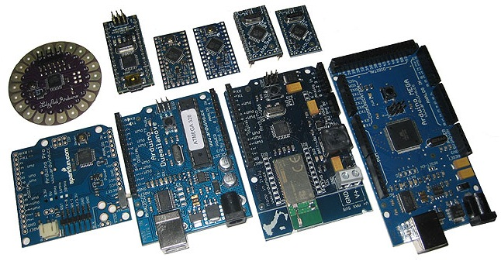
ARDUINO EXPLAINED

Slide 2
What is Arduino?
The Arduino is frankly anything that can be considered fun while learning is a truly revolutionary device in our opinion.
Technically, the Arduino is a programmable logic controller, which is an open-source electronics prototyping platform.
It’s like a little computer you can program to do things, and it interacts with the world through electronic sensors, lights, and motors.
In essence, it makes some truly hardcore electronics projects accessible to anyone – so artists and creative types can concentrate on making their ideas a reality.
It’s the ultimate tinkering tool

Slide 3
How Arduino Looks?

Slide 4
Why Arduino?
Cross-platform
Simple, Clear programming environment
Open source and extensible software
Open source and extensible hardware
Inexpensive

Slide 5
Types of Arduino
Arduino Uno
Arduino Leonardo
Arduino Due
Arduino Yun
Arduino Micro
Arduino Robot
Arduino Esplora
Arduino Mega ADK
Arduino Mega 2560
Arduino Ethernet
Arduino Mini
LilyPad Arduino USB
LilyPad Arduino SimpleSnap
LilyPad Arduino
Arduino Nano
Arduino Pro Mini
Arduino Pro
Arduino Fio

Slide 6
What can be done with this?
It consists of two parts; the hardware and the software, and with these you can build almost anything, from simple glowing light to complicated robots
Our home computers are great at communicating with other computers and (sometimes) with us, but they have no idea what is going on in the world around them.
Arduino, on the other hand, is made to be hooked up to sensors which feed it physical information. These can be as simple as pressing a button, or as complex as using ultrasound to detect distance.

Slide 7
Connectivity
As a piece of hardware, the Arduino can operate either independently (like in a robot), connected to a computer (thereby giving your computer access to sensor data from the outside world and providing feedback), or connected to other Arduino’s, or other electronic devices and controller chips.
Pretty much anything can be connected and is bounded only by your imagination, willingness to put some time and effort into learning something new, and the availability of components.
If you can think of it – the Arduino can do it.

Slide 8
Versatility
An official complete unit costs far less than other micro controller platforms, which makes these little electronic miracle babies accessible to hobbyists and electronic enthusiasts.
The programming language you upload with is incredibly simple, and should be familiar to C or similar languages.
Overall, it is a fantastic learning tool, with which you can experiment with electronics and learn the foundations.

Slide 9
Exploring Arduino
SOME OF THE PROJECTS THAT CAN BE DONE USING ARDUINO….

Slide 10
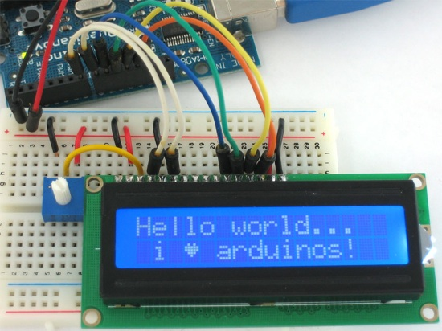
Hello Arduino

Slide 11
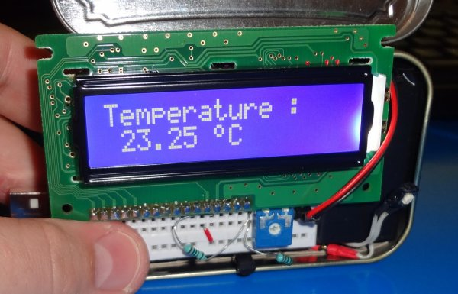
Checks Room Temperature

Slide 12
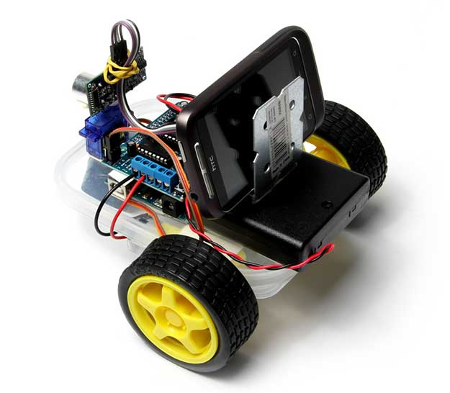
Mobile Controlled Robot

Slide 13
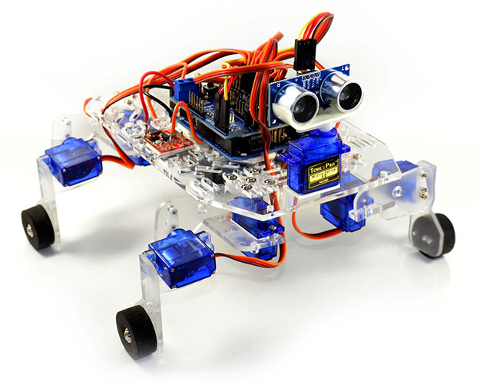
Walking Robot

Slide 14
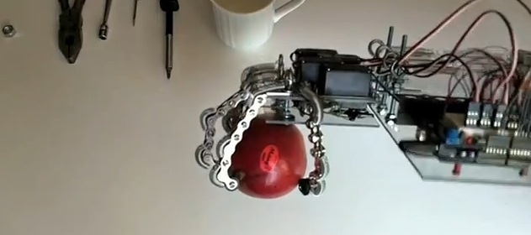
Pick & Place Robot

Slide 15
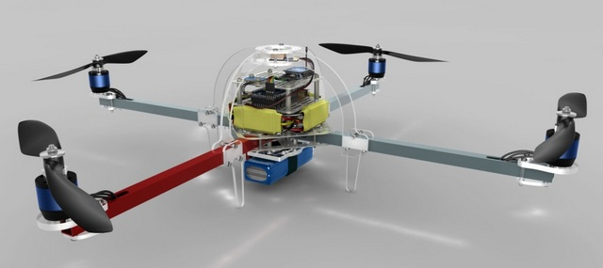
Flying Robot

Slide 16
AND LOTS MORE….
@
www.arduino.cc

Slide 17
THANK YOU!!!
www.playppt.com

