Slide 1
Business Directories Toronto

Slide 2
Business Directories Toronto
The Silk Road Business Directory was initiated to bring together people settled in Ontario, Canada, from the lands of the most ancient and successful trade route known in history called the "Silk Route". It truly represents great opportunities to build bridges and trust with consumers in one of the fastest growing markets in Canada. With over 1,000,000 people residing in Ontario from countries that include Western China, South Asia (India, Pakistan, Bangladesh), West Indians (Trinidad, Guyana), Central Asia, Middle East, Turkey, North Africa (Egypt to Morocco), Sub Saharan Africa (Sudan, Somalia to South Africa), Indonesia, Malaysia and Eastern Europe (Bosnia, Croatia, Kosovo,etc).The Silk Road Directory is the first of its kind with premium quality publishing and networks to link you with this rapidly growing market segment.

Slide 3
Why Us?
Unique: We are the first business directory to reach such a diverse base of ethnic communities on this scale. The communities range from the Caribbean, Africa, Middle East, South Asian, Central and East Asia.
Online Advertising: We will also list your business online for free as a special offer. Our growing 20,000+ email subscriber base will become your potential customers.
Distribution: We will distribute the Silk Road Directory at high traffic locations across GTA. See more details on our distribution insert.
Quality: We will print 50,000 premium quality, professionally designed full-color glossy directories for consumers to keep free of charge.
Reach: With an above average family size of 5 people per household our directories and online website will reach over 500,000 plus members of this community!

Slide 4
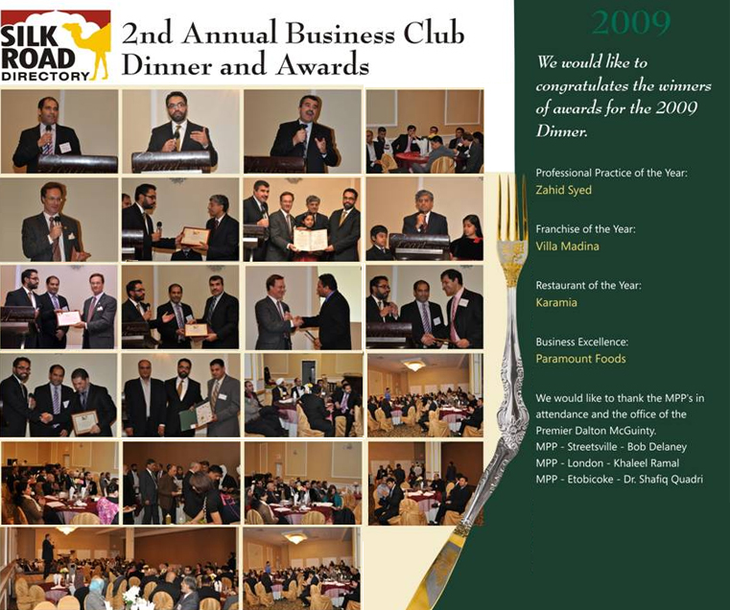
Business Club

Slide 5
For learn our services please visit-
http://www.silkroaddirectory.com

Slide 6
Thank You!!
http://www.playppt.com

