Slide 1
How to Use Content Marketing to Transform Your SEO
Tiffany Sands
Creative Media Manager
Adam de Jong
Marketing Manager

Slide 2
Agenda
Content in 2013 and Beyond
Your Content Goals for SEO
The Marketing Opportunity
Guide to Content Marketing
Action Plan

Slide 3
Content in 2013 and Beyond
SEO has changed forever
To generate top rankings and drive traffic for clients, you must generate great content
Content needs to be seen as a link and traffic acquisition strategy!
Notes:
To win in the SEO space you need great content
Google is ever evolving
All content should work together
I know we used to be able

Slide 4
Your Content Goals for SEO
Authority
Backlinks
Rankings
Traffic
Conversions
Notes:
How do you become an authority? How does this happen?

Slide 5
The Marketing Opportunity
Quality backlinks and organic promotion = top Google rankings that last
Makes you bulletproof to the next Google algorithm update!
Customers see you as the Industry Leader

Slide 6
Guide to Content Marketing

Slide 7
Content Strategies
Position yourself as the expert
Embrace your niche
Create a value exchange

Slide 8
Website Content
The most important content you have
Content themes around a bunch of topics (keywords)
Optimize existing content
Fresh, unique content built regularly
Notes:
This is the most important content
Your website is the most critical
Well structured
Built around keywords
Help with conversions
The face of your business
This is where you are going to create credibility
It’s an investment in your business

Slide 9
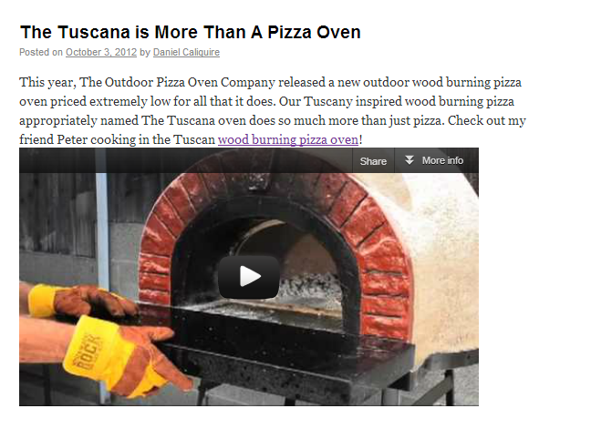
Blogging
Blogging is absolutely crucial to your SEO!
Blog at least twice/week
An extension of your content themes
Backlink to internal/product pages
Incorporate images and videos
Promote on social media
Notes:
Blogging on its own can boost rankings

Slide 10
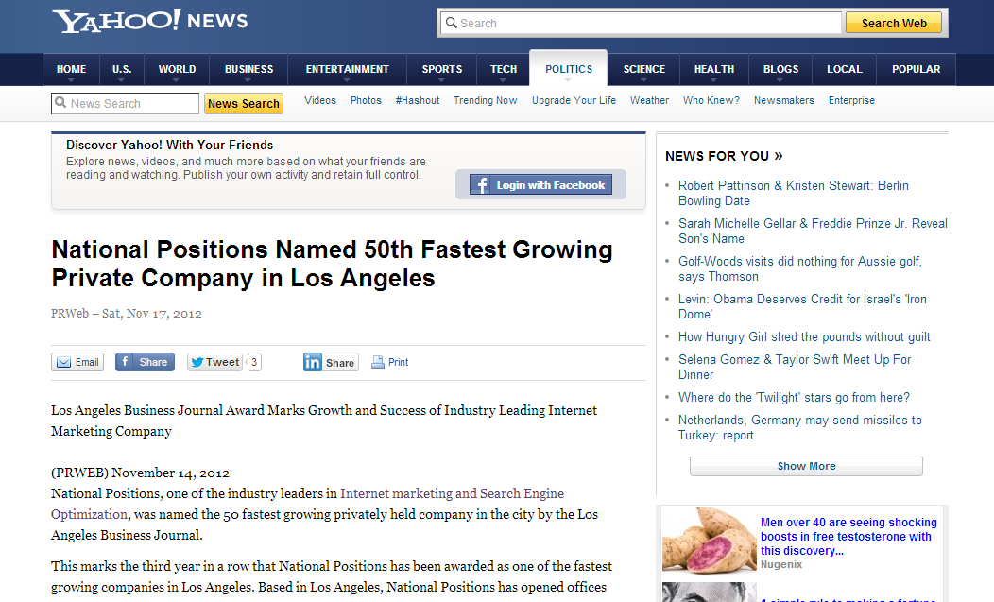
Press Release
Notes:
Pros and cons

Slide 11
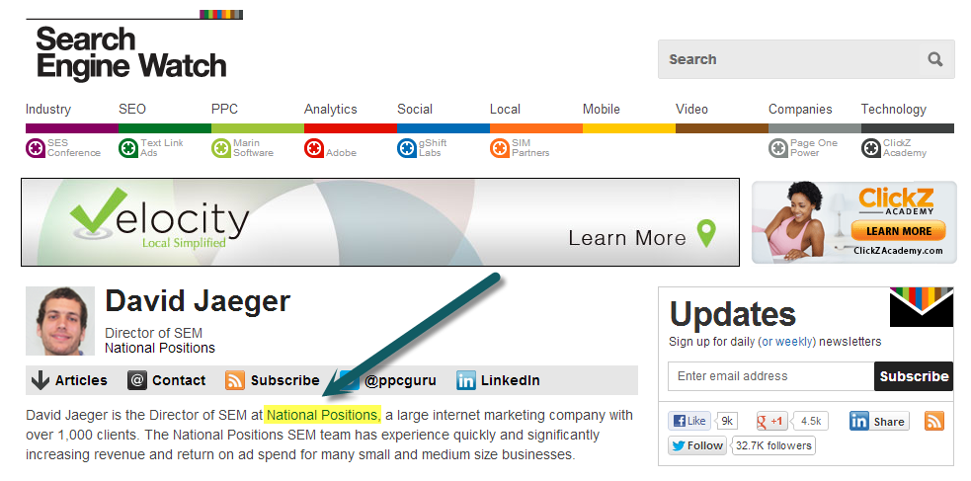
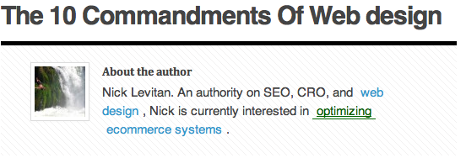
Guest Blogging
Notes:
The difference between onsite and guest blogging
What do we do? It’s like PR
We find the best bloggers and the one that fits your message
Get content posted on these sites
100% safe and powerful
Talk about the value exchange

Slide 12
Guest Blogging

Slide 13
Infographics
GPS tracking devices
Custom Infographic campaign:
“Why Teens Suck at Driving”
30+ quality backlinks including PR 7, PR 6 and P6 5 sites
Posted on National Geographic!

Slide 14
Infographics
Month 1
Research/Plan/Design
Month 2
Creation & Implementation
Month 2
Outreach, Promotion & Reporting

Slide 15
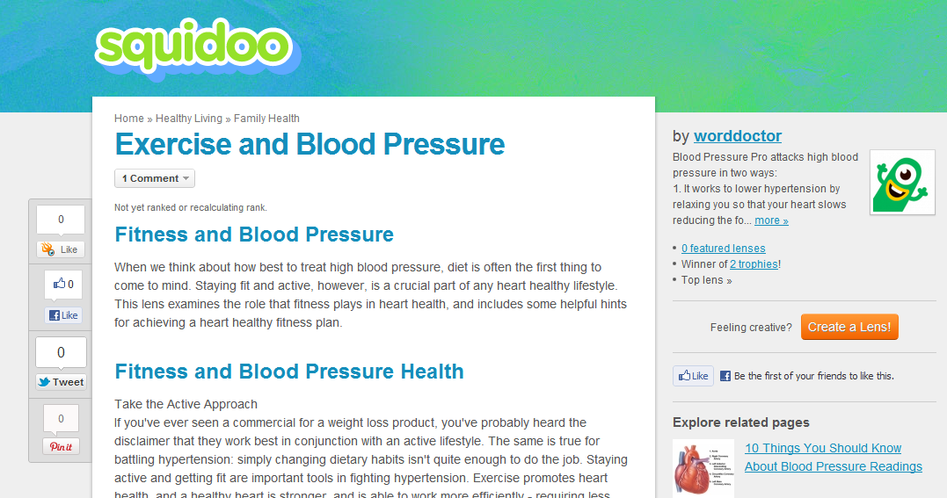
Squidoo
Notes:
A lot of you might do squidoo, infobarrel, posterous
Just want to say this is a great technique. Shows that you have depth. You need to swap this in and out.
Use these four sites interchangably, or multiple ones at the same time.
Talk about the future of this…where we see this going?
It’s becoming harder, it needs to informative. Can’t do it purely for marketing purposes.
Squidoo doesn’t allow spammy content because they want to keep a high PR so they can get a lot for advertising
Talk about pitch engine.
All of these could generate traffic in addition to backlinks.

Slide 16
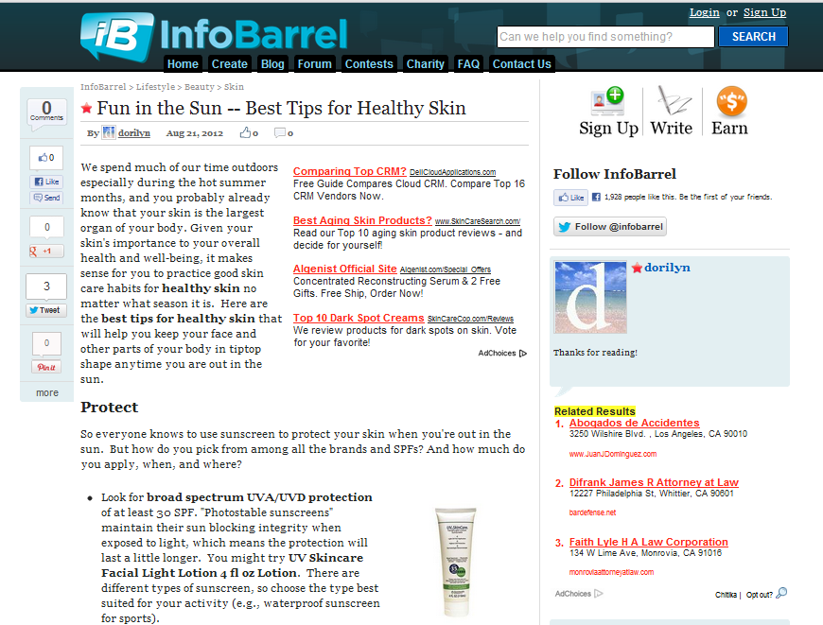
InfoBarrel
Notes:
A lot of you might do squidoo, infobarrel, posterous
Just want to say this is a great technique. Shows that you have depth. You need to swap this in and out.
Use these four sites interchangably, or multiple ones at the same time.
Talk about the future of this…where we see this going?
It’s becoming harder, it needs to informative. Can’t do it purely for marketing purposes.
Squidoo doesn’t allow spammy content because they want to keep a high PR so they can get a lot for advertising
Talk about pitch engine.
All of these could generate traffic in addition to backlinks.

Slide 17
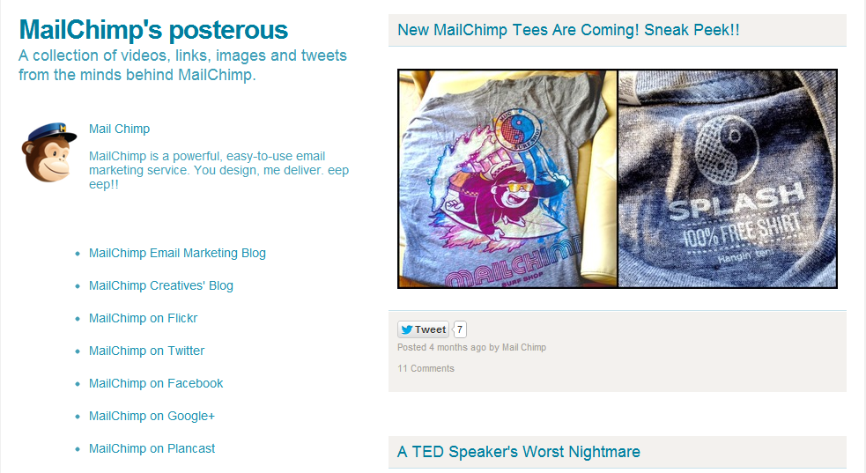
Posterous
Notes:
A lot of you might do squidoo, infobarrel, posterous
Just want to say this is a great technique. Shows that you have depth. You need to swap this in and out.
Use these four sites interchangably, or multiple ones at the same time.
Talk about the future of this…where we see this going?
It’s becoming harder, it needs to informative. Can’t do it purely for marketing purposes.
Squidoo doesn’t allow spammy content because they want to keep a high PR so they can get a lot for advertising
Talk about pitch engine.
All of these could generate traffic in addition to backlinks.

Slide 18
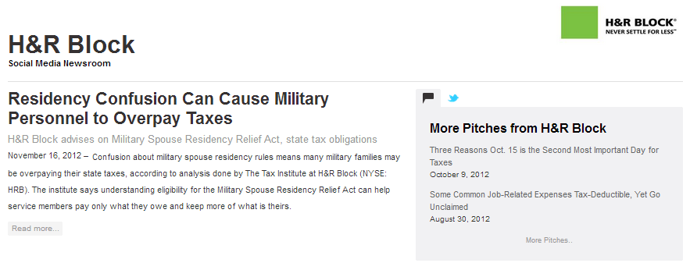
Pitch Engine

Slide 19
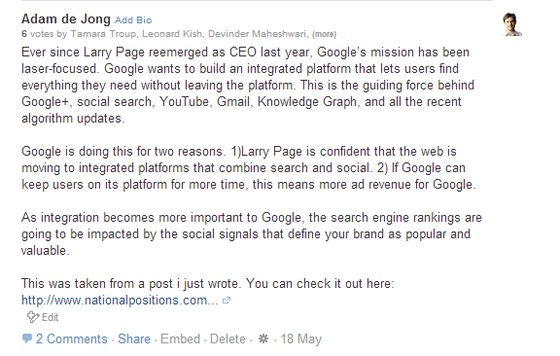
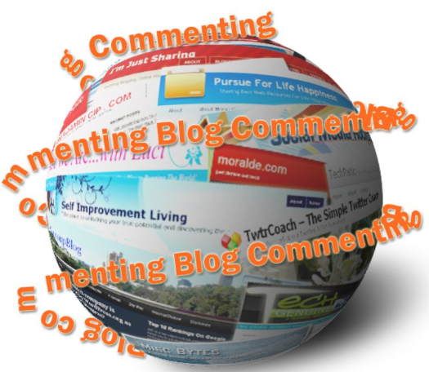
Blog Commenting
Notes:
Our commenters need to add value
there are two ways to comment. Many do it in a spammy way, and that’s not good.
Matt cutts always talks about organic value.
You want it to stick. Talk about the pros and cons.

Slide 20
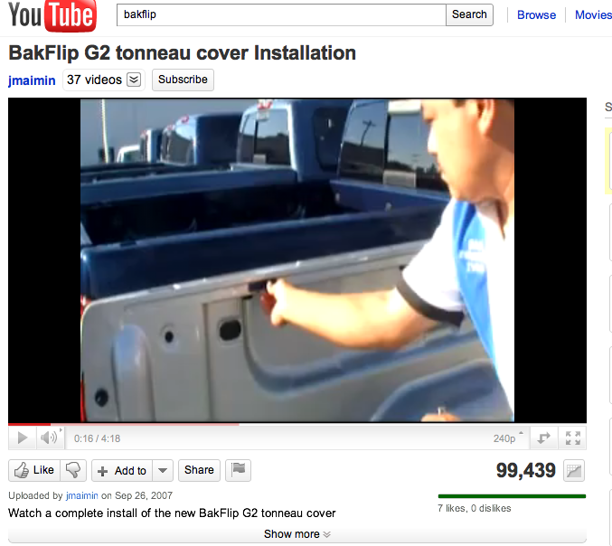
Video Submission
Dominates for “Truck Bed Covers”
99,504 Video Views
18,746 site visits
314% increase in traffic
Notes:
We’ve found that there are other video sites for submission that help generate quality backlink
We’re not going to spin the content…all unique

Slide 21
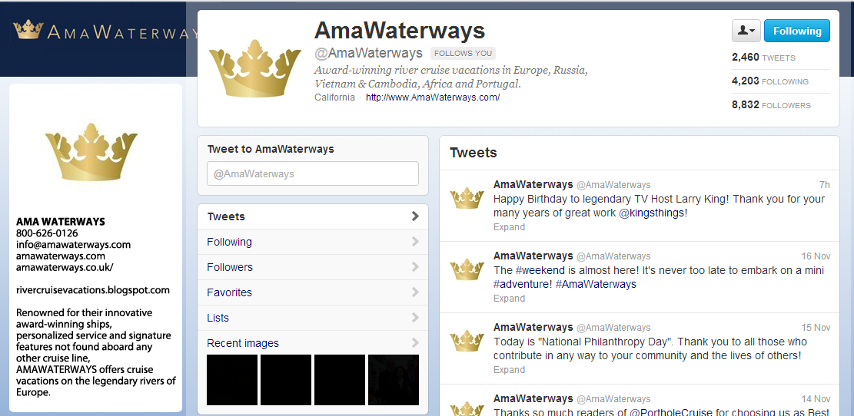
Social Media Marketing
Created awareness amongst thousands of travel critics and travel agents
Over 1000 new visits per month
New Sales

Slide 22
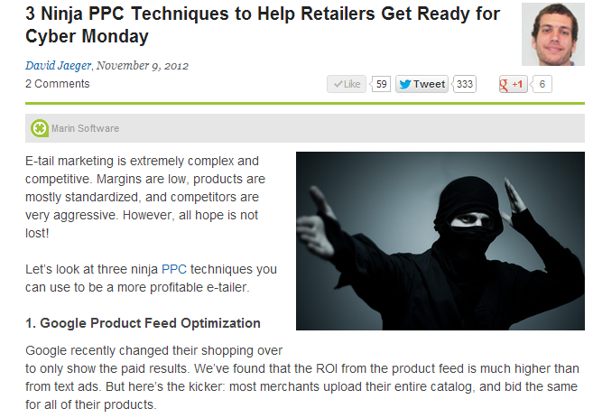
Provide Value Exchange

Slide 23
Looking Ahead
New ways to build authority and backlinks
Keep generating offsite content in a variety of ways and on a variety of top ranking websites
Blogs
Videos
Webinars
Photo galleries
Presentations
Audio
Social media bookmarking

Slide 24
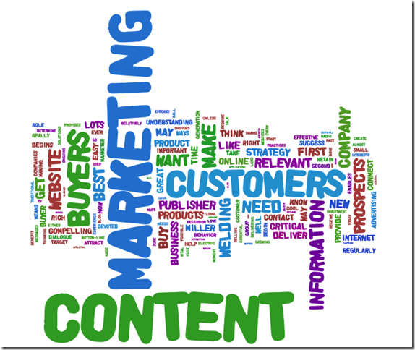
Conclusion

Slide 25
Your Action Plan
Get a Free Content Marketing Audit!
Identify the holes in your content strategy
Where can you build authority?
Where can you generate backlinks?
How can you build your brand?
Contact your Account Manager today!
http://www.nationalpositions.com

Slide 26
Thank You
www.playppt.com

