Slide 1


Memorial Tree Tags

Slide 2

A Family Tree provides custom engraved stainless steel tree tags that are both environmentally responsible and a permanent Tree Dedication for a friend, a family member, or significant moment in our lives. The moment that changed my life was in 1974. I was out with my high school friends and on their way to the store, they got into a car accident and all 4 of them lost their lives. I carried that pain with me for over 20 years and finally developed Memorial Tree Markers. Our Tree Tags have been used for everything from Memorial Trees, honoring a pet, a celebration for marriage and is also a useful fundraiser for City Tree Programs! With our high grade stainless steel used as the tree tag, the marker will not leach chemicals into the wood itself, and our gentle fasteners allow the tag to stretch with the growth of the tree, therefore there is no further maintenance and it takes seconds to install! Our diamond tipped engraving machine, permanently etches your message into the Tree Tag.

Slide 3
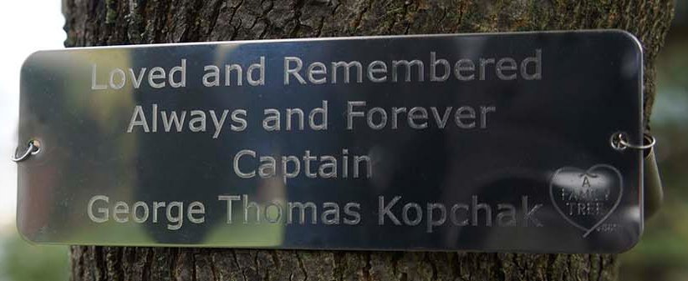
Bench Tags
A Family Tree’s custom engravable bench tags are a contemporary way to tag a traditional bench! Our high quality stainless steel tags are made from tougher steel than what automakers use in order to make the tag stand up to all weather conditions and last a lifetime. We can engrave 35 characters per line x 4 lines. Each custom engraved tag comes with 2 stainless steel screws for a fast and easy installment onto your bench.

Slide 4
For more information please visit
http://www.afamilytree.com

Slide 5
Thank You!!
http://www.playppt.com

