Slide 1
Leukemia
www.playppt.com

Slide 2
Introduction
Leukemia is a cancer formed in the cells of blood.
Infections, bleeding and anemia are the major risk for the people affected by leukemia.
The causes of leukemia are not yet known, but risk factors are known.
Chemotherapy is the most common treatment for the patients affected on leukemia.
Sometimes, bone marrow transplantation and radiation therapy are also done.

Slide 3
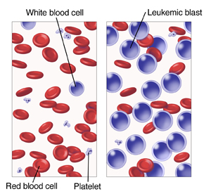
Overview

Slide 4
Types
The types of leukemia can be classified according how quickly the disease becomes worse. Therefore, the leukemia can be chronic or acute.
Chronic - generally becomes worse very slowly.
Acute - generally becomes worse very quickly.
The four common types of leukemia are:
Chronic Myeloid Leukemia.
Chronic Lymphocytic Leukemia.
Acute Myeloid Leukemia.
Acute Lymphocytic Leukemia.

Slide 5
Symptoms
Some of the common symptoms caused by chronic and acute leukemia are:
Fever
Night Sweats
Swollen Lymph Nodes – Generally it does not hurt
Always feeling tired
Bleeding very easily
Close succession infections
Feeling discomfort in abdomen
Pain in joints or bones
Loss of weight with no reason

Slide 6
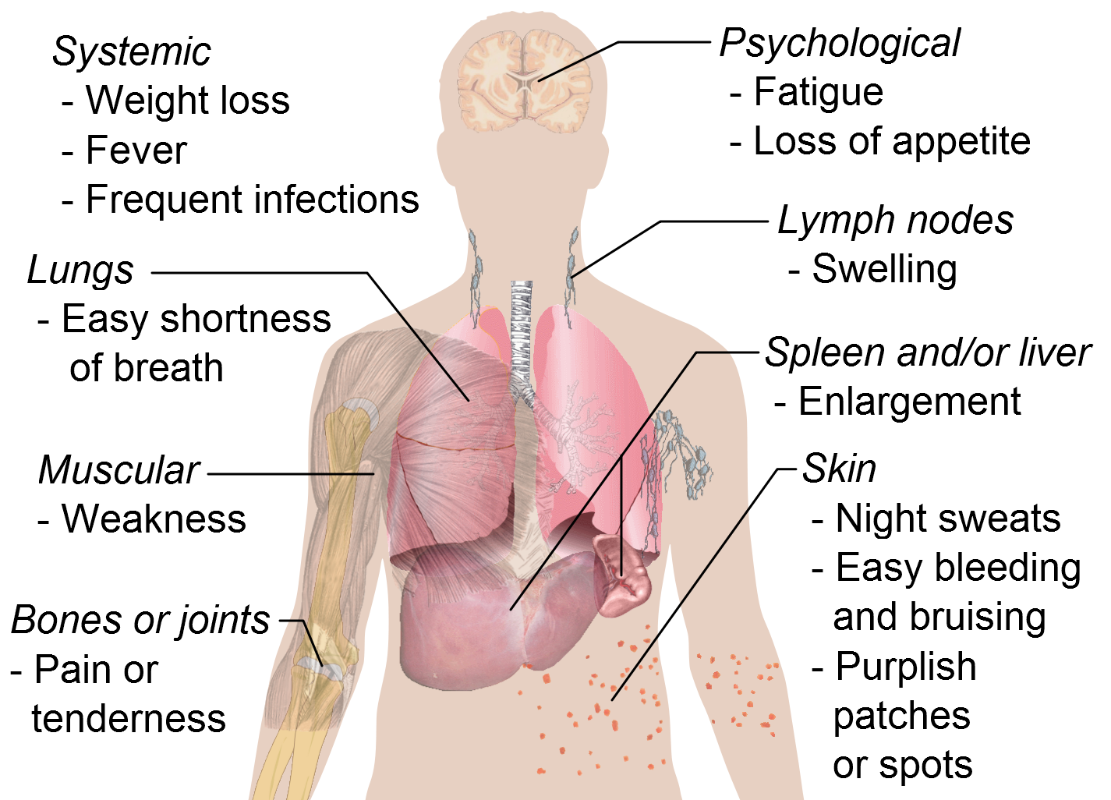
Symptoms

Slide 7
Risk Factors
The risk factors of leukemia are:
Peoples affected by high rays of radiations can get chronic myeloid leukemia, acute lymphocytic leukemia or acute myeloid leukemia.
Peoples also affected by benzene in their work place can get chronic myeloid leukemia, acute lymphocytic leukemia or acute myeloid leukemia.
The main risk factor for causing acute myeloid leukemia is smoking cigarettes.
Down syndrome can increase the cause of acute leukemia.
Myelodysplastic syndrome can increase the cause of acute myeloid leukemia.
HTLV – I infected peoples have the risk of causing human T-Cell leukemia.
Sometimes acute lymphocytic leukemia or acute myeloid leukemia can be caused by cancer fighting drugs.

Slide 8
Treatment Methods
There are many treatment methods for the peoples affected by leukemia cancer: The treatment methods can depend on type of leukemia affected and age of the patient.
Targeted Therapy
Chemotherapy
Biological Therapy
Stem Cell Transplant
Radiation Therapy

Slide 9
Thank You!!
www.playppt.com

