Slide 1


Rewording
generator
Efficient and rapid rewording Help

Slide 2
About Us
If you want to describe an old concept in a
different way, then our rewording generator
is
the exact
assistance you
could
use.
A
reword
generator
is
an
expert
writer who
takes an article and rewrites it in a way that
the original concept remains same but
the
expressing words are different so it become plagiarism free a have a totally new look.
We also emphasize on spelling, punctuation and other grammatical aspects.

Slide 3
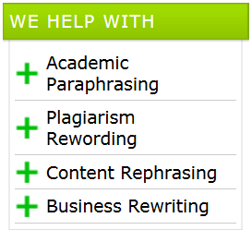

Our Services
Rewording
Summarizing
Editing
Proofreading

Slide 4
Why Us
◆
Rewording is
an art.
It
requires
proper
analysis of topic and recognizing the core concept. Our team is capable of rewording any article.
◆
We
employ experienced
writers
for
your
work. Which ensures that the original sense of the article remain intact.
We make a thorough check for plagiarism and grammatical mistake.
◆
◆
RewordingGenerator.com contains
all
the
skills you require to get a totally distinctive essay.

Slide 5
How We Work
❖ Fill up the order form on our site. Communication
will be via email.
❖ Attach the essay. We will inform you about the
cost of your order in reply.
❖ You pay us through our safe payment method.
❖ Our expert writer initiates the work. a
professional with an wide-ranging vocabulary
develops a totally rephrased composition.
❖ You get the reworded article via email.

Slide 6

We Offer
Natural Text Flow
No plagiarism
Full Privacy
Grammatically Correct
Contextual Rephrasing
24/7 Customer support
Money Back guarantee

Slide 7


Order Now

Slide 8

Order Now Get Discount

Slide 9
Thank YOU
www.playppt.com

