Slide 1
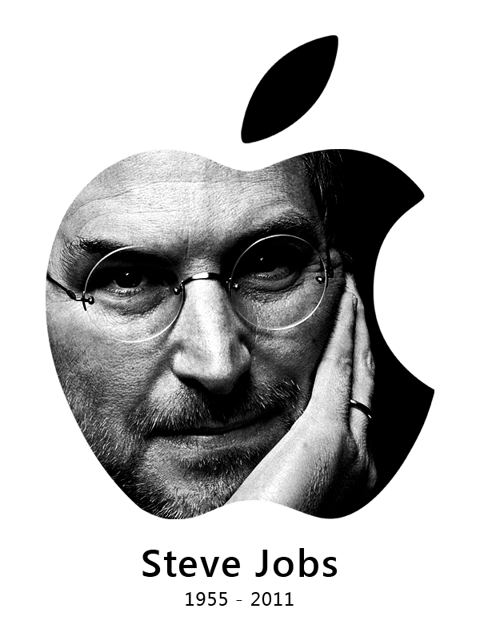
Apple’s One More Thing
www.playppt.com

Slide 2
stevenote
Steve Jobs, former CEO of Apple used the magic word “One More Thing” to release the best products of Apple.
It later came to known as “Stevenote” which was used in keynote speeches by Steve Jobs.

Slide 3
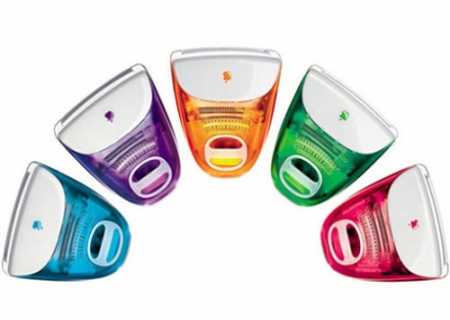
1999 iMAc in colors at macworld san Francisco

Slide 4
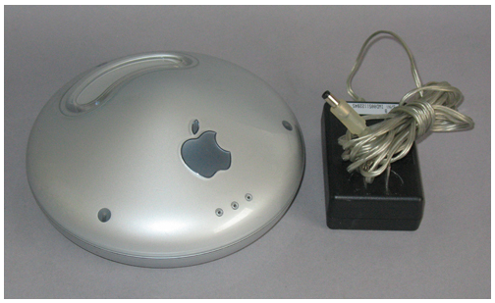
1999 airport Wi-Fi at macworld new York

Slide 5
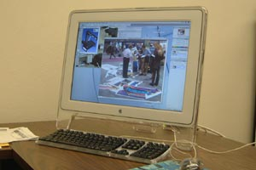
1999 22” Apple Cinema Display at Seybold

Slide 6
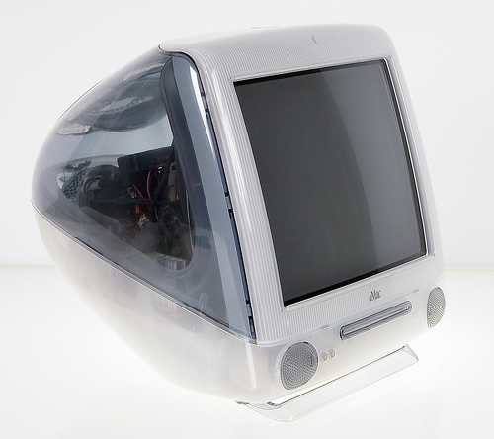
1999 iMac DV & iMac DV Special edition at special event

Slide 7
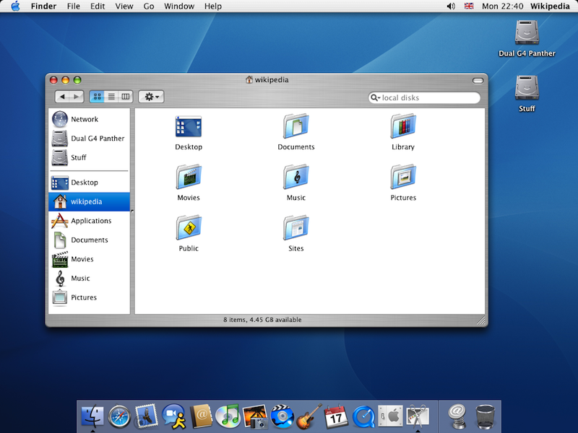
2000 Aqua User Interface at Macworld San Francisco

Slide 8
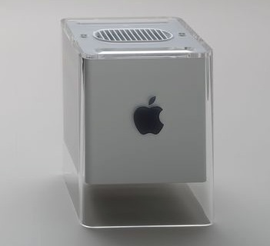
2000 G4 Cube at macworld New York

Slide 9
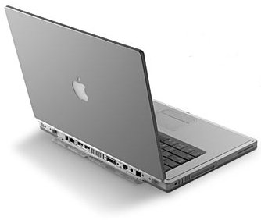
2001 PowerBook G4 at MacWorld SF

Slide 10
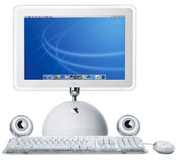
2002 17-inch iMac G4 at Macworld NY

Slide 11
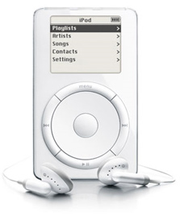
2002 iPod for Windows at Macworld NY

Slide 12
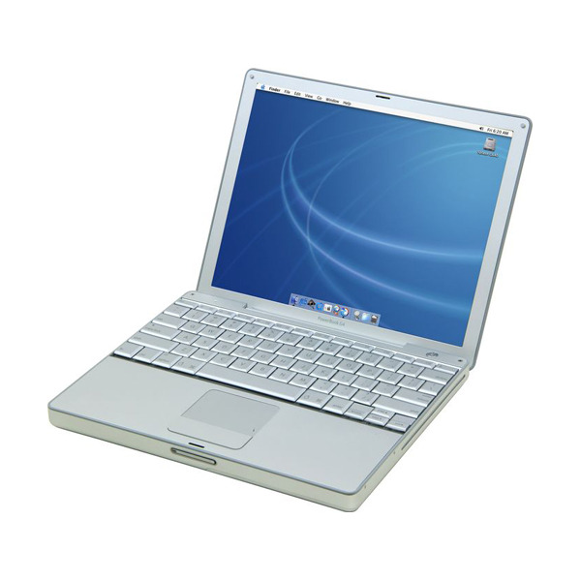
2003 12-inch Aluminum PowerBook g4 at Macworld

Slide 13
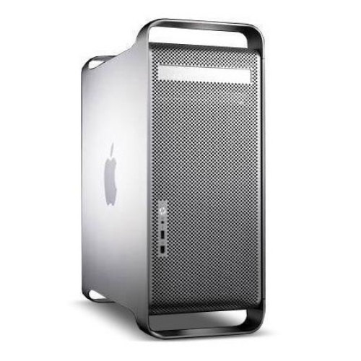
2003 Power Mac G5 at WWDC

Slide 14
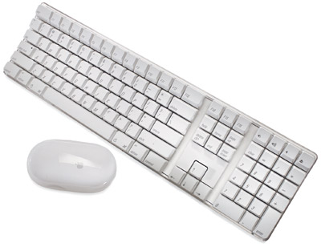
2003 Wireless Mouse & Keyboard at Paris Expo

Slide 15
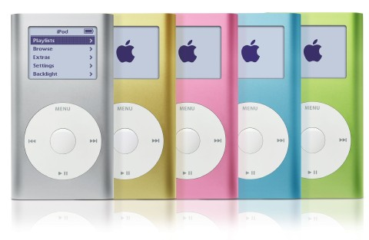
2004 iPod mini in color at Macworld SF

Slide 16
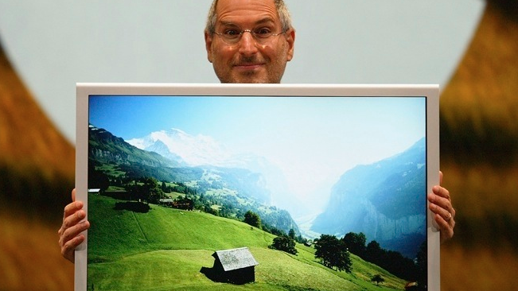
2004 30-inch Cinema Display at WWDC

Slide 17
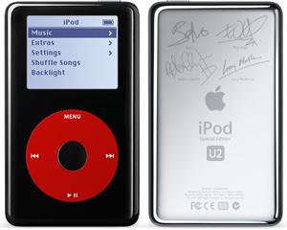
2004 Special u2 iPod at Special Event

Slide 18
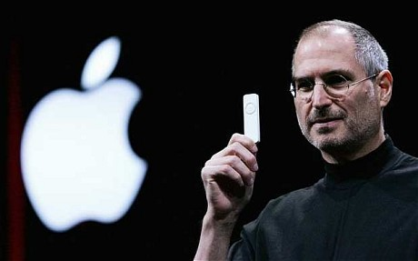
2005 iPod Shuffle at Macworld

Slide 19
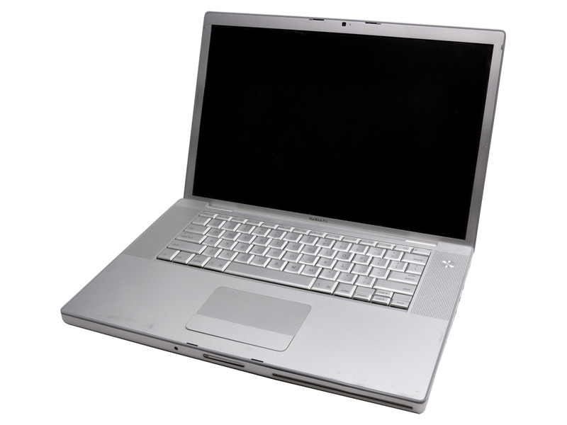
2006 MacBook Pro at Macworld

Slide 20
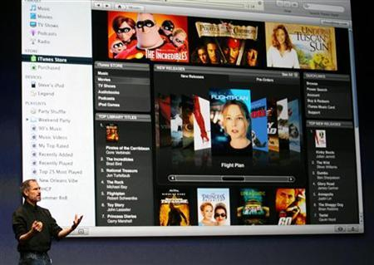
2006 Movies on iTunes store

Slide 21
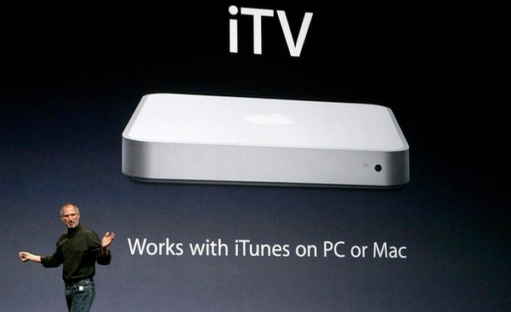
2006 iTv (later known as Apple TV)

Slide 22
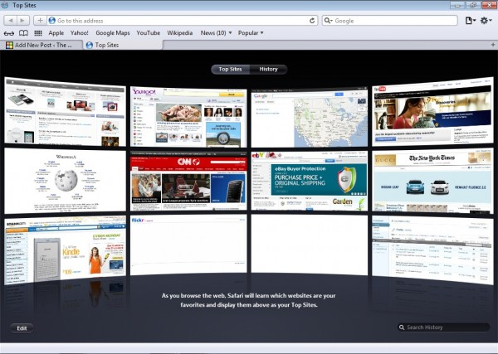
2007 Safari for Windows at WWDC

Slide 23
2007 Web App for iPhone

Slide 24
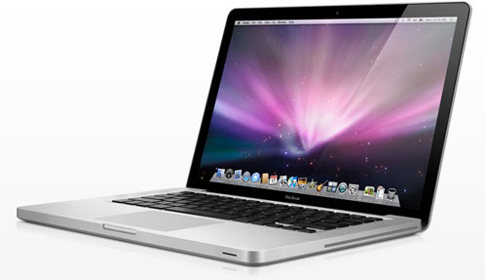
2008 Aluminum Unibody MacBook

Slide 25
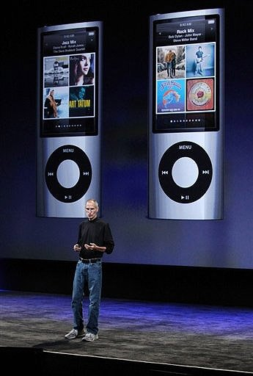
2009 iPod Nano with Video Camera at apple music event

Slide 26
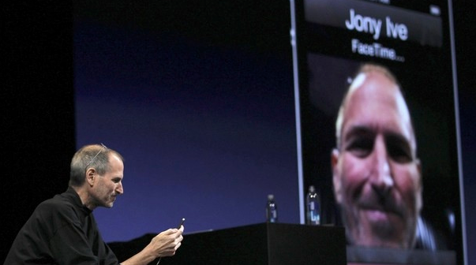
2010 FaceTime at WWDC

Slide 27
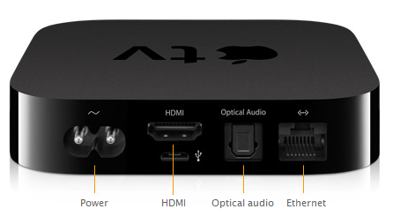
2010 Apple TV (2nd Gen) at Apple Music Event

Slide 28
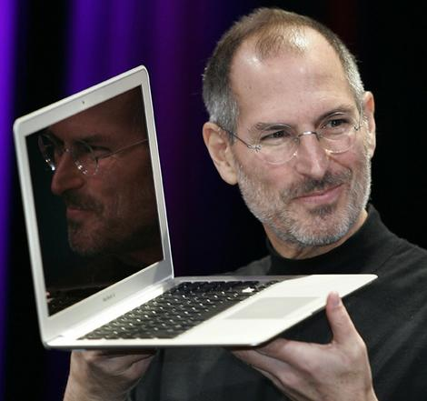
2010 New MacBook Air

Slide 29
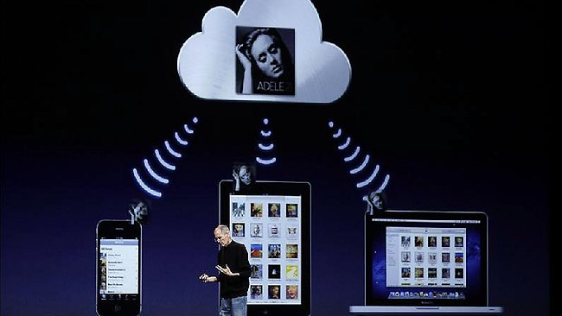
2011 iTunes Match at WWDC

Slide 30
Thank You!!
www.playppt.com

