Slide 1
GROUP TECHNOLOGY
www.playppt.com

Slide 2
What is Group Technology?
Group Technology also known as GT, is a manufacturing technology where similar parts are collectively identified and grouped to use the benefit of their relationship in design and as well as in production.
The similar parts are grouped to form part families.
Each and every family has similar design and manufacturing qualities.
Example: A plant manufacturing 10,000 various parts could be capable to arrange into 30 to 40 part families.

Slide 3
GT Cells
As each member in a family have nearly processing activities, collection of machines needed for processing of all part family members leads to the most efficient method of manufacturing.
This group or collection of machines is called as GT Cells and this method of manufacturing is called as Cellular Manufacturing.

Slide 4
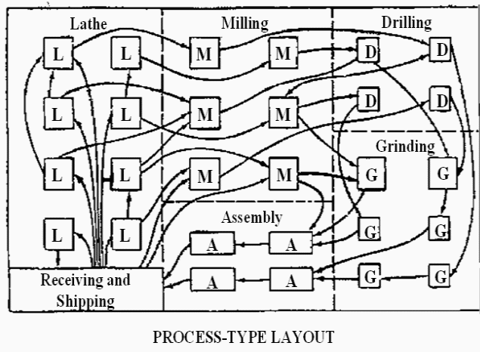
Overview

Slide 5
Part Family
The collection of parts with similar design characteristics and similar manufacturing characteristics is known as part family.
The parts in a part family are different however the similarities are good enough to classify them as one of the member of a family.
The various methods implemented for part family grouping are visual inspection, coding and classification, and analysis of production flow.

Slide 6
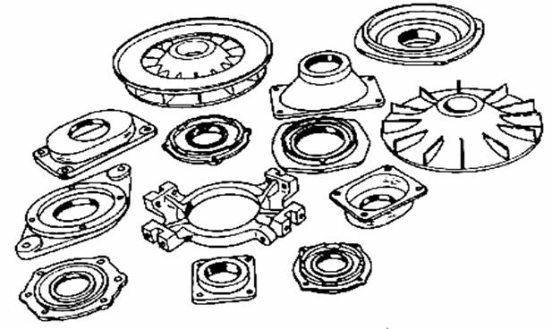
Production Family

Slide 7
Part Classification and Coding System
It concerns with identification of similarities with parts and it relates those similarities in the form of code.
The similarities could be design characteristics alone or manufacturing characteristics alone or both characteristics.
The part classification and coding system can be fallen into three categories:
System related to design characteristics,
System related to manufacturing characteristics, and
System related to both design and manufacturing characteristics.

Slide 8
Coding Structure
The coding system is comprised of series of symbols which is used to identify the design and manufacturing characteristics of the parts.
The symbols can be in the form of all alphabetic or all numeric or the both.
This arrangement of symbols is called as Coding Structure. It can be divided into three types:
Chain type Structure,
Hierarchial Structure, and
Hybrid Structure.

Slide 9
Advantages
Maximizes the output,
Less lead time,
Less setting time,
Reduced scrap, and
Reduced material handling.

Slide 10
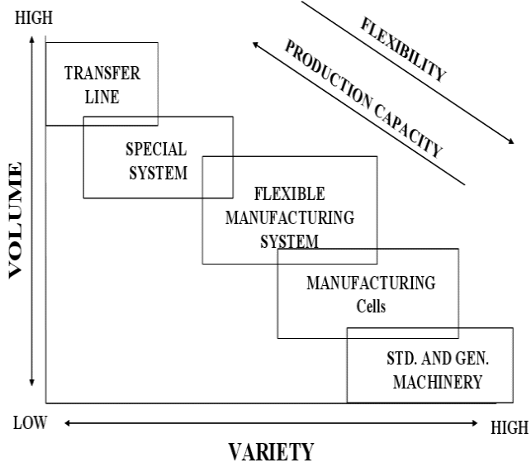
Conclusion
Therefore by concluding, a plant implementing group technology will obtain better overall control and better job satisfaction.

Slide 11
Thank You!!!
www.playppt.com

