Slide 1
Mobile Controlled Robot without Microcontroller
www.playppt.com

Slide 2
Introduction
There are various wireless modes like Bluetooth, Wi-Fi, Zig Bee, etc., but these wireless controls has limitations in its control distance.
To overcome this limitation, Mobile Controlled Robot is designed to add long distant wireless controllability to your robot.
This robot can be developed without microcontroller and hence it is very easy for the beginners to build it.

Slide 3
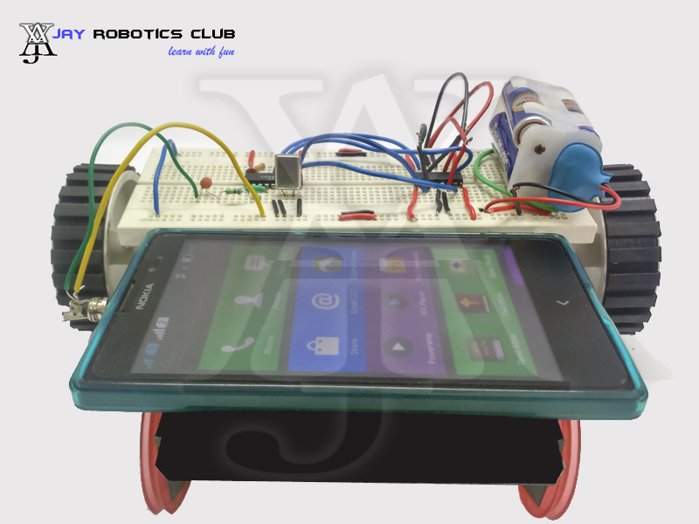
Prototype

Slide 4
Important Components
Robot Chassis
Motors
Breadboard
IC L293D
IC CM8870
Resistors
Capacitors
Headphone Jack
Wires
Batteries

Slide 5
How it Works?
In Mobile Controlled Robot, we use two mobile phones.
This robot is controlled by a mobile phone that makes a call to another mobile phone attached to the robot.
When the user calls the mobile which is mounted on the robot the call is received by auto-answer mode.
In the course of a call, if any button is pressed, a tone corresponding to the button pressed is heard at the other end of the call.

Slide 6
How it Works? (Contd.)
This tone is called “Dual Tone Multi Frequency (DTMF)” tone.
The robot receives this DTMF tone with the help of the headphone attached to the robot.
The received tone is processed by the DTMF decoder IC, and then transmits the signal to the motor driver IC to operate the motors.

Slide 7
Applications
Can be used in military for disposing land mines
Best suited for Search and rescue operations
Addition of wireless camera helps to access this robot from any part of the world to monitor your house or office.

Slide 8
Advantages
This robot can be virtually controlled anywhere from the world
Easy to setup
No microcontroller & no tough coding

Slide 9
Disadvantages
Requires a camera to maneuver your house or office when you are far away from the robot
Call charges will be deducted according to the service provider plans when you control your robot

Slide 10
Wanna Build it?
Now you can learn to build your own Mobile Controlled Robot from JAY Robotics Club’s Self Learning Portal.
Learn Now

Slide 11
Thank You!!
www.playppt.com

