Slide 1

Numerical Control Machine
www.playppt.com

Slide 2
Introduction
Numerical Control machine is shortly called as NC machine.
A NC machine is an automation method, in which the machine tool control is by means of prepared program having series of numbers.
These numbers represents the position of slide, cutting speed, feed, etc.

Slide 3
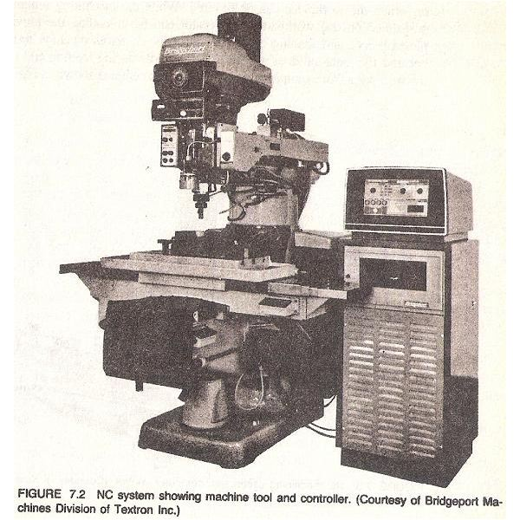
NC Machine

Slide 4
Generations of NC Machine
I Generation – 1952 (Vacuum tubes),
II Generation – 1955 (Electromechanical Relays),
III Generation – 1960 (Discrete Semi Conductors),
IV Generation – 1965 (Integrated Circuits),
V Generation – 1968 (DNC),
VI Generation – 1970 (CNC), and
VII Generation – 1975 (Micro Processor & Micro Controller)

Slide 5
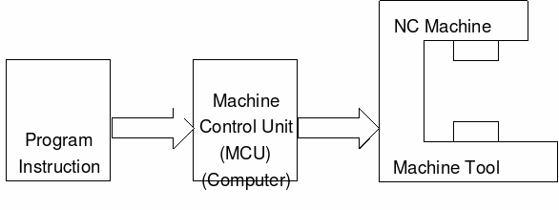
Components of NC Machine
The main components of a NC machine are as follows:
Program of instructions
MCU (Machine Control Unit)
Machine Tool

Slide 6
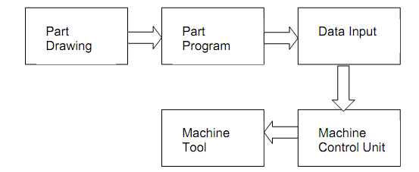
Program of instructions
It is a step by step direction for performing the operation of the machine tool.
It uses various input media like 25 mm Wider Paper Tape, Magnetic Tape, and Punched Card for storing the programs.

Slide 7
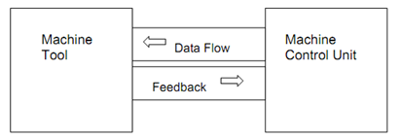
MCU (Machine Control Unit)
It reads the program of instructions and translates into machine tool mechanical actions.
It has various elements such as tape reader, data buffer, signal output channels, feedback channels, sequence control unit, and a control panel.

Slide 8
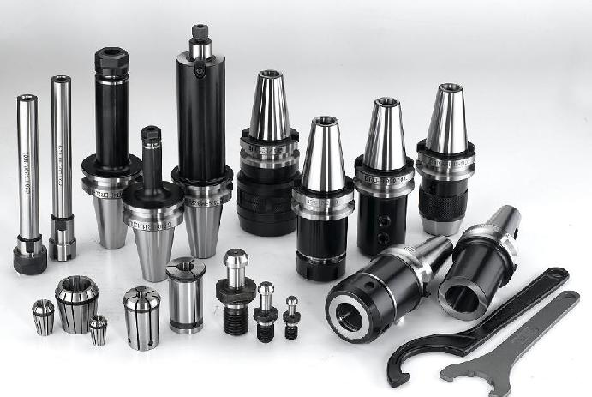
Machine Tool
It is the important part in a NC machine.
It comprises slides, worktables, and spindle including individual servo motors and controls.

Slide 9
Part Program
A part programming is a set of instructions with coordinate values to specify the work of a tool in order to get the preferred machining form. The different methods of creating part programs are:
Manual Part Programming
Voice Programming
Computer Aided Part Programming
MDI Programming (Manual Data Input)
Graphic NC Programming

Slide 10
Working of NC machine
Create the required part program
Place the work piece on the table
By the use of control panel buttons, the tools and slides can be moved with reference to work piece. Place it at zero position of work piece.
Place the tape in the tape reader
Now by pressing the appropriate control panel, it reads the data in first block in the tape into data buffer
After the reading of data in first block, the control signals are given to machine tool and operation is started
Next it reads the data in second block and the operation continues
Corrections are done if it is necessary

Slide 11
Advantages
Flexibility with accuracy
Repeatability
Reduced Scrap
High Production Rates
Good quality

Slide 12
Disadvantages
Non Optimal Speeds and Feeds
Unreliable Tape Reader
Inflexible Controller

Slide 13
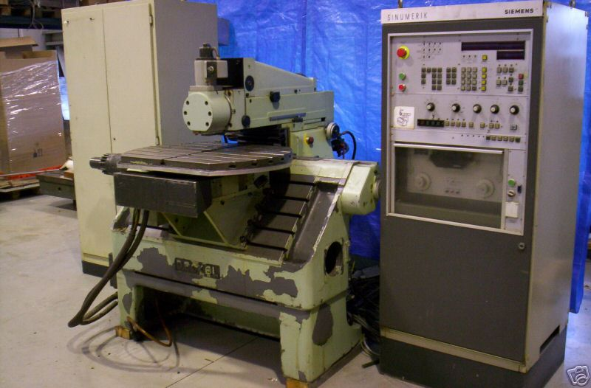
Conclusion
NC technology is concerned with a wide range of cutting and non cutting operations.
Overall, a NC machine is very much suitable for work pieces of small and medium size batches.

Slide 14
Thank You!!!
www.playppt.com

